Slide 1
Happy Dads. Healthy Babies. Infant Vitality Toolkit
Pregnancy Prevention

Slide 2
Agenda
Test Your Knowledge Pre Test
Guys and Birth Control
Contraceptive Choices
Birth Control Facts
Community Resources
Test Your Knowledge Post Test

Slide 3
Pre-Test

Slide 4
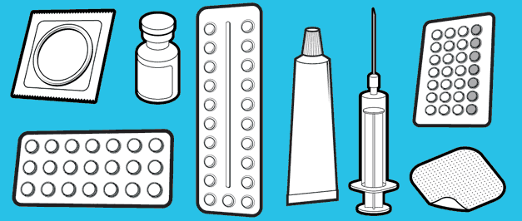
Question 1
How many forms of birth control exist for men?
1
2
4
5
Notes:
D – Abstinence, condoms, outercourse, vasectomy, withdrawal

Slide 5
Question 2
When it comes to birth control, men should be just as knowledgeable as women about:
What methods are available
How different methods work
Where you can go to get birth control
A, B & C
N/A (knowing about birth control is only for women)
Notes:
D

Slide 6
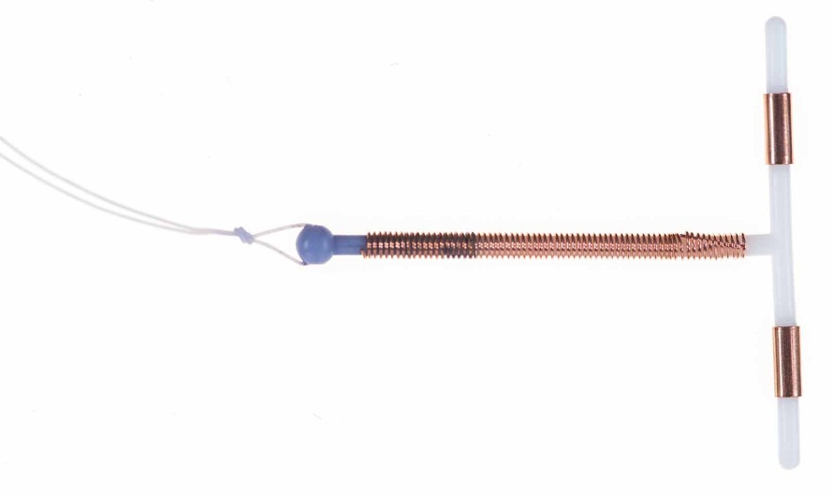
Question 3
What is this?
Pogo stick
Fish hook
Copper IUD
Nothing I’ve ever seen before!
Notes:
C

Slide 7
Question 4
Which of the following is the most effective form of birth control currently available?
Intrauterine Device (IUD)
The pill
The shot (Depo)
Male condom
Notes:
A
According to Planned Parenthood, less than 1% of women using an intrauterine device (IUD) will become pregnant within a year, compared to 2-9% for the pill and 15-24% with male condoms.

Slide 8
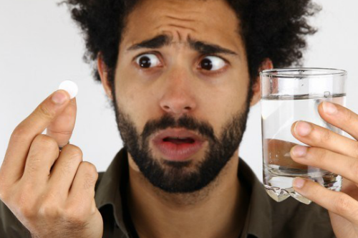
Guys and Birth Control
What birth control methods exist for men?
Planned Parenthood cites FIVE (5) different methods:
Abstinence
Condoms
Withdrawal
Most Effective
Least Effective
Vasectomy
Outercourse
Notes:
Talk about what is actually available for guys as well as what is not. Discuss why it’s important for guys to know about birth control.
Visit https://www.plannedparenthood.org/get-care/our-services/birth-control

Slide 9
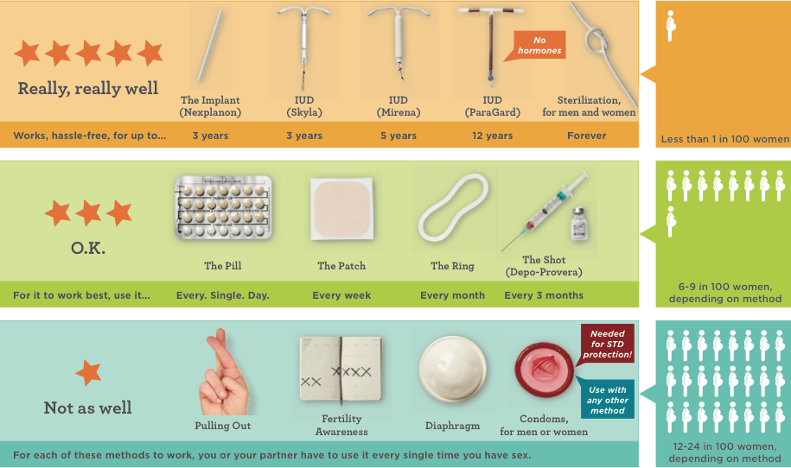
Menu of Choices
Notes:
There are so many methods available, it is important to find the one that works best with your lifestyle
This is a good time to ask about why guys need to know about birth control: Open ended question: Why do guys need to know about this?
Use example: If your girlfriend said she can’t get pregnant because she took her shot 6 months ago… is that ok? Examples like that.. Talk about guys’ responsibility.
Visit https://www.bedsider.org/methods
View the Guy’s Guide to Birth Control: Your 101 Guide to Understanding Birth Control in All its Forms – https://www.askmen.com/sports/health/guy-s-guide-to-birth-control.html

Slide 10
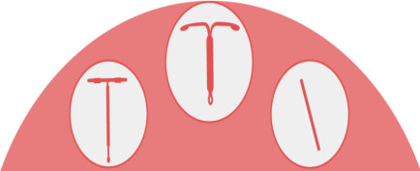
Most Effective Birth Control Options
Long-Acting Reversible Contraception
(also referred to as LARC)
Intrauterine Devices (IUDs) and the Implant
Notes:
Explain what is meant by the term LARC:
Long-acting – it lasts for years at a time
Reversible – it only works while inside a woman
Contraception – birth control
Make it very plain – it’s low maintenance, which means that a woman doesn’t have to do anything but get it inserted by a doctor or other health care provider for it to work

Slide 11
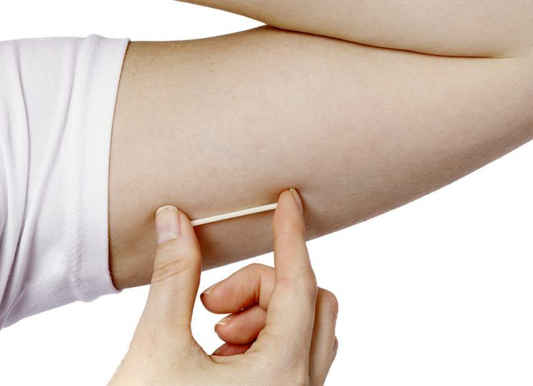
Contraceptive Implant
Inserted under the skin in the upper inner arm by a medical professional
Lasts for up to 3 years
99.95% effective
Completely reversible
Resource:
Bedsider’s
Guy’s Guide/the implant
Notes:
View the video by Bedsider: https://www.bedsider.org/features/301-the-implant

Slide 12
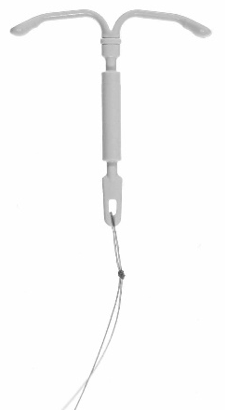
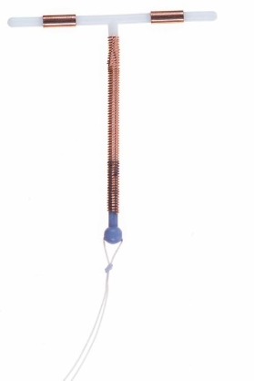
Intrauterine Devices (IUDs)
Small, flexible T-shaped device
Over 99% effective
Completely reversible
Safe for women who have never had children, including teens
Resource:
Bedsider’s
Guy’s Guide/IUD
Hormonal IUD
Lasts 3-5 years
5-year IUD is FDA
approved to reduce
menstrual bleeding
Safer than many birth
control pills
Non-Hormonal IUD
Lasts 10 years
Can be used as an
emergency birth
control option
Notes:
View the video by Bedsider: https://www.bedsider.org/features/300-iud

Slide 13
Local Resources
For information and resources related to pregnancy prevention, or to establish early care in the event of a pregnancy, visit the following resources:
Notes:
Columbus Public Health: Women’s Health & Family Planning Center – https://www.columbus.gov/publichealth/programs/Women-s-Health,-Family-Planning/
StepOne – https://www.columbus.gov/Celebrate-One/StepOne-for-a-Healthy-Pregnancy/
Nationwide Children’s BC4Teens – https://www.nationwidechildrens.org/specialties/bc4teens
PrimaryOne Health – https://www.primaryonehealth.org/

Slide 14
Questions

Slide 15
Post-Test

Slide 16
Question 1
How many forms of birth control exist for men?
1
2
4
5
Notes:
D – Abstinence, condoms, outercourse, vasectomy, withdrawal

Slide 17
Question 2
When it comes to birth control, men should be just as knowledgeable as women about:
What methods are available
How different methods work
Where you can go to get birth control
A, B & C
N/A (knowing about birth control is only for women)
Notes:
D

Slide 18
Question 3
What is this?
Pogo stick
Fish hook
Copper IUD
Nothing I’ve ever seen before!
Notes:
C

Slide 19
Question 4
Which of the following is the most effective form of birth control currently available?
Intrauterine Device (IUD)
The pill
The shot (Depo)
Male condom
Notes:
A
According to Planned Parenthood, less than 1% of women using an intrauterine device (IUD) will become pregnant within a year, compared to 2-9% for the pill and 15-24% with male condoms.

