Slide 1
Arbitration and Discipline
Rich Coglianese
Senior Attorney

Slide 2
Why is discipline part of a collective bargaining agreement?
Ohio Law
RC 4117.08 specifies the mandatory subjects of bargaining.
Discipline affects a term and condition of employment.

Slide 3
The City’s Collective Bargaining Agreement
“No member shall be terminated, demoted, suspended, required to forfeit accrued leave (excluding sick leave), given documented constructive counseling or a written reprimand, or suffer any career disadvantage except for just cause.” Art. 10.1

Slide 4
What kind of discipline?
“For other than charges of insubordination, the principles of progressive corrective action apply. If the offenses are of a critical nature, the Chief of Police may determine that a different sequence is required.” Article 10.3

Slide 5
What is progressive discipline?
Article 10.3 requires progressive discipline.

Slide 6
The framework for discipline
The Constitution
The Charter
The Collective Bargaining Agreement
Case Law

Slide 7
Constitutional issues in discipline
Loudermill
Due Process
Garrity

Slide 8
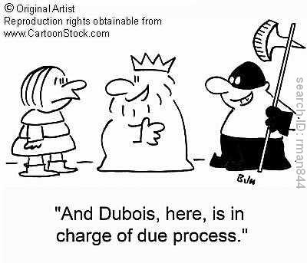
Loudermill requirements
Notice
Opportunity

Slide 9
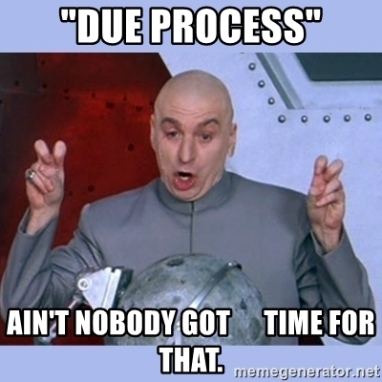
Due Process
Is there a property right?
What is the pre-deprivation requirement?
What is the post-deprivation requirement?

Slide 10
State law determines whether a government employee has a property right in his or her job.

Slide 11
Pre-deprivation rights
Notice
Representation
Disclosure
Access to records
The Chief may recommend appropriate discipline.
Departmental Hearing in front of Director of Public Safety.

Slide 12
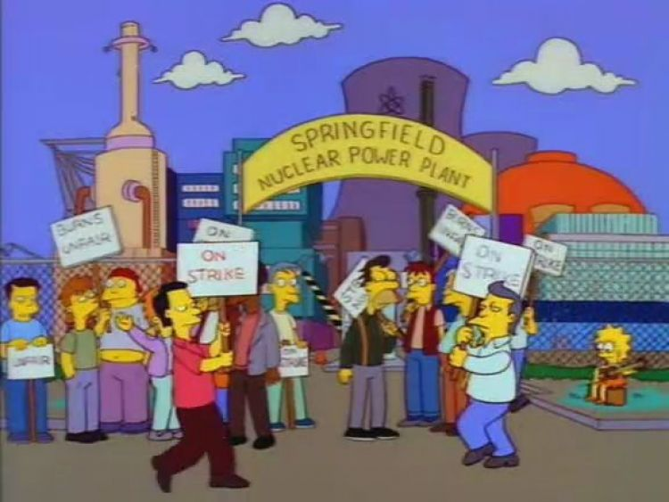
Investigation and notice
Investigations must be conducted by the chain of command, the Equal Opportunity Office, personnel assigned to IAB, or the Office of the Public Safety Director. Art. 8.1
Right to union representation. Art. 8.2

Slide 13
Questioning
Told of allegations and known basic facts before interview.
Given copy of citizen complaint or written summary of allegations.
Article 8.5

Slide 14
Garrity
May compel employee to give statement.
Compelled statement cannot be used in a criminal matter.
If statements are compelled, must answer or face discipline.

Slide 15
Notice
Once investigation that might result in discipline is complete, member shall be immediately notified of result.
Article 10.5

Slide 16
Contract vs. Loudermill
Notice
Opportunity to be heard
Right to representation
Notified 24 hours in advance of interview
Access to documents that relate to the investigation
Apprised of allegations and known basic facts
Only asked questions relate to the allegations
Interview must be recorded
Minimal
Extensive

Slide 17
Action Pending Hearing
Continues in position
Chief has the ability to reassign pending outcome.
Article 10.8(A).

Slide 18
Requirements of the City Charter
If the Chief suspends, demotes, or terminates an employee, that employee has the right to a hearing before the Director of Public Safety.
Columbus City Charter Article 108

Slide 19
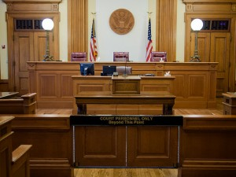
The Director’s Hearing
Member entitled to representation.
Safety Director has ultimate authority to determine whether charges are sustained and level of discipline.
Not bound by discipline recommendation from Chief.

Slide 20
Director’s hearing (con’t)
Member must receive a written statement of all charges and specification from the Chief.
Allowed to question adverse witnesses.
Allowed to call witnesses.
Recorded by the City
Closed to the public unless otherwise mutually agreed.
Article 10.9

Slide 21
Post deprivation process
Collective Bargaining Agreement, Article 12.
Member can request a hearing in front of Civil Service Commission

Slide 22
Dispute about the CBA Art. 12

Slide 23
Selection of Arbitrator
Panel of 6
Random draw
Once selected, unavailable until everybody has been selected
Hold arbitration within 60 days of selection
Art. 12.5(E)(2)

Slide 24
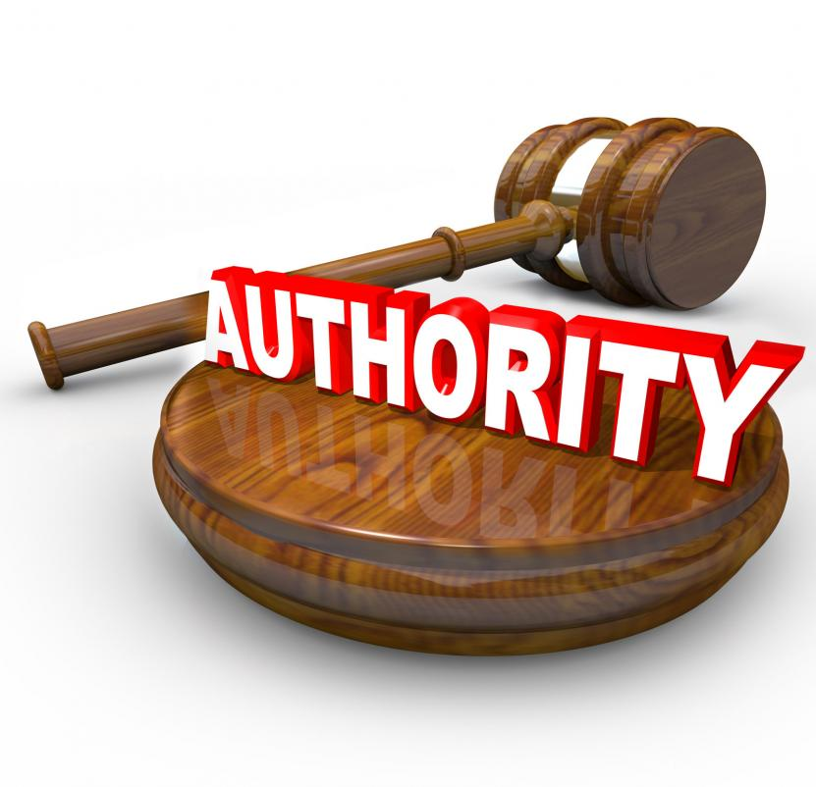
Authority of Arbitrator
Conduct a fair and impartial hearing
Record testimony from both parties
Apply generally accepted arbitration rules
No authority to add to, detract from, modify, or otherwise change any of the terms or provisions of the contract.
Decision is final and binding.
Art. 12.5(E)(3).

Slide 25
Just Cause?
Was the employee forwarded of the consequences?
Are the rules reasonably related to business efficiency and performance?
Was an effort made before discipline to determine if the employee was guilty?
Was the investigation fair and objective?
Was there substantial evidence of guilt?
Were the rules applied fairly?
Was the level of discipline reasonable and proportionate to the offense and past record?

Slide 26
Arbitrator can set aside or modify
Must made two determinations
Whether a cause for discipline exists;
Whether the amount of discipline was proper under the circumstances.
Franklin County Sheriff v. Teamsters Local 413, 2018-Ohio-3684 (10th Dist.)

Slide 27
Goal of discipline
Just cause requires that discipline be corrective, not punitive.

Slide 28
Authority of Arbitrator
Can determine if there are mitigating factors.
Can review the appropriateness of the disciplinary action
Can fashion a remedy different from the one imposed.

Slide 29
Level of discipline – Past Practices
What have you done to others?
Why is this different?

Slide 30
Limited court review
Public policy favors arbitration so very limited court review.
Award procured by corruption, fraud, or undue means
Partiality or corruption
Misconduct or refusal to hear material evidence
Exceeded powers or so imperfectly executed that no final award made
ORC 2711.10

Slide 31
What does the Court examine?
Does award draw its essence from the contract?
Does it conflict with the contract?
Can it be rationally derived from the contract?

Slide 32
Public Policy exception
Can vacate if the award violated well defined public policy.
Does not apply to employee conduct.
The award itself violated a well-defined and dominant public policy.

Slide 33
Violate public policy?
Police officer falsified a traffic ticket.
Police officer lied in an investigation
Police officer lied to supervisor about another officer’s absence
Safety sensitive position has a positive drug test
Yes
No

Slide 34
QUESTIONS?

