Slide 1
City Of Columbus
Department of Public Service
ADA Training 2019
Notes:
My name is Steve Wasosky, I am the Design Section Manager for the Department of Public service, Design and Construction
My background is predominantly construction. I have administered the construction of thousands of curb ramps and PARs working at ODOT and for the City of Columbus.
I moved to the Design section in 2014 and the first major task given was to update our ADA Rules and regulations from 2011
My experience in construction provided perspective on the difficulties of PAR and ramp design and construction
I would also like to say, consider this an open training. Kathleen and I worked very hard putting this presentation together over the last couple weeks, but we know we can make this much better.
If we come to a place where you have a specific question, raise your hand after we get through the slide and we can answer your question or let you know we will be hitting it later.
Your questions and feedback will help us make this a better presentation.
Also, please take it easy on us. This is our first time giving this presentation, so we won’t be totally polished

Slide 2
Presentation Overview
Why have to comply with ADA
Scoping
Design Basics
Components
Intersection design
Standard Drawings
Construction inspection
Notes:
The goal of this presentation is to speak to a wide audience about ADA requirements within the ROW for the City of Columbus. Contractors, Designers, Inspectors, and planners. It is impossible to cover all facets of ADA in a 2 hour presentation, but we will provide highlights on the bulletted topics
What is YOUR experience with ADA?
How many folks design ada ramps?
How many construct them?
How many have used a wheelchair?
Conclusion: designing for people we are not

Slide 3
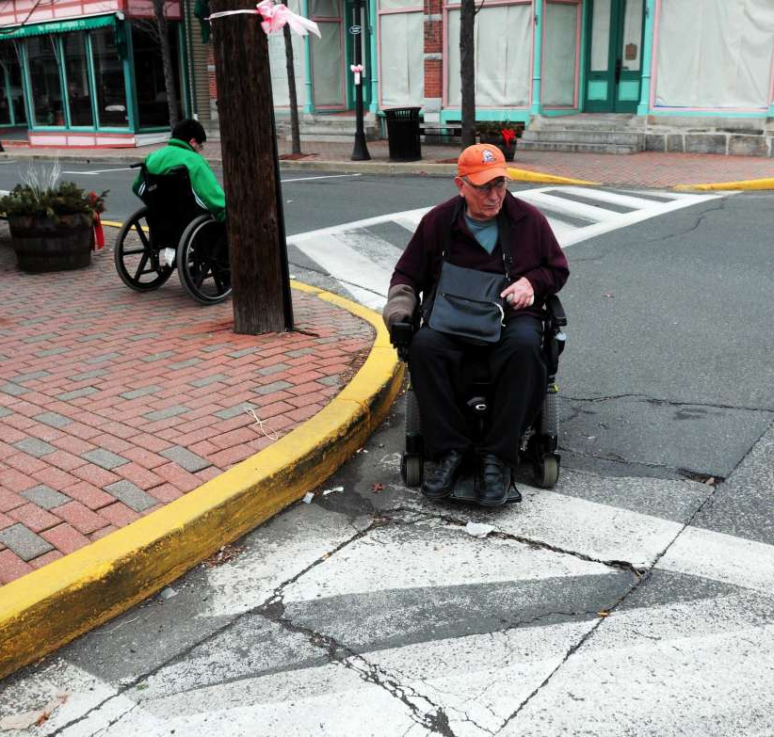
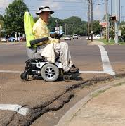
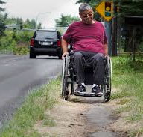
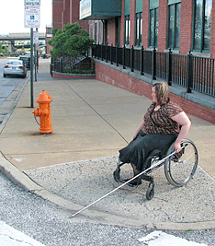
Why ADA?

Slide 4
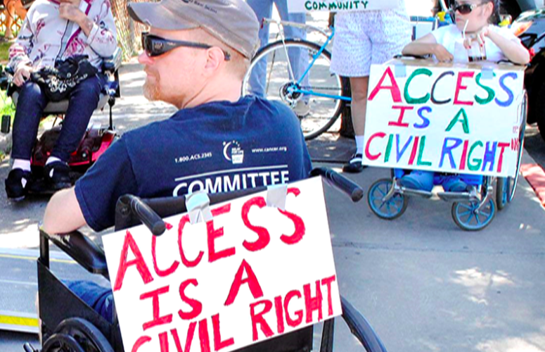
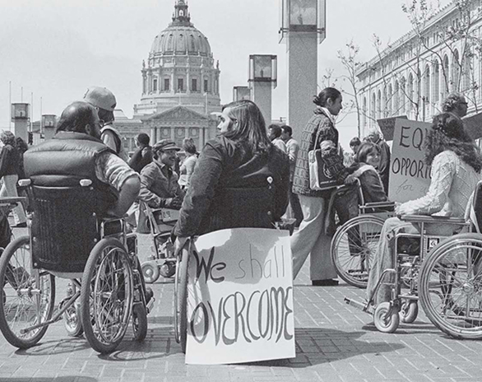
ADA is a civil right
The Americans with Disabilities Act (ADA) was signed into law on July 26, 1990, by President George H.W. Bush.
The ADA is one of America's most comprehensive pieces of civil rights legislation that prohibits discrimination and guarantees that people with disabilities have the same opportunities as everyone else to participate in the mainstream of American life -- to enjoy employment opportunities, to purchase goods and services, and to participate in State and local government programs and services.
Modeled after the Civil Rights Act of 1964, which prohibits discrimination on the basis of race, color, religion, sex, or national origin – and Section 504 of the Rehabilitation Act of 1973 -- the ADA is an "equal opportunity" law for people with disabilities.
Notes:
The first thing we need to understand is that access for the disabled is considered a Civil Right.
This is not a new concept. The start of legally recognized disabled rights was in 1964 with the civil rights act.
ADA came more to the forefront in 1973 with section 504 of the Rehabilitation act of 1973.
In 1990 the American Disabilities act was signed in to law in 1990. This really pushed forward the ADA requirements in the ROW that we deal with today.
The bottom line is that ADA is not new and there has been plenty of time to adapt to it.

Slide 5
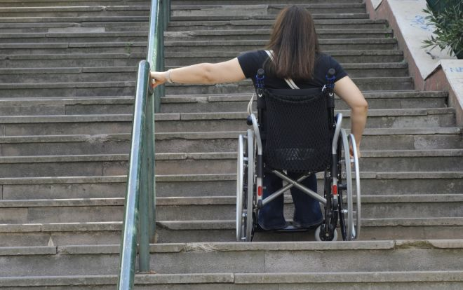
Equal Access
The ADA is one of America's most comprehensive pieces of civil rights legislation that prohibits discrimination and guarantees that people with disabilities have the same opportunities as everyone else to participate in the mainstream of American life -- to enjoy employment opportunities, to purchase goods and services, and to participate in State and local government programs and services.
ADA in the ROW rule of Thumb:
If an able bodied person has access to a facility, a disabled person should also be provided access.
Notes:
If you attended the last ADA training provided by the City of Columbus, you probably watched some videos showing the difficulty folks with different disabilities have navigating the ROW. We are not going to spend any more time in this presentation convincing you why we should make things ADA compliant. This is the law and not up for judgement on whether it should be done. If you would like watch some videos on the plight of the disabled, there are many available on Youtube.

Slide 6
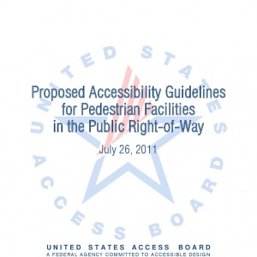
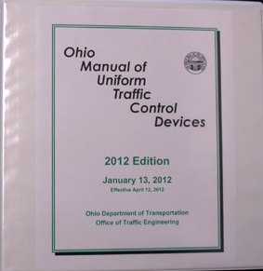
Federal Guidance
City of Columbus ADA Rules and Regulations are based off of Federal Guidance:
Heirarchy of ADA Reference Documents
DOJ’s 2010 ADA Standards for Accessible Design
PROWAG
OMUTCD
Notes:
All of the rules in the City of Columbus ADA R&R are based on the requirements of federal documents. New documents have been generated since the last ADA update and we list the documents referenced in the R&Rs. We reference these documents in this order and when the highest document does not provide guidance on an issue, we go to the next. This is the also the order you should use the outside documents when a specific answer is not clear from the City ADA R&Rs.
2010 DOJ standards is #1 and is adopted by the department of Justice
2011 PROWAG is #2 and provides much more specific information related to ADA in the ROW. It was created by the US Access Board and is recommended for use by ODOT, FHWA, and others. It has not been officially adopted by DOJ
OMUTCD primarily covers pushbuttons, signing, and striping for the purposes of ADA

Slide 7
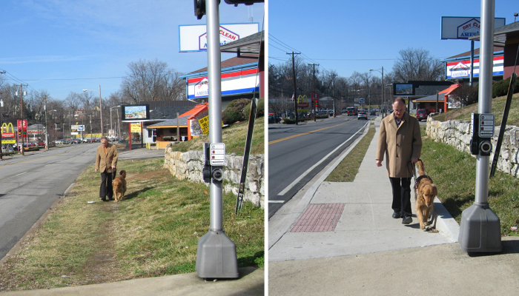
ADA Scoping

Slide 8
ADA Scoping
New Construction – a brand new roadway or complete removal and replacement of a roadway without existing constraints. Subject to 100% ADA compliance
Alteration – composes 98%+ of City projects where existing constraints will affect what can be constructed and the scope of work is limited. More specific rules on what is required for ADA.
Notes:
Intro to conditions and scoping

Slide 9
ADA Scoping Project Type
Resurfacing
The most common trigger for ADA compliance
Other project types will often kick in ADA curb ramp construction based off of required resurfacing
Curb to Curb resurfacing from intersection to intersection will trigger Curb ramps
NEW - Any width of resurfacing adjacent to a curb within the legal crosswalk will trigger Curb Ramps
Notes:
Mention 1441 update coming soon

Slide 10
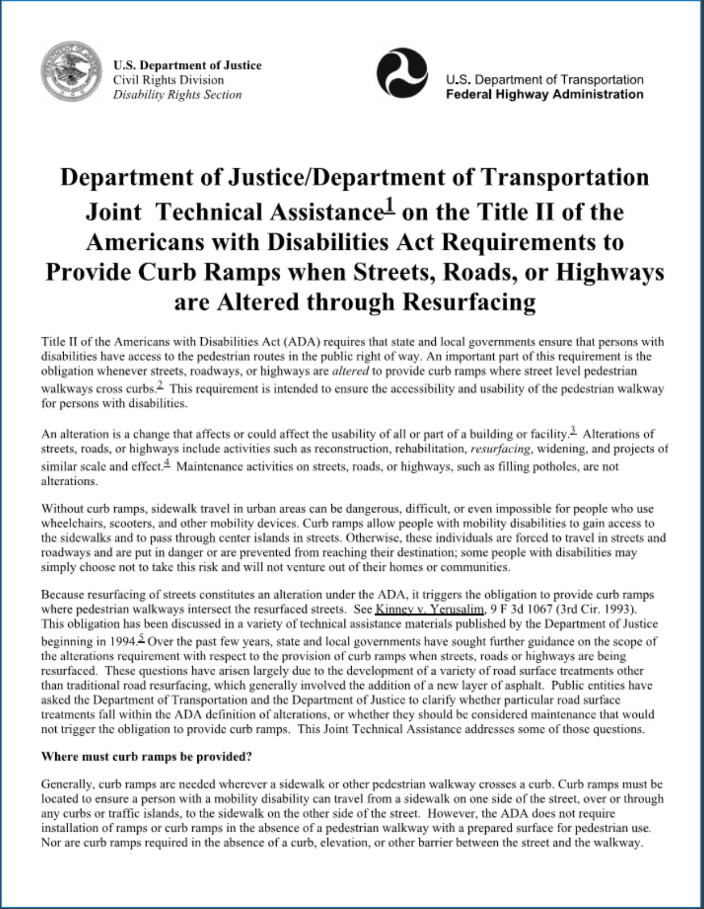
ADA Scoping Project Type
New ADA responsibilities related to resurfacing are based on a DOJ/DOT Joint Technical Assistance document https://www.ada.gov/doj-fhwa-ta.htm

Slide 11
ADA Scoping Project Type
Title II – The City of Columbus and other Title II agencies are held to a higher standard, and certain operations trigger ADA compliance beyond what the project immediately disturbs.
Private entities working within the ROW are required to repair the area directly disturbed up to current ADA compliance.

Slide 12
ADA Scoping Project Type
CIP Roadway projects will make curb ramps for all legs of an intersection compliant when compliance is triggered at one leg
CIP Utility projects will generally be triggered into ADA compliance by the resurfacing required. Where only one leg of an intersection is affected, only that leg is required to be made compliant for CIP utility projects

Slide 13
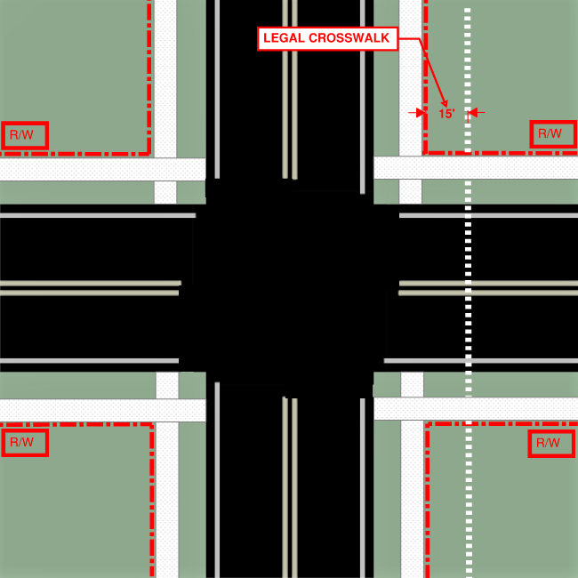
CIP Utility Project
Project Requirements
ADA Responsibilities Project Type
CIP Roadway Project
ALL CURB RAMPS REQUIRED
CURB RAMPS REQUIRED
NO RAMPS REQUIRED
RAMPS REQUIRED
Notes:
Section VII.C. Curb Ramp Construction: Conditions and Scoping
Responsibilities of Project Types
Now we’ll talk about requirements for different project types
In an intersection
Let’s take a look at a CIP Utility Project
The first scenario is a utility trench does not enter the legal XW
Although it does trigger resurfacing of the full lane width
No ramps are required
The second scenario is the utility trench does enter the legal XW.
As before, full lane resurfacing is required
But, because we’ve entered the legal XW, ramps are required at that leg

Slide 14
ADA Scoping Project Type
Privately funded Property improvements typically bring the legs of the PAR that they impact into compliance.
This could be CC plan, E-plan, or Permit work
When ramps at one corner are replaced, there must be ramps on the opposite side of the street to receive them, unless there is no sidewalk or pushbutton.
The intersection will be designed, but the ramps not to be constructed only designed to a Design/Build level

Slide 15
ADA Responsibilities Project Type
Privately Funded Roadway projects (CC and E plans going through One Stop Shop) follow the same requirements for ramp corner disturbance as described for Privately Funded Property Improvements
Other improvements trigger ADA CIP project requirements. Such as signal work will trigger current pushbutton compliance.
3P projects will be treated as CIP Roadway Projects

Slide 16
ADA Scoping Project Type
Homeowner improvements – When a single unit dwelling on an existing platted lot replaces sidewalk in front of the property, they will not be required to construct the ramp.
The DPS permit section will report these locations to the DOIM designee for construction using the annual Citywide Curb Ramp Project

Slide 17
ADA Scoping Project Type
Private Utility
Any corner disturbed will be required to be brought into current compliance. If there is no existing ramp, one must be constructed
Resurfacing only will not require ramp construction if the sidewalk was not disturbed
A design/build level drawing must be submitted for approval by the City, and Compliance sheet completed when constructed

Slide 18
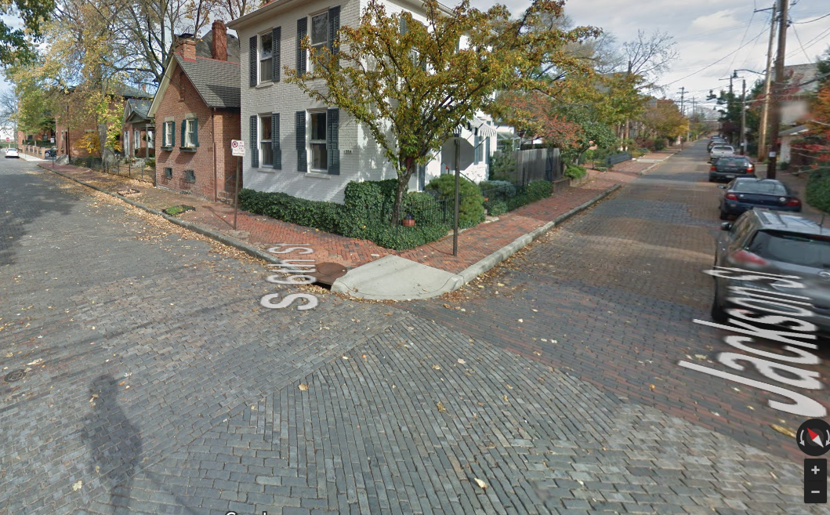
ADA Scoping Private Utility

Slide 20
ADA Scoping Existing Ramps
After determining the area required to be brought into ADA compliance, it is important to determine which existing ramps are already compliant
An existing curb ramp may be considered compliant if it contains a currently accepted detectable warning in good condition and has no visible signs of non-compliance.
If it does not appear visually compliant, the designer must complete a compliance form to determine compliance.
The designer must show that existing ramps were checked where no improvement is shown in the plans and compliant ramps are required
Notes:
A supplemental spreadsheet detailing the compliance review would be one way of showing this. Minimum 20 minutes in

Slide 21
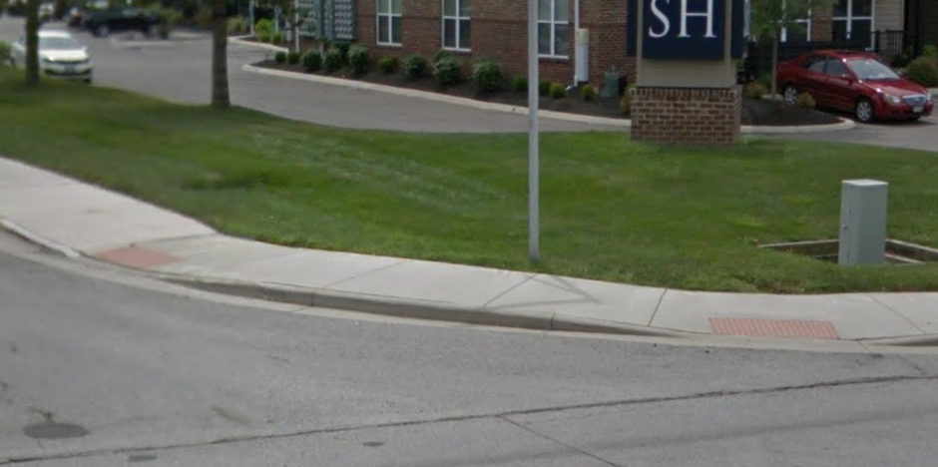
ADA Scoping Existing Ramps
Visually Compliant Ramps
Notes:
Note the detectable warning and slopes appear compliant

Slide 22
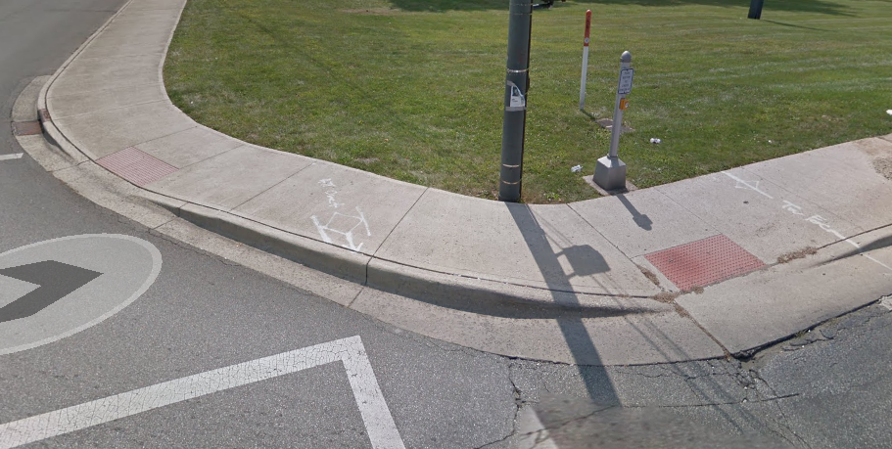
ADA Scoping Existing Ramps
Visually Compliant Ramps
Notes:
Check that pb is currently compliant

Slide 23
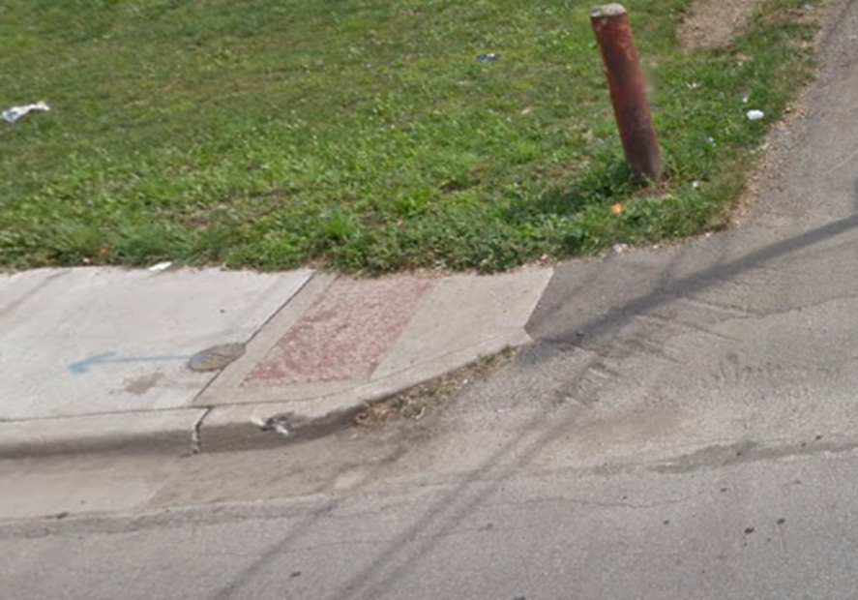
ADA Scoping Existing Ramps
Visually Non-Compliant Ramps
Vertical drop >1/2” in PAR at lip
Notes:
This has a detectable warning, but we have a vertical drop

Slide 24
ADA Scoping Existing Ramps
Visually Non-Compliant Ramps
Notes:
This ramp is not compliant because there is no DW where the curb is flush with the street

Slide 25
ADA Scoping Existing Ramps
Visually Non-Compliant Ramps

Slide 26
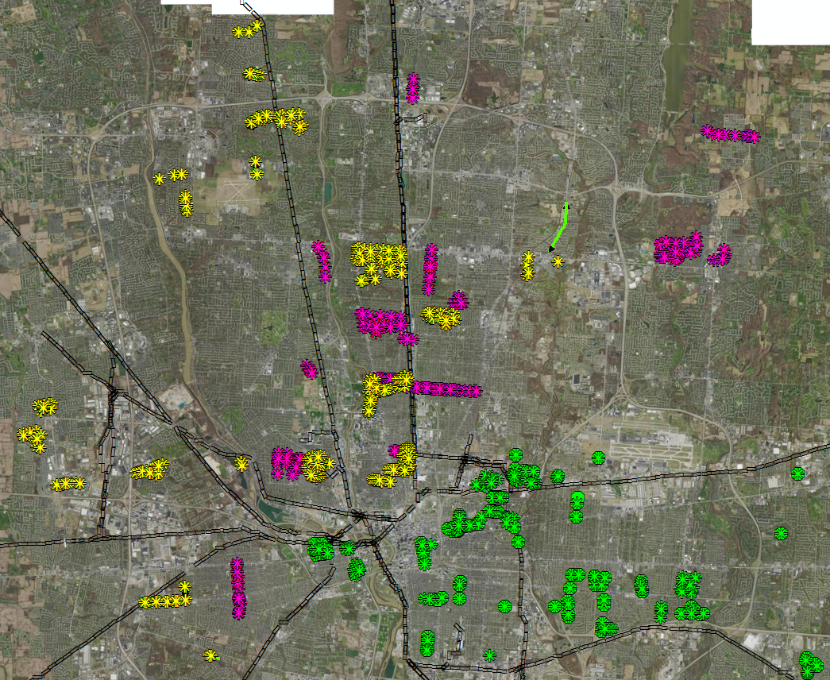
ADA Design Basics
2018 Resurfacing
1132 intersections with potentially 8 ramp locations-In House Design evaluated
9056 corners
Notes:
I am Kathleen Harman and over the last 5 years have learned more than I thought possible about ADA issues.
I am the ADA Design Manager in In-House Design. My staff, Dave Krier and Dinesh Patel, have been involved in ADA design way before me and have been invaluable. In 2018, Dave and Dinesh evaluated 1132 intersections on the roads that were to be resurfaced. If each intersection has potentially 8 ramps, that could mean field review, design and documentation of over 9000 ramps!

Slide 27
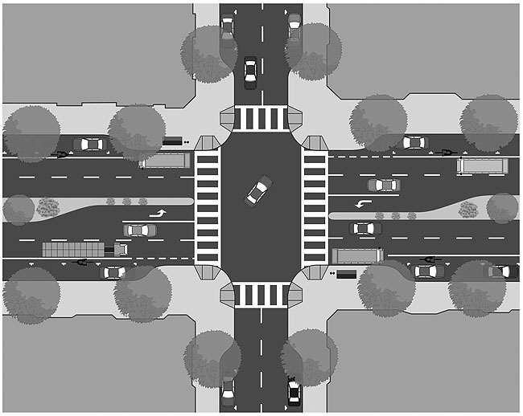
ADA Design Basics
PAR-Pedestrian Access Route
Curb Ramps and other components
Notes:
We are going to talk about 2 major components of ADA in the public right of way:
First, a PAR, or pedestrian access route
Second, the curb ramp, it’s components and what requirements must be met

Slide 28
ADA Design Basics
PAR
PAR=Pedestrian Access Route
The concept of PAR was developed by the Access Board
It is a path through and contained within a pedestrian facility, and has slope, grade, surface characteristics, and other features that make it useable by persons with mobility, sensory, or cognitive impairment conditions.
It is an unbroken, unobstructed route that provides access to any destination along a given right-of-way, that can otherwise be reached by an able-bodied pedestrian.
Stairways and escalators are not considered part of a PAR.

Slide 29
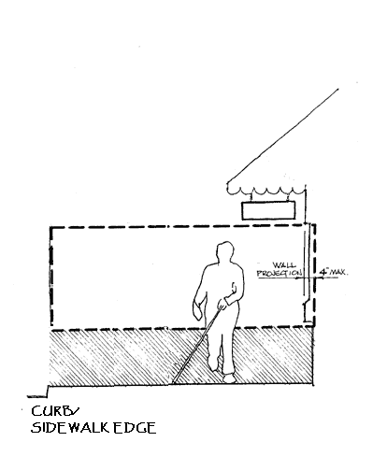
ADA Design Basics
PAR
Pedestrian facility
PAR is to be:
no less than 4ft wide
may not be reduced in width due to street furnishings (e.g., bicycle racks, parking meters, newspaper stands….)
may extend the entire width of a sidewalk or walkway, or it may consist of only a specified width of the overall path.
PAR
Notes:
1. This diagram shows a nice wide sidewalk
2. And represents a pedestrian facility
3. Most sidewalks, however, look more like this: with trees, street lights, signs, overhangs, etc.
4. The PAR must be a minimum of 4’ wide through this pedestrian facility. A PAR also has other requirements. This is a protected zone. Note the hatching-that is 27” high; all obstructions must be in this range so that a blind person’s cane can detect that it is coming up. The protected zone must also be clear to 80” in height. Projections into the protected zone are limited to 4”. A building wall may have window planters or signs that project 4” max.

Slide 30
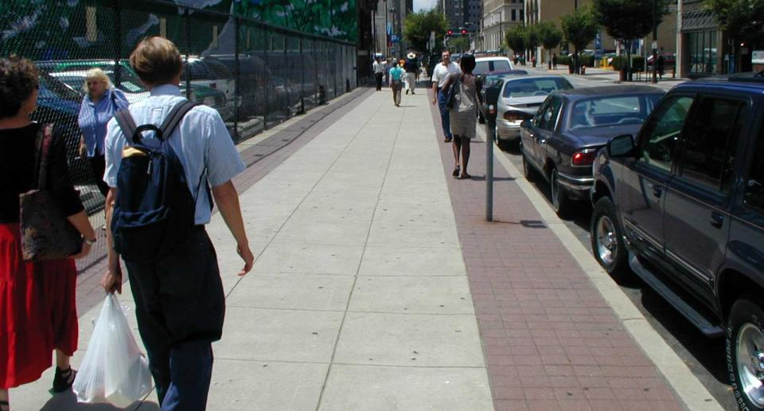
ADA Design Basics
PAR
PAR
Notes:
Here’s an example of a PAR between the chain link fence and the parking meters. Looks like this is greater than 4’, doesn’t it?

Slide 31
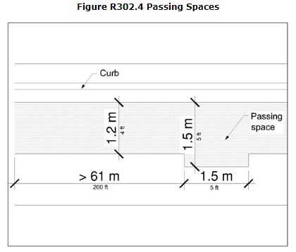
ADA Design Basics
PAR is to be:
Where the clear width of pedestrian access routes is less than 5.0 feet, passing spaces shall be provided at intervals of 200.0 feet maximum. Passing spaces shall be 5.0 feet minimum by 5.0 feet minimum. Passing spaces are permitted to overlap pedestrian access routes.
200 ‘
5 ‘
Source: PROWAG-Proposed Right of Way Accessibility Guidelines
Notes:
Add slide showing 5’ passing every 200’; state cross slope of PAR <1.56%; simplify graphic

Slide 32
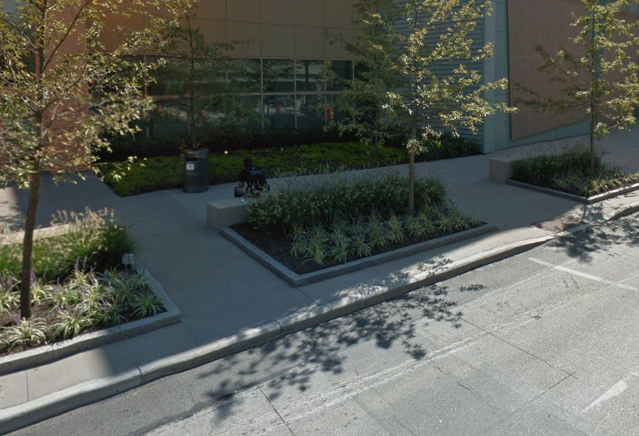
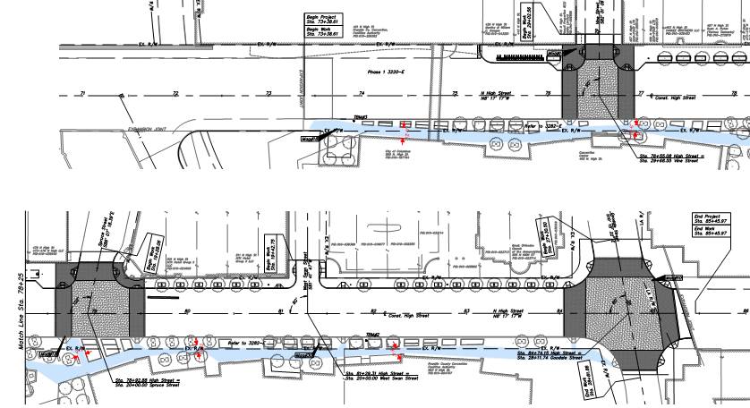
Columbus PAR
Notes:
The construction drawing shows a meandering, continuous, PAR through the Convention Center-note the blue highlight;
The photo shows the street furniture including benches, trash cans, landscaped areas and pedestrian crossing with ADA ramps

Slide 33
ADA Design Basics
Curb Ramps have the primary function of providing access from the sidewalk to the street when curb is present.
Typically installed at legal crosswalks (intersections)
May provide access to pedestrian facilities (pedestrian activated push buttons)
Are NOT installed where NO sidewalk is present
A Blended Transition is installed to provide access from the sidewalk to the street when curb is not present.
Blended Transitions have slopes 5% or less.
Are not required to have landings.

Slide 34
ADA Design Basics
Curb Ramps
A Compliant Curb Ramp has the following Components:
Landings-turning space
Flares
Slope
Running Slope
Cross Slope
Counter Slope
Detectable Warning
Notes:
Add animation; change dimensions to be in animation and arrowed callouts; include slope callouts; call out long flare and slope

Slide 35
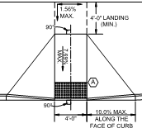
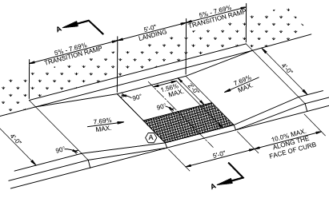
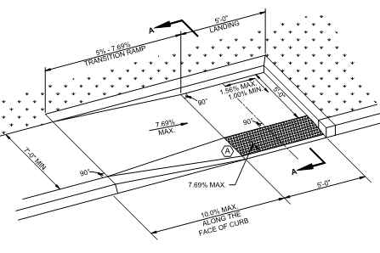
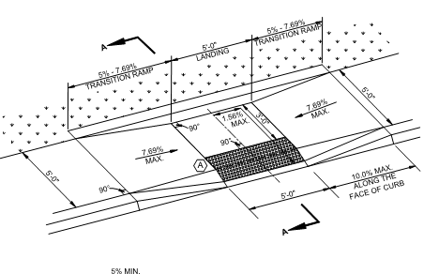
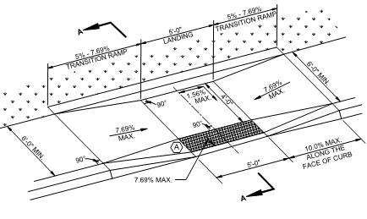
ADA Design Basics
REQUIREMENT: Landings
Landing area is required at the top of perpendicular ramps.
Landing area is required at the bottom of parallel ramps.
When a ramp is constrained on 2 or more sides, the landing area must be 5’ x 4’
All Columbus parallel ramps have 4’x5’ landings
Landings (turning space)
Notes:
A landing is defined as the same as a turning space in City policy. (see the definitions on page i (2 of 34) and page 16 in Section IX. C.)

Slide 36
ADA Design Basics
Landings
4’x4’ Turning Space
Notes:
The ramps on the right have 4’x4’ landings; a 4’x4’ turning space is also required to allow the PAR to continue to turn the corner; note that this turning space can overlap the landing. This turning space meets the landing requirements because sidewalk is required to have a maximum 1.56% cross slope. When the PAR meets, each direction meeting that requirement, means the turning space does as well.

Slide 37
ADA Design Basics
Flares
REQUIREMENT: Flares
Long Flares
Required on perpendicular ramps
No steeper than 10% (i.e., 6” curb requires a 5’ flare), measured along the curb line
Required where the circulation path or walkable surfaces is adjacent to the curb ramp.
Advisory R304.2.3 Flared Sides. The flared sides are part of the pedestrian circulation path, but are not part of the pedestrian access route. Curb ramps whose sides have returned curbs provide useful directional cues where they are aligned with the pedestrian street crossing and are protected from cross travel by landscaping, street furniture, chains, fencing, or railings.

Slide 38
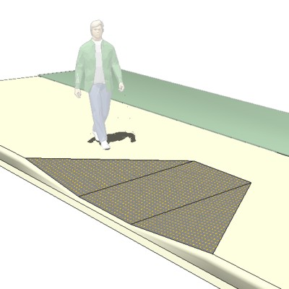
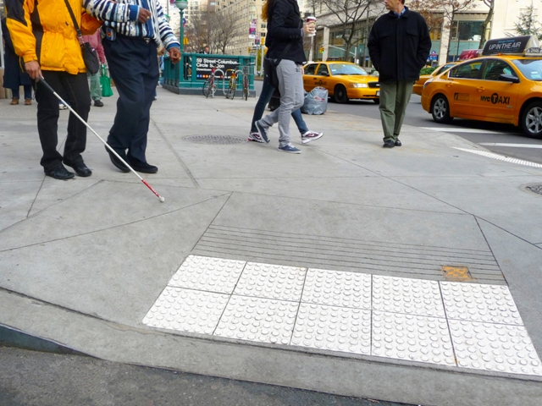
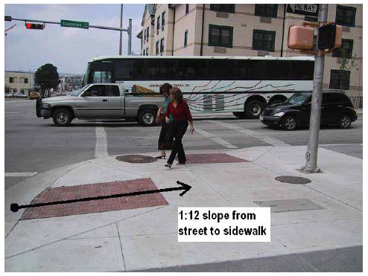
Long Flares are walkable
Notes:
Here are a couple examples of pedestrians using the long flare as a walkable surface.

Slide 39
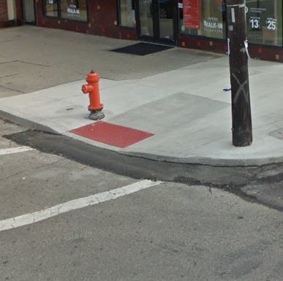
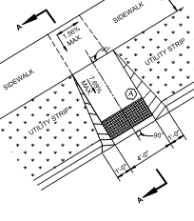
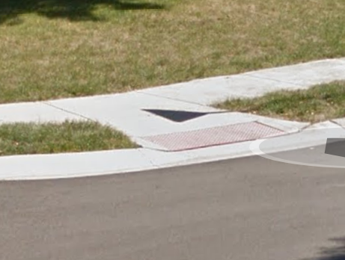
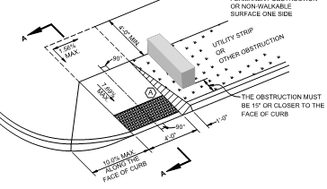
ADA Design Basics
Flares
REQUIREMENT: Flares
Short Flares
Can be used where there is a non-walkable surface (grass, trees, landscaping, areas blocked by utility pole, street furnishings, hydrants, etc.) adjacent to the ramp,
i.e., should never be used at any location where pedestrian traffic can be expected to cross the curb ramp
Are commonly 6” to 12” wide at the curb
Note: Manhole covers and hatches are considered to be walkable surfaces, if they are flush with the sidewalk surface.
RAMP TYPE C
RAMP TYPE D
Notes:
Short flares are used on 2 types of ramps:
1. both flares on a C ramp are short flares
2. here’s an photo
3. and a D ramp, where one flare is long and one is short due to grass or an obstruction;
4. here’s an example

Slide 40
ADA Design Basics
Running slopes
There are ramp requirements which are the Federal Standard, established by the Department of Justice and City of Columbus Standards.
City of Columbus Standard
Running slope maximum: 1:13, or 7.69%
Federal Standards
Running slope maximum: 1:12, or 8.33%
Inspection Guidelines
If an ensuing inspection notes this standard has not been met, yet the slope of the ramp does not exceed the Federal standard of 1:12, the ramp may be approved if it does not violate the other standards established by the City of Columbus.
There is no construction tolerance, the difference between City and Federal requirements is the only construction tolerance available. Anything outside of Federal standards is a FAIL.
Notes:
The city requires a max running slope of 7.69% and the Feds require max 8.33%; Construction inspection may approve 8.33% if other standards aren’t violated. There is no other “wiggle room”.

Slide 41
ADA Design Basics
Running slopes
7.69% Max

Slide 42
ADA Design Basics
Cross slopes
REQUIREMENT: Ramp and PAR Cross Slope
City of Columbus Standard
Cross slope maximum: 1:64, or 3/16” per foot, or 1.56%
Federal Standards
Cross slope maximum: 1:48, or 1/4” per foot, or 2.08%
Inspection Guidelines
Ramps are to be designed and constructed to the 1:64 cross slope maximum.
If an ensuing inspection notes this standard has not been met, yet the slope of the ramp does not exceed the Federal standard of 1:48, the ramp may be approved if it does not violate the other standards established by the City of Columbus.
**Blended Transitions are required to also meet this standard for cross slope.
Notes:
The city requires a max running slope of 1.56% and the Feds require max 2.08%; Construction inspection may approve 2.08% if other standards aren’t violated. There is no other “wiggle room”.
Make a point that cross slope applies to the entire PAR

Slide 43
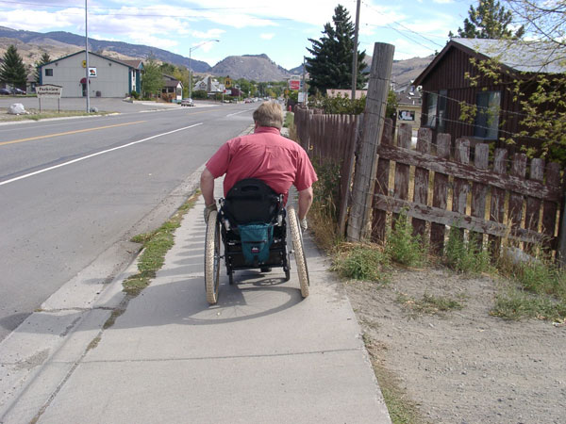
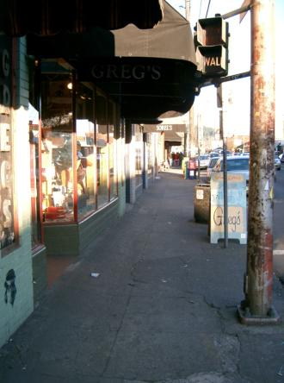
ADA Design Basics
Cross slopes
Par not 4’ in width
1.56% HERE
Cross Slope: 1.56% maximum
Source: PROWAG-Proposed Right of Way Accessibility Guidelines
Notes:
The cross slope requirement is necessary so that wheelchair users are stable and upright as they navigate to their destinations. The person on the left must compensate for the excessive cross slope.
In the photo on the right, we can see a portion of the PAR meets the cross slope requirement, but, there are times when building entrances are higher than the existing sidewalk. That is the case here. So, the PAR does not meet the minimum 4’ width.

Slide 44
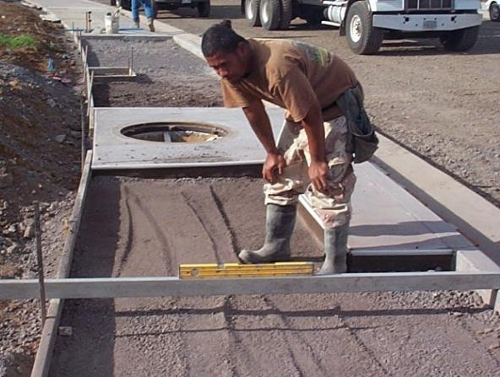
ADA Design Basics
Cross slopes
Par not 4’ in width
2% HERE
Cross Slope: 2% maximum
Source: PROWAG-Proposed Right of Way Accessibility Guidelines
Notes:
Note that the same cross slope requirements also apply to sidewalks;
This photo shows a portion of the walk meeting 1.56%. We use digital levels extensively in field review. (show a level).

Slide 45
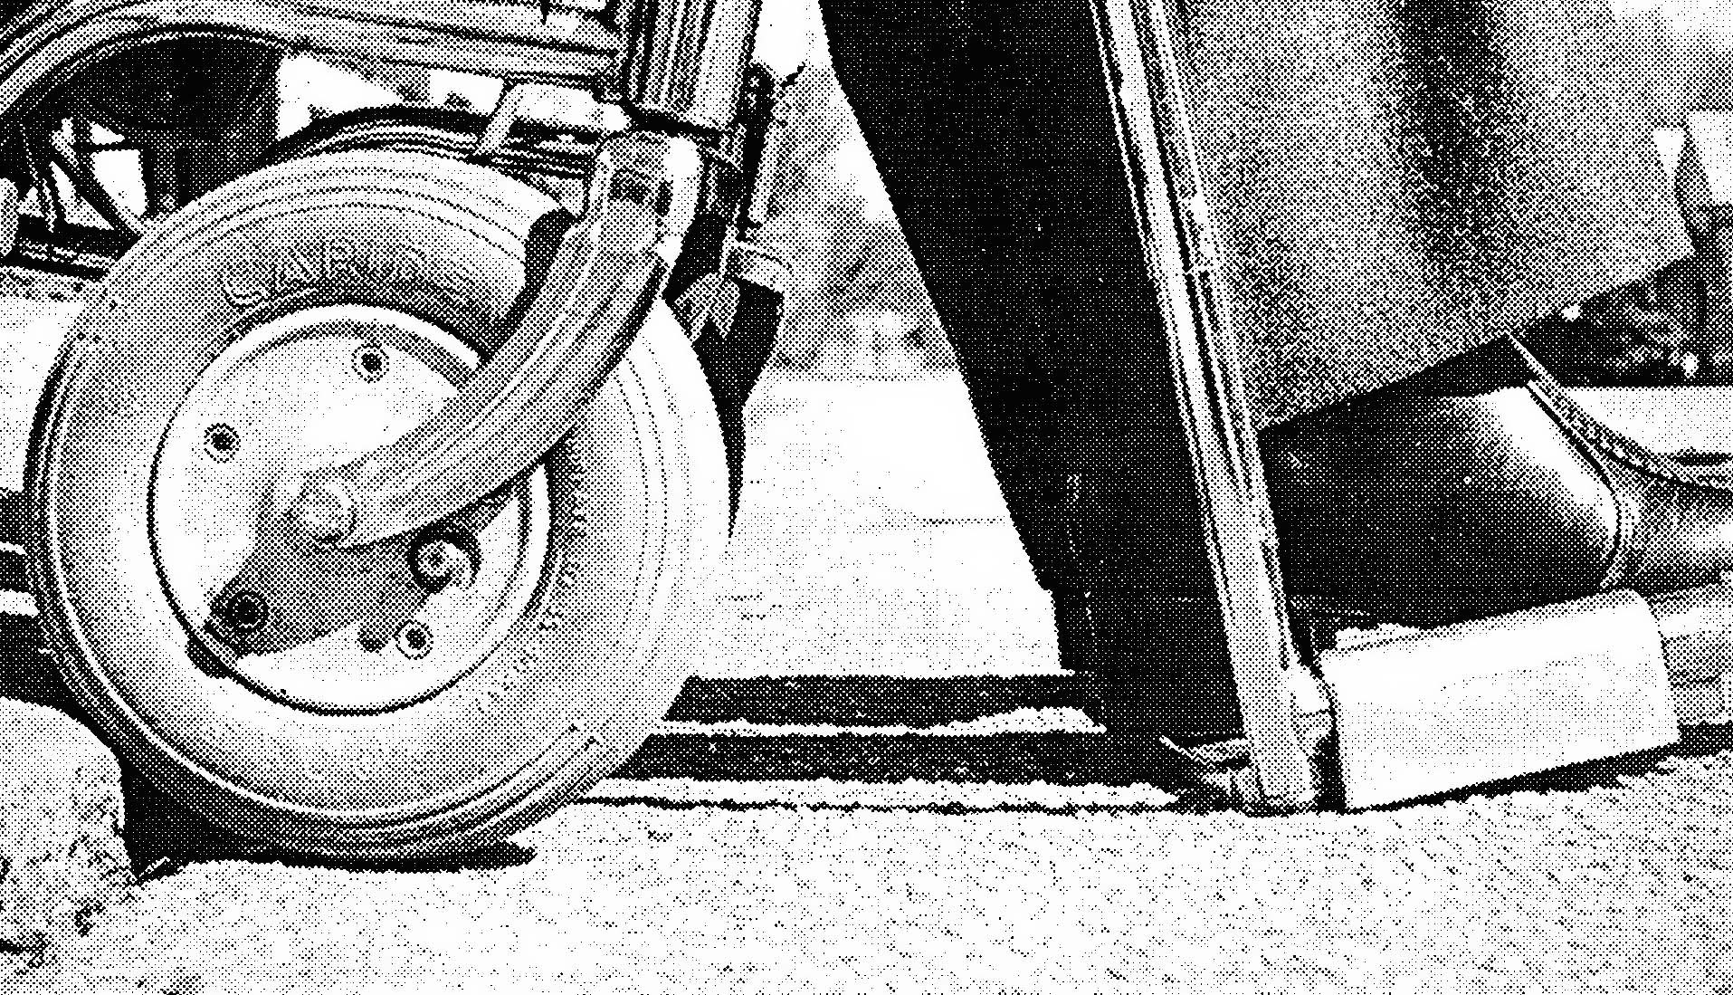
ADA Design Basics
Counter slopes
The cross-slope of the street (perpendicular to the curb) cannot exceed 5%
Bottoming out at opposing slopes
Notes:
The counter slope is defined as the cross slope of the street perpendicular to the curb. If the 5% is exceeded, a wheelchair user could bottom out-ie his feet scrape the pavement.

Slide 46
ADA Design Basics
REQUIREMENT: Off-Sets
A vertical change in level (lip) greater than ¼” is not permitted on curb ramps, blended transitions, landings, and gutter areas within the PAR.
Notes:
Elevation differences are limited to ¼” throughout the ramp and PAR. In the last couple of years, the City has been addressing many lips caused by tree roots. We fix these near the intersections we are constructing ramps at.

Slide 47
Maintain Gutter drainage
Construct the ramp to meet the roadway edge.
Do not adjust the road later to meet the ramp
The curb no longer drains along the gutter in this example
Heatwelding is often an obvious sign of post construction adjustment

Slide 48
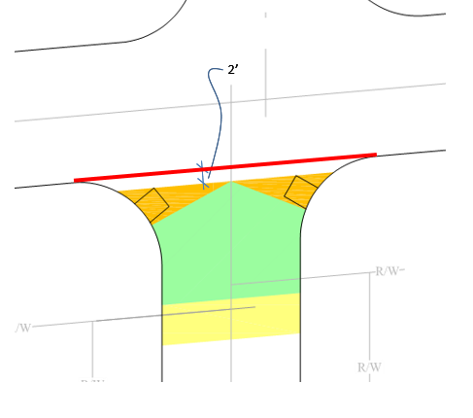
ADA Design Basics Clear Space
Curb Ramp Design Boundary
-Beyond the bottom grade break, a clear space (minimum 4’x 4’)shall be provided within the width of the pedestrian street crossing and wholly outside the parallel vehicle travel lane with a 2’ buffer.
-Purpose is for turning
-not required to meet 1.56%
Buffer
Clear Space
Notes:
We’ll be going over the changes to the Curb Ramp Design Boundary soon, but I wanted to show you clear space in it. When striped the clear space must be fully contained in the striped crosswalk.

Slide 49
ADA Design Basics
Detectable Warnings
A Detectable Warning (DW) is used to provide a distinct surface of truncated domes, detectable by cane or underfoot, and is of a contrasting color, to alert those with vision impairments of the transition to a vehicular route.
Note: all DW must be installed so that the unit is surrounded by a border of concrete.
Truncated Domes
Shall comply with City of Columbus Standard Drawings 2319,
Supplemental Specification 1551 has been removed: Material requirements for DW’s are found in 2018 CMSC Item 608 and Item 712.14
Note: all DW installed in Columbus MUST be from the list of products approved by the City of Columbus, available at our website).
Contrast
DW surfaces shall contrast visually with adjacent walking surfaces, either light-on-dark, or dark-on-light.
No color substitutions are permitted without the express written
Notes:
The purpose of a detectable warning mat is to alert those with vision impairments that you are entering a vehicular route.
There are very specific guidelines for this feature and it is now documented in the new 2018 CMSC under ITEM 608 and 712.14; In the downtown area, cast iron or granite DW’s are required; the city prefers cast iron

Slide 50
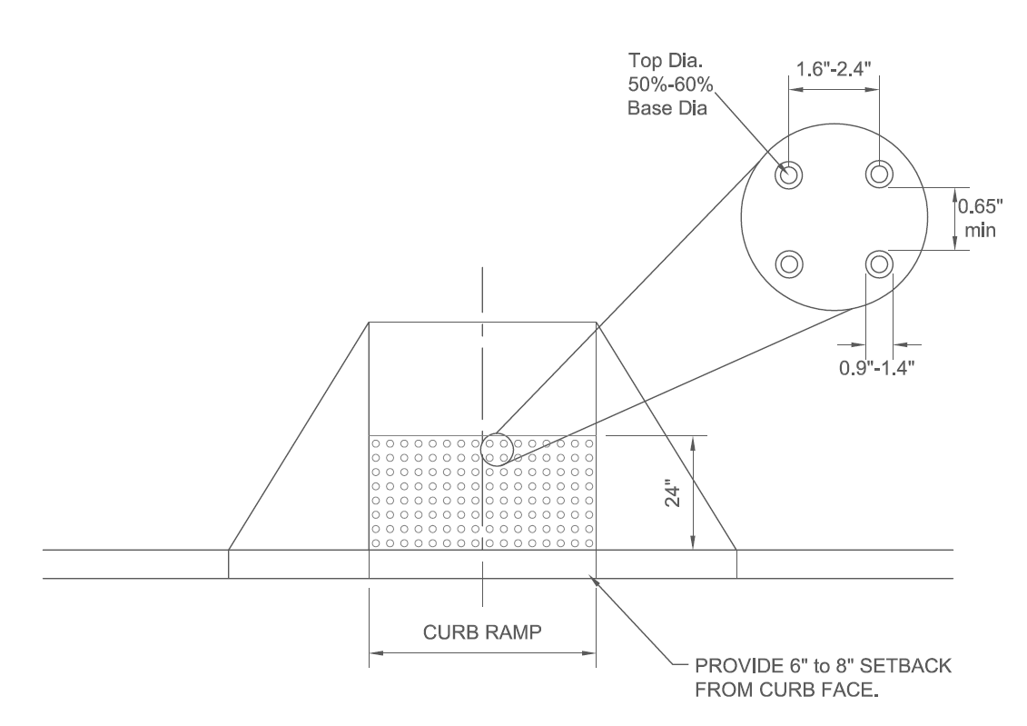
ADA Design Basics
Detectable Warnings
Note: The truncated domes must be aligned parallel & perpendicular
to the curb line
Included in all PAR crossings of
Public roadways
Alley crossings
Striped commercial drives
Identify following features:
Curb ramps
Blended transitions
Borders of medians/islands
Street crossings for shared use paths
Sidewalk crossing at RR tracks
Notes:
Where are DW’s used? They are used where the PAR crosses public roadways, alley crossings and striped commercial drives
1. Note how the DW mat is oriented to the direction of travel behind the curb.

Slide 51
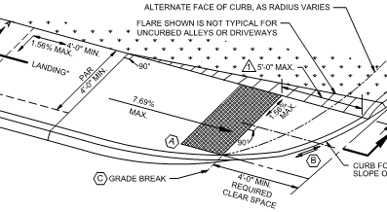
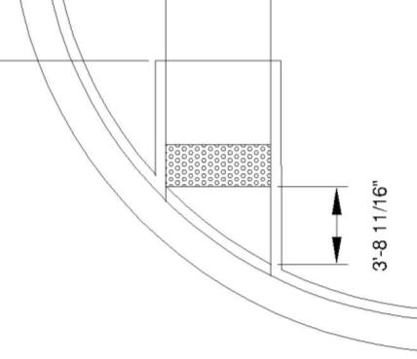
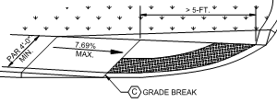
ADA Design Basics
Detectable Warnings
Place DW on curb ramp at grade break if Clear Space at bottom of ramp is less than 5’ deep.
< 5’
Place DW on clear space if clear space is more than 5’ deep at any point (DW moves but grade break does not).
Notes:
On alley ramps, DW placement changes based on the length of the landing at the bottom. In the top diagram, the DW is placed at the grade break if the level landing at the bottom is less than 5’
When the landing is >5’, the DW is placed on the bottom landing. Bottom is not a landing it is a clear space. Make sure not to confuse

Slide 52
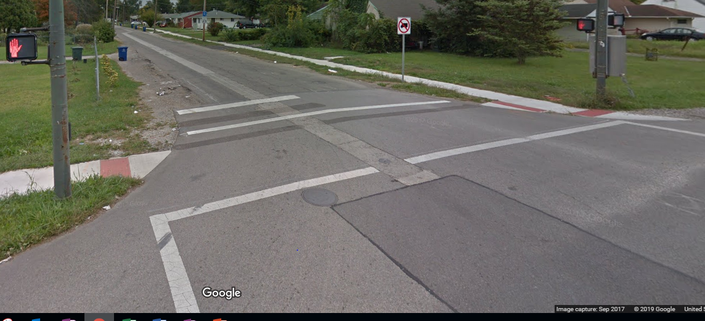
ADA Design Basics
Blended Transition
Elements of a PAR that serve the same function as a curb ramp and all requirements of the curb ramp remain with the exception of a landing is not required and the running slope cannot exceed 5%.
Notes:
Blended transition have been constructed here.

Slide 53
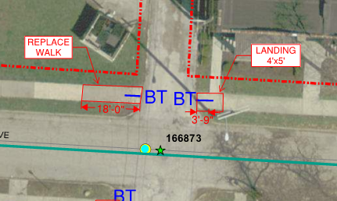
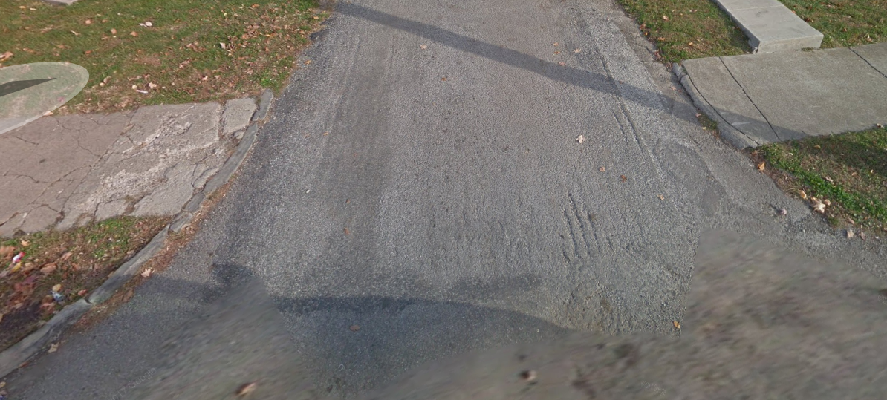
ADA Design Basics
Blended Transition
Blended transitions will now also receive a lump sum Ramp Each payment and will be subject to the same compliance check requirements as curb ramps
Notes:
Here is another example of a location where a blended transition would be constructed at an alley in Columbus.

Slide 54
ADA Design Basics Pinch Points
An allowance is made for a narrower than 4’ PAR for a very short distance on Alteration Projects Only.
The obstruction creating the pinch point must be out of the scope of the project and considered technically infeasible
Pinch Point requirements are based on 2010 DOJ Standards

Slide 55
ADA Design Basics Gratings and Access Covers
Gratings, access covers, and other appurtenances shall not be located on curb ramp landings or slopes
These items can show up in the PAR if they are flush and compliant per DOJ 2010 Standards
We do not want tree grates to be part of the required PAR
Notes:
As you know, urban streets typically have a multitude of grates, access covers, manhole lids. These are not permitted on the curb ramp itself, although they can be in the PAR, provided they meet Federal standards.
Although tree grates are allowed in the PAR, according to DOJ, Columbus will flag their use during plan review. Tree grates should not be placed in the PAR.

Slide 56
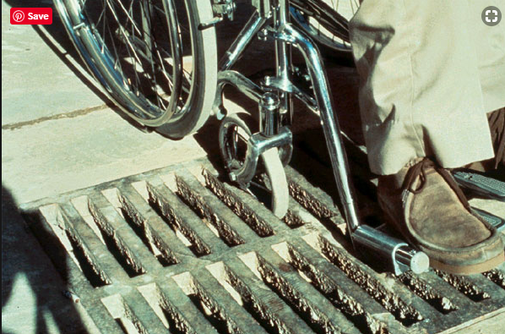
ADA Design Basics Gratings and Access Covers
Notes:
As you know, urban streets typically have a multitude of grates, access covers, manhole lids. These are not permitted on the curb ramp itself, although they can be in the PAR, provided they meet Federal standards.
Although tree grates are allowed in the PAR, according to DOJ, Columbus will flag their use during plan review. Tree grates should not be placed in the PAR.

Slide 57
Design Best practices
A design best practices section has been added to the ADA Rules and Regulations
This describes the City’s preferences that aren’t hard and fast rules
The best practices should always be followed unless there is a reason why they can’t be
Notes:
These are the Shoulds, not the Shalls

Slide 58
Design Best practices
Locate ramps close to the intersection
For corners with tight radii (<11’) typically locate ramps on the straight section of curb
For larger Radii, locate ramps on the radii
Perpendicular ramps are most preferred
Align ramp across from each other as much as possible, but there is no longer a 2’ alignment rule
Notes:
An ADA Best Practices section has been added
These are not absolute rules, but should generally be followed unless there is a reason preventing that.

Slide 59
Design Best practices
Maximize ramp running slope (<7.69%) to keep water in the street
Utilize all available ramp designs before deciding to acquire ROW
Provide a walking surface to accommodate both wheelchairs and the able bodied. Minimize small grass patches

Slide 60
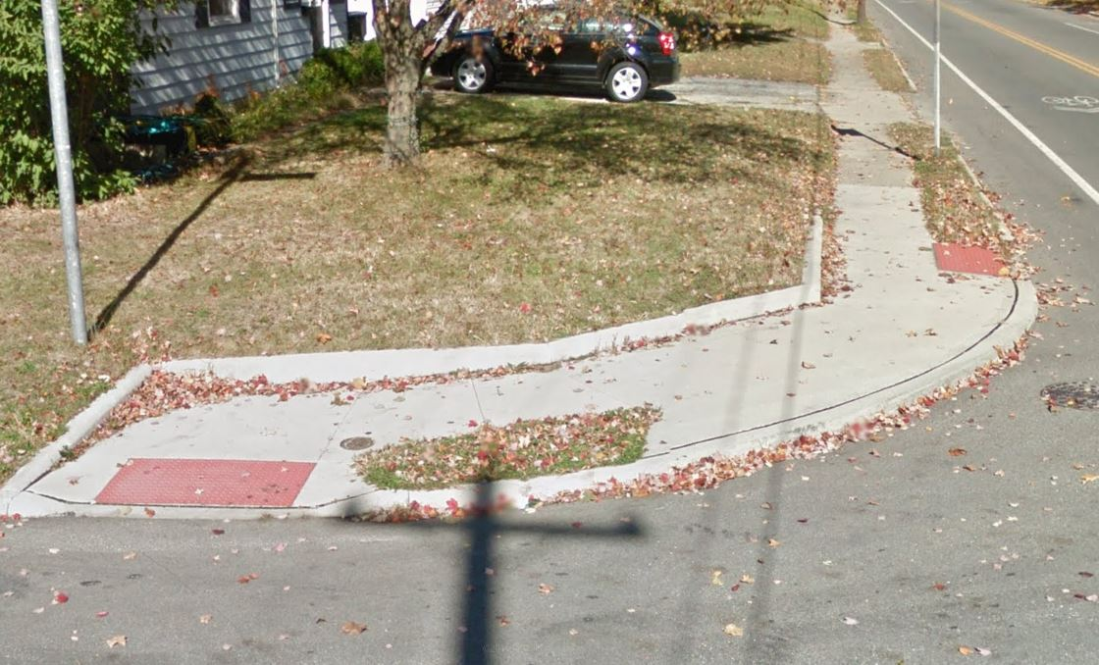
Design Best practices Curb Walls and Work Agreements
Minimize use of walls behind sidewalk. Grade back whenever possible to a maximum 3:1 slope
Notes:
Although the R/W is likely close behind the walk, most homeowners would rather allow us onto their property to grade back in order to not use a curb wall. This can be achieved by having them sign a work agreement.

Slide 61
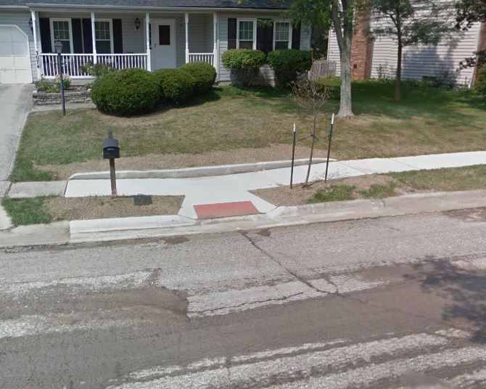
Design Best practices Curb Walls and Work Agreements
Work agreement would have avoided this
Notes:
Although the R/W is likely close behind the walk, most homeowners would rather allow us onto their property to grade back in order to not use a curb wall. This can be achieved by having them sign a work agreement.

Slide 62
Design Best practices Curb Walls and Work Agreements
Notes:
You can see R/W was close to the back of sidewalk. If the designers see the need for curb wall, we will call it out and quantify it. The contractor requested Work Agreements at all 3 corners. 2 owners signed a work agreement.

Slide 63
Design Best practices Cell Walls
Cell walls are used when the height is greater than 18” and up to 48”; In resurfacing projects, we note Versa-lok should be used.
Notes:
This cell wall was built due to R/W constraints on Cleveland Ave in a recent resurfacing project, as well as the sidewalk.

Slide 64
Intersection Design
Notes:
This is an intersection on Walcutt near Ridgeway staff designed. The existing catch basin is surrounded by concrete, but no ramps exist. Design best practice would place D ramps. Long flares will connect to the existing concrete and short flares will be constructed on the opposite side.

Slide 65
Intersection Design Ramp Location
Columbus is making an effort to locate curb ramps closer to the intersection.
Pedestrians cross in a more visible location
Marked crosswalks appear a more standard width
Ramps are closer to the natural walking path, keeping disabled and able bodied pedestrians in the same area.
Notes:
Ramp locations closer to the intersection are most desirable. We’ll be going over the location hierarchy shortly.
Locations closer to the intersection place pedestrians in the most visible location for vehicular traffic to be aware of them.
Keeping ramps close to the intersection will also direct them on the natural walking path that able bodied pedestrians will be travelling.

Slide 66
Intersection Design Ramp Location
The Curb Ramp Design Boundary drawing has been updated to provide an order of preference in locating curb ramps.
Follow the Curb Ramp Design Boundary steps.
Do not move to the next area of preference unless the more preferable area is exhausted.
Notes:
We will be reviewing the updated Curb Ramp Design Boundary next. The preferred order of ramp location is documented and designers shall place ramps in the most preferable location achievable within the site constraints.

Slide 67
Intersection Design
2. Either the Maximum Safe Crossing Limit (Line A) or the back of the legal crosswalk (Line B)-whichever is the closest to the intersection.
Step 6-Intersect crown of roadway at 2 ft setback (Lines C1 & C2)
Step 1-Define Roadway Projection: Use PC & PT to connect curb lines or extend edge of pavement
Step 7
Establish Design Boundary defined by:
The maximum rotation around the curb radius into the intersection that will allow a level turning area at the flat roadway crown inside the crosswalk and at a safe distance from parallel vehicular traffic. Lines C1 and C2 represent the centerline of the curb ramp, perpendicular to the curb (radius), and
Step 5-Locate Maximum Safe Crossing Limit (Line A)
X=25’ for radius < 20’
Otherwise, X=radius +5’
Step 4-Define legal crosswalk
(Line B) using roadway projection farthest from roadway PLUS 15 ft
Step 2-Establish 2 ft setback parallel to roadway projection
Step 3-Extend each R/W parallel to roadway projection
3. Where obstructions or vehicle sight distance prevent the curb ramps from being located as described in 1 and 2, the ramp may be located closer to the intersection providing a 4’x4’ clear space parallel to the ramp centerline is provided with a 2’ setback from the parallel roadway projection as shown (D)
Step 2
Step 6
2’
Step 1
First area to place ramps
Second area to place ramps
D
Third area to place ramps
D
Line C1
x
Line C2
Step 5
R/W
Line A
R/W
Line B
Step 3
Step 4
Notes:
Show the 2’ and 15’ dimension for offset and ROW

Slide 68
Intersection Design Ramp Type
Existing conditions and particularly ROW space will limit the options of Ramp type
Standard Drawing 2319 details the hierarchy in tiers
Do not go to the next tier of ramps until the more preferred tier is exhausted

Slide 69
Intersection Design Ramp Type
Tier 1 (perpendicular ramps)
RAMP TYPE A
RAMP TYPE D
RAMP TYPE C
Notes:
Wheelchair has a straight path over the curb
User can rest further back from the street

Slide 70
Intersection Design Ramp Type
TIER 2 (Parallel ramps)
RAMP TYPE P-4
RAMP TYPE P-6
RAMP TYPE P-5
RAMP TYPE P-7
Notes:
These are typically used where ROW is constrained
Higher risk of ponding
Affect the entire PAR
Note the 5’ width on the landing. Explain… The 5’ when constrained is about the foot overhang on a wheelchair and the clearance needed when rotating

Slide 71
Intersection Design Ramp Type
TIER 3 (Rarely used ramps)
RAMP TYPE RADIAL
RAMP TYPE J
RAMP TYPE SINGLE SHARED RAMP
Notes:
Ramp Type J is a new ramp type and is rarely used.
Using a single shared ramp instead of separate ramps is also not commonly used.
A radial ramp type is used where large radii exist. In this photo of Broad and High is an example.
1. Here is a street view of it. Note the DW goes all around the ramp. Radial ramps work downtown with wide sidewalks and large ped volumes

Slide 72
Intersection Design Ramp Type
SPECIALTY RAMPS (Alleys and Medians)
RAMP TYPE G
RAMP TYPE H
RAMP TYPE L-1
RAMP TYPE L-2
Notes:
These ramps are just for specific locations; Talk about L-1 new, preferred, drainage concerns

Slide 73
Intersection Design Ramp Type
Specialty Ramps (Pedestrian Pads)
Notes:
Pedestrian pads have been changed to build connected sets when possible; their purpose is to access pushbuttons

Slide 74
Intersection Design Ramp Type
Brick Ramps
Used in historic districts with brick sidewalks
Used in new construction anywhere brick sidewalk is adjacent
Notes:
Brick ramps

Slide 75
Intersection Design
Design Level

Slide 76
Intersection Design
Design Level
Full Design
These designs require TOPO.
They show all grade breaks and elevations at all grade break intersections
Right-of-way limits are shown
All existing and proposed facilities are shown
Pushbutton location is shown
Typically these are shown in the intersection details section of the plans
Default design for CIP projects and Private CC and E plan work
Notes:
Full design and design build

Slide 77
Notes:
Elevations at every grade break intersection
Dimensions of ramps and landings
Grade %
Flow lines
Shows the curb line drains
Existing facilities
Ex stone and proposed concrete curb

Slide 78
Intersection Design
Design Level
Design-Build
Uses an aerial orthographic photo as the base drawing
Designer determines the ramp type and centerline location of the proposed ramp
Right-of-way limits are shown, all acquisition must be complete before construction
All existing facilities are shown with direction on how they are dealt with. I.E relocating stops sign, encroachments, etc…
Ramp should be designed from the roadway edge back and also needs to accommodate existing sidewalk connections like lead walk and driveways
Notes:
Full design and design build

Slide 79
Intersection Design
Design Level
Design-Build (cont.)
Only for alteration projects
Default design for Resurfacing projects
May be used for private utility projects or private property improvements
Very limited use on CIP projects and only based on advanced approval given at the scoping stage
City always maintains the right to require a full design
Notes:
Full design and design build

Slide 80
Example pic of Design/Build

Slide 81
Intersection Design
Design Level
Design-Build Construction Responsibilities
The contractor visits the site and generates a sketch for approval by the Project Manager (PM)
The PM reviews and approves the submittal, looking at deviations from the original design and quantities
The contractor is responsible for building a compliant ramp and transition to existing sidewalk
Notes:
Full design and design build

Slide 82
Design Basics
3-Way (Tee) Intersections

Slide 83
Design Basics
3-Way (Tee) Intersections
When the distance between the two legs of the offset exceed 200’, the configuration now reflects a situation where there are actually two “tee”, or 3-way intersections, and procedures for offset intersections will not be used. The design procedures for 3-way intersections will be utilized to determine the number and location of ramps for each of the two intersections

Slide 84
Design Basics
Unsignalized Arterial Intersections

Slide 85
Design Basics Benching Crosswalks
Notes:
When a PAR crosses an alley, we construct ramps on either side. This figure shows the maximum slopes on the alley profile within the 15’ limit of reconstruction. Most of the time, this can be achieved.

Slide 86
Design Basics Benching Crosswalks
It is a best practice to bench crosswalks to meet PAR compliance when constructing adjacent ramps
The requirement to bench will be based on the original project scope.
Benching often requires full depth construction for extended lengths
Where it is not a stop controlled intersection with existing grades of greater than 1.56%, up to 5% is allowed for the crosswalk slope. Use of this exception should be limited.
Notes:
Typically full depth reconstruction would need to be scoped to require a bench be placed in the roadway. A small improvement to the benching can be done through variable mill or fill. It is important to design for the transition to grade breaks. This is not just Alley benching we are discussing, but benching for all crosswalks

Slide 87
Design Basics Orphan Ramps
In General, we want fully compliant and connect crosswalks
This means ramps almost always come in pairs.
Avoid building a ramp on one side of the street and not the other where sidewalk or a pushbutton exists on both sides
Do not place ramps that connect to nothing
A single ramp still serves as access to sidewalk

Slide 88
Design Basics Orphan Ramps
No ramp on north because no sidewalk

Slide 89
Design Basics Orphan Ramps

Slide 90
Pushbuttons Change Highlights
The order of pushbutton preferred placement has changed

Slide 91
Pushbuttons Change Highlights
Pushbutton orientation has changed when the button is located on the back of the landing.
The rear reach for this PB location is 10”.
This required an update to the pedestal foundation standard drawing 4163 to make the foundation footprint smaller to allow for the 10”reach
Where curb wall is placed on the back side of sidewalk, the pedestal foundation must be integral to the curb

Slide 92
Pushbuttons Change Highlights

Slide 93
Pushbuttons Change Highlights
Accessible Pedestrian Signals (APS)
APS will not be required at all traffic signals
Where deemed appropriate, City projects will require APS in the project scope
All new traffic signal builds will incorporate conduit for the easy future additional of APS.
See the Columbus Traffic Signal Design Manual for further Details

Slide 94
Pushbuttons
Pushbuttons
We also require that 2 pushbuttons on the same corner be separated by at least 10’
This makes the button positions compliant for future APS use
Notes:
Note that the position of the pushbutton is always parallel to the crosswalk

Slide 95
Pushbuttons
Pushbuttons
Notes:
Note that the position of the pushbutton is always parallel to the crosswalk

Slide 96
Pushbutton Fails
Notes:
In the photo on the left, we can see there is greater than a 10” reach to the pushbutton.
In the photo on the right, we can see the vertical grade change between the sidewalk and the pushbutton.

Slide 97
ADA On Street Parking
4% of all individually marked or metered on street parking spaces must be designated ADA
Unless specifically scoped to do so, the City is no longer marking individual parking spaces with transverse stripes
The DPS Division of Traffic Management is responsible for managing parking zones and ensuring 4% of metered parking spaces are ADA
Notes:
The previous R&Rs did not provide requirements for marked ADA on street parking outside of residential requests.
2010 DOJ calls for the requirement of 4% of marked or metered parking spaces to be designated ADA spaces.
PROWAG added the requirement of at least 1 spot per block
ODOT was the first to enforce this on the City with some Urban Resurfacing projects

Slide 98
ADA On Street Parking
Projects making alterations to parking will trigger compliance
Streetscape projects will be the most common
ADA parking spaces should always be located at the end of the block, closest space to an existing ramp, and on the more minor street of the intersection
Notes:
End of the block allows us to not make other special accommodations for the ADA space. The existing ADA ramp at the corner is permitted to be used for access

Slide 99
Design Exceptions
Design exceptions should not be required for “New Construction” projects
PARs and Ramps shall be designed and constructed to be 100% compliant unless they have received a documented design exception from the DPS Design Section Manager
For alterations, all “technically feasible” options shall be considered prior to asking for a design exception.

Slide 100
Design Exceptions

Slide 101
Design Exceptions Technically infeasible path
When it is technically infeasible to provide a compliant PAR triggered by an alteration, it may be necessary to sign the ADA compliant path
This must go through the design exception process
Signage must be placed to follow the complete alternate pathway, just like a roadway detour

Slide 102
Design Exceptions Technically infeasible path

Slide 103
Design Exceptions Technically infeasible path
This sign indicates the alternate path for disabled persons to use
It does not restrict pedestrians from using the ADA non-compliant route

Slide 104
Design Exceptions Technically infeasible path
This sign restricts access to ALL pedestrians
It should only be used where a crosswalk is not safe for ANYBODY to cross
Use of this sign should be approved by the DPS Division of Traffic Management

Slide 105
Design Exceptions Ramp slope example
Notes:
The existing slope on Front St near Liberty St is close to 7%. We designed a ramp length of 17’ to chase the grade, but could only achieve 10.3% ramp slope. This will be constructed this season.

Slide 106
Pop Quiz
Notes:
Ramp should have mx slope on curb at least
Roadway drainage issue needs to be resolved

Slide 107
Notes:
Missing curb wall

Slide 108
Pop Quiz
Notes:
Unintended radial ramp with no DW
Needs distinct flares
No ramp at other street
Mention cota landing

Slide 109
Pop Quiz
Notes:
Missing curb wall
Pushbutton in wrong place
No landing
Tree damage

Slide 110
Pop Quiz
Notes:
Ramp built too high
Using an asphalt patch to avoid a lip, but damming the gutter in the preocess

Slide 111
Pop Quiz
Notes:
Unnecessary use of shared ramp
Poor placement of the pullbox
Poor pushbutton placement
New construction, could be better

Slide 112
Pop Quiz
Notes:
Improper use of short flare
Small grass patch

Slide 113
Construction (add construction activity background)

Slide 114
Pedestrian (MOT)
Consider the pedestrian route when phasing construction.
Before closing sidewalk to begin work, a pedestrian detour must be set up.
Ensure signage is set up in all directions of traffic to allow pedestrians to follow the detour without doubling back
Ensure the detour pathway is ADA compliant.
Notes:
You can’t close all 4 corners of an intersection simultaneously

Slide 115
Pedestrian MOT
Planning your MOT is critical

Slide 116
Pedestrian MOT
Common elements

Slide 117
Pedestrian MOT

Slide 118
Pedestrian MOT

Slide 119
Pedestrian MOT

Slide 120
Construction
It is critical for Construction Inspection personnel to have an understanding of ADA compliance.
Full design projects should require minimal direction during the construction curb ramps.
Design/Build Ramps require the inspector to review the contractor’s submittal and approve them in the time specified by the contract.

Slide 122
Construction
Contractors constructing ramps within Columbus ROW must identify an ADA Compliance Officer to take responsibility for compliance of all ramps constructed
ALL ramps constructed will require a compliance form to be completed and signed by the ADA Compliance Officer.
Compliance forms shall be maintained in the project records for any project building curb ramps.

Slide 123
Construction
Construction inspection shall spot check and complete compliance forms for least 10% of ramps for quality assurance
If it is found an ADA compliance officer calls a ramp compliant 3 times in a rolling 2 years, that individual will no longer be allowed to be designated as an ADA Compliance Officer in Columbus

Slide 124
Compliance verification
Documentation of compliance is now required per CMS 608.07 (CMS Revision July 1, 2018)
The contractor must identify an ADA compliance officer for the project
The contractor must provide a signed compliance form for every ramp constructed.
Construction Inspection must verify at least 10% of the compliance forms
Notes:
The counter slope is defined as the cross slope of the street perpendicular to the curb. If the 5% is exceeded, a wheelchair user could bottom out-ie his feet scrape the pavement.

Slide 125
Questions?

Slide 126
Steve Wasosky, PE
Design Section Manager
614.645.3183
sswasosky@columbus.gov
David Krier, PE
ADA Project Manager
614.645.8238
dckrier@columbus.gov
Kathleen Harman, PE
ADA Design Manager
614.724.0574
keharman@columbus.gov
Dinesh Patel
ADA Inspector
614.645.3167

