Slide 1
Labor Law and Collective Bargaining Community Safety Advisory Commission
Presentation by:
Pamela Gordon, Chief, Labor and Employment Section, Columbus City Attorney
Ronald Linville, Partner, Baker & Hostetler, LLP

Slide 2
Topics of Discussion
Governance – Private and Public Sector
Bargaining Process and Good Faith
Impasse Process
Unfair Labor Practice
Overview of Columbus CBA

Slide 3
Governance

Slide 4
Private Sector
National Labor Relations Act (NLRA)
Enacted in 1935
Guarantees basic right of employees to organize into unions, engage in collective bargaining, and engage in collective action

Slide 5
Private Sector
National Labor Relations Board (NLRB)
Established by the NLRA
Primarily responsible for administering and enforcing the NLRA
5 members appointed by the President and confirmed by the Senate

Slide 6
Public Sector
Hagerman v. City of Dayton (1947) – “labor unions have no function which they may discharge in connection with civil service appointees”
Ferguson Act (1947) – prohibited public employee strikes
Dayton Classroom Teachers Association v. Dayton Board of Education (1975) – school board had discretionary authority to enter CBA so long as it did not abrogate the duties imposed on the board by law
Failed attempts to enact legislation in 1971, 1975, and 1977
1983 - Ohio Public Employee Collective Bargaining Act - Ohio Revised Code Chapter 4117

Slide 7
Public Sector
State Employment Relations Board (“SERB”) makes bargaining unit determinations, polices fairness in bargaining, and enforces mandatory content of agreements
SERB has three members

Slide 8
Bargaining Process and Good Faith

Slide 9
Important Terms and Concepts
State Employment Relations Board (SERB)
Employee Organization
Exclusive Bargaining Representative
Bargaining Unit
Police Department
Terms and Conditions of Employment
Good Faith
Unilateral Change

Slide 10
Important Terms and Concepts
Collective Bargaining Agreement (CBA)
Impasse
Dispute Resolution
Strike Permissive v. Strike Prohibited
Fact-Finding/Interest Arbitration
Management Rights Clause
Just Cause
Past Practice
Grievance
Arbitration
Unfair Labor Practice (ULP)

Slide 11
Bargaining Process and Good Faith
Union must be selected by a majority of employees in an appropriate bargaining unit
Factors:
employees’ desires
community of interest
wages, hours, and other working conditions
effect of over-fragmentation
efficiency of operations
employer’s administrative structure
history of bargaining
Union becomes the employees’ “exclusive representative” with respect to wages, hours, and other terms and conditions of employment
FOP Capital City Lodge No. 9
2 separate bargaining units

Slide 12
Bargaining Process and Good Faith
Duty to Bargain
Employers are required to negotiate in good faith with their employees’ representative concerning wages, hours, and terms and conditions of employment
Must meet at reasonable times and places
Must demonstrate an intent to reach agreement or resolve questions arising under agreement

Slide 13
Bargaining Process and Good Faith
Collective Bargaining
Parties can make any proposal they wish
Parties are not required to agree to any proposal or make any concession
Must bargain in good faith

Slide 14
Bargaining Process and Good Faith
The Duty to Bargain in Good Faith
“[T]o bargain collectively is the performance of the mutual obligation of the employer and the representative of the employees to meet at reasonable times and confer in good faith with respect to wages, hours, and other terms and conditions of employment… but such obligation does not compel either party to agree to a proposal or require the making of a concession…”

Slide 15
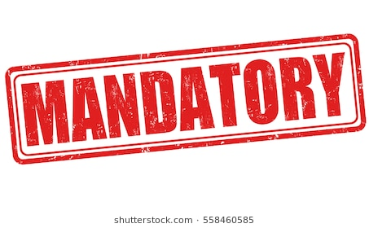
Bargaining Process and Good Faith
Mandatory subjects: wages, hours, terms and other conditions of employment; or continuation, modification, or deletion of an existing provision of a collective bargaining agreement
Prohibited subjects: conduct and grading of civil service exams, establishment of eligibility lists for entry positions, original appointments from eligibility list

Slide 16
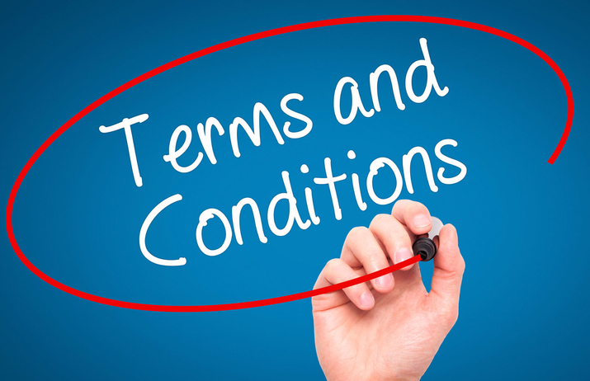
Bargaining Process and Good Faith
A public employer is not required to bargain on subjects reserved to the management and direction of the governmental unit, unless they affect wages, hours, and terms and conditions of employment and the continuation, modification, or deletion of an existing provision of a collective bargaining agreement

Slide 17
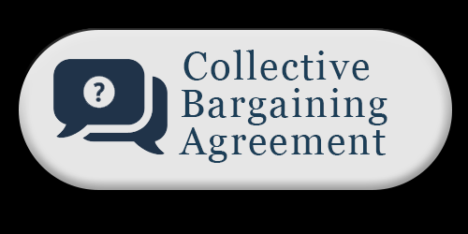
CBA
Must be reduced to writing and signed
Contract shall contain
Grievance procedure
Dues deduction
Used to permit a “fair share fee” provision
Cannot have an expiration date later than 3 years from the date of execution
CBA may supersede state law in some areas

Slide 18
Bargaining Process
R.C. 4117.21 – Collective bargaining meetings are private and not subject to R.C. 121.22, which usually requires deliberations upon official business to be conducted in open meetings

Slide 19
Bargaining Process and Good Faith
Midterm Changes
Duty To Bargain
Cannot make any unilateral changes on any mandatory subject without first negotiating with the union
Union not required to negotiate agreed terms during term of CBA
If mandatory subject, must offer to meet and negotiate with union if not included in CBA
If permissive subject, no duty to bargain if not included in CBA

Slide 20
Bargaining Process and Good Faith
Direct Dealing
Employer is prohibited from “dealing directly” with employees concerning terms and conditions of employment
Cannot undermine the union by announcing bargaining strategies or unilateral changes in mandatory subjects without first dealing with the union

Slide 21
Impasse Process

Slide 22
Impasse Process
Strike prohibited: members of a police or fire department, members of the state highway patrol, deputy sheriffs, dispatchers employed by a police, fire, or sheriff’s department or the state highway patrol…
Several other occupations
Strike permissive: other employees
10-days’ prior written notice of intent to strike
Full, consecutive work days, with beginning date at least 10 work days after ending of most recent prior strike by same bargaining unit

Slide 23
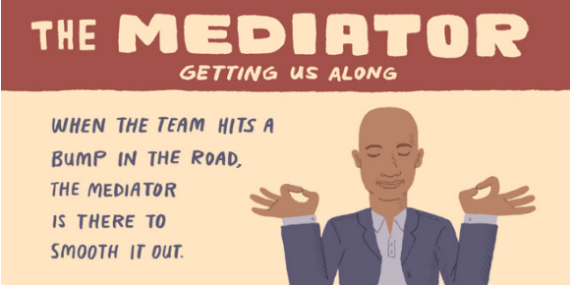
Impasse Process (R.C. 4117.14)
Serve written notice of proposed termination, modification, or successor agreement not less than 60 days before expiration or proposed termination/modification
Offer to bargain
Notify SERB
If unable to reach agreement, may submit issues to mutually agreed upon dispute settlement procedure any time prior to 45 days before expiration
May request for SERB to intervene
If impasse exists or 45 days before expiration, Board shall appoint mediator

Slide 24
Impasse Process (R.C. 4117.14)
Any time after appointment of a mediator, either party may request fact-finding panel appointed by SERB
Fact-finding panel may establish times and place of hearings
Fact-finding panel, acting by a majority of its members, shall transmit its findings of fact and recommendations on the unresolved issues to the public employer and employee organization involved and to the Board no later than 14 days after appointment, unless the parties mutually agree to an extension

Slide 25
Impasse Process (R.C. 4117.14)
Not later than 7 days after findings and recommendations are sent, legislative body and employee organization may reject recommendations by 3/5 vote
If neither rejects, a CBA shall be executed between the parties, including the fact-finding panel’s recommendations, except as otherwise modified by the parties by mutual agreement
If there is no agreement within 7 days, parties shall submit to final offer settlement procedure (conciliation)

Slide 26
Impasse Process (R.C. 4117.14)
Parties select one conciliator from list of 5 provided by SERB within 5 days of receiving list
Conciliator shall hold a hearing within 30 days of SERB’s order to submit to a final offer settlement procedure, or as soon thereafter as is practicable
Not later than 5 calendar days before the hearing, each of the parties shall submit to the conciliator, to the opposing party, and to the board, a written report summarizing the unresolved issues, the party’s final offer as to the issues, and the rationale for that position

Slide 27
Impasse Process (R.C. 4117.14)
The conciliator shall resolve the dispute by selecting, on an issue-by-issue basis, from between each of the party’s final settlement offers, considering the following factors:
Past collectively bargained agreements
Issues related to other public and private employees doing comparable work
Interests and welfare of the public, the ability of the public employer to finance and administer the issues proposed, and the effect of the adjustments on the normal standard of public service
The lawful authority of the public employer
The stipulations of the parties
Other factors that are normally or traditionally taken into consideration in the determination of the issues submitted to final offer settlement

Slide 28
Impasse Process (R.C. 4117.14)
The conciliator shall make written findings of fact and promulgate a written opinion and order, which is a binding mandate.

Slide 29
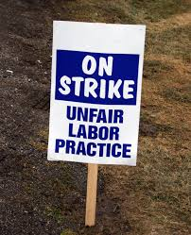
Unfair Labor Practice

Slide 30
Unfair Labor Practice
Conduct that violates Chapter 4117
Can be committed by both employers and unions
Charge must be filed with SERB within 90 days of occurrence and served upon charged party before filing
SERB Investigations Section conducts initial review to determine if allegations would constitute violation
If they would not, Board reviews and may dismiss

Slide 31
Unfair Labor Practice
If Board finds probable cause, complaint is issued
Potential mediation
Charged party files response
Hearing by ALJ, Board members, or Board itself
Proposed order with findings of fact and conclusions of law – either party may file exceptions within 20 days of receipt
If exceptions are filed, Board may adopt proposed order, or a portion, or issue its own opinion

Slide 32
Employer ULPs
Interfere with, restrain, or coerce employees in the exercise Chapter 4117 rights
Initiate, create, dominate or interfere with the formation or administration of any employee organization, or contribute financial or other support to it
Discriminate in regard to hire or tenure of employment or any term or condition of employment on the basis of the exercise of Chapter 4117 rights.
Discharge or otherwise discriminate against an employee because he has filed charges or given testimony under Chapter 4117
Refuse to bargain collectively with the representative
Establish a pattern or practice of repeated failures to timely process grievances
Certain lock-outs
Cause or attempt to cause an employee organization, its agents, or representatives to violate division (B)

Slide 33
Union ULPs
Restrain or coerce employees in the exercise of Chapter 4117 rights
Cause or attempt to cause an employer to violate division (A)
Refuse to bargain collectively with a public employer
Call, institute, maintain, or conduct a boycott against any public employer, or picket any place of business of a public employer, on account of any jurisdictional work dispute
Induce or encourage any individual employed by any person to engage in a strike in violation of Chapter 4117
Fail to fairly represent all public employees in a bargaining unit
Induce or encourage picketing of the residence or any place of private employment of any public official or representative of the public employer
Engage in any picketing, striking, or other concerted refusal to work without proper notice

Slide 34
Bargaining Process and Good Faith
Grievance Procedure – Article 12
Any unresolved question or dispute regarding interpretation and application of terms of contract
Step 1: Within 10 working days of event, Lodge or aggrieved member may submit grievance form in writing to supervisor whose actions gave rise to grievance
Within 5 working days, supervisor must respond
Step 2: Within 5 working days, grievant may appeal to Deputy Chief in chain of command for a hearing
Step 3: Within 5 working days, may appeal to Chief for a hearing
Step 4: Within 5 working days, may appeal to Safety Director

Slide 35
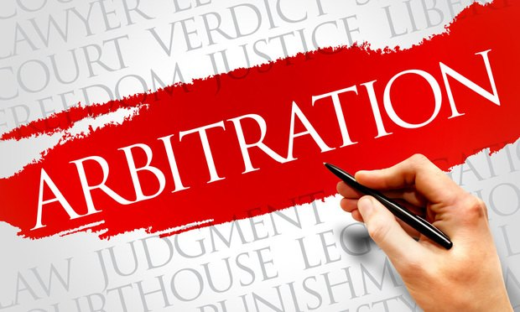
Bargaining Process and Good Faith
Step 5 – Arbitration
Lodge must initiate within 14 days of receipt of written answer
Permanent panel of 6 arbitrators – parties select one
Arbitrator shall have no authority to add to, detract from, modify, or otherwise change any of the terms or provisions of the CBA
The arbitrator shall render in writing his/her findings as quickly as possible within 30 calendar days after the close of the hearing or the receipt of post hearing briefs, whichever is later

Slide 36
Bargaining Process and Good Faith
Duration of Contract – Article 38
Retroactivity provision
Ratification by Lodge membership and approval of City Council
Follow dispute settlement procedure in R.C. Chapter 4117

Slide 37
Bargaining Process and Good Faith
Mid-term bargaining: City must notify Lodge of any proposed changes not specifically addressed in contract
Lodge has 10 calendar days to demand effects bargaining in writing
Good faith bargaining for 30-45 days
Mediation for 30 days or until resolution is reached or impasse declared, whichever occurs first
City may implement its last offer or maintain status quo and submit unresolved issues to arbitration
Arbitrator’s award incorporated into contract

Slide 38
Status of Current FOP Bargaining
Contract expired December 8, 2017
Bargaining started September 2017
22 sessions before impasse reached
30+ unresolved issues
5 days of hearing before Fact-Finder Goldberg
Report and Recommendation expected November 27

Slide 39
Questions

