Slide 1
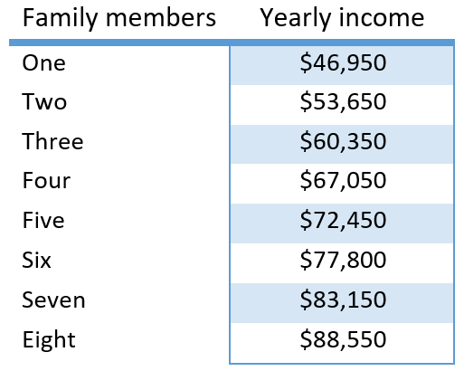
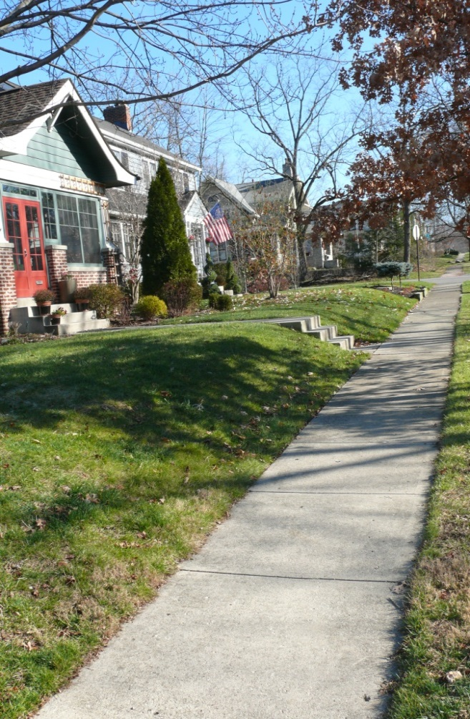
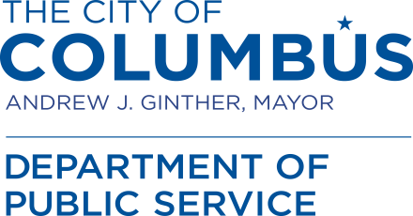
Income eligibility requirements for the sidewalk rescue grant:
Business owners in NCR Districts do not have income requirements that limit participation in the program.
Eligible residential properties must have a total household income of 80% or less of the area median income (AMI) as determined by the United States Department of Housing and Urban Development (HUD), with adjustments for household size.
Total residential household income includes the income of all people 18 years of age and older living in the home at least 50% of the year. The HUD AMI is calculated annually.
As of March 22, 2020, the HUD AMI eligibility limits are:
As of the publishing of this pamphlet, HUD had not released the updated 2021 AMI figures. These numbers are likely to increase. It is suggested you submit an application even if your income is slightly above the limits shown in this chart.
City of Columbus
Steps to completing a Sidewalk Rescue Grant repair:
1 Obtain a Sidewalk Rescue Grant application form by downloading it from the Public Service website or contact 311 and request a copy by mail. If a Notice to Repair was received, an application was included in that packet.
2 Complete the application and submit it to the Department of Public Service along with the required income verification.
3 Public Service will verify eligibility and inform the property owner of the results by mail.
4 If approved, the location will be added to the next available repair contract performed by the City. If the property owner elects to make repairs or hire their own contractor then an inspection request should be submitted to the contact included in the approval notice. An inspection will then be performed and the property owner will be informed of the results.
5 Repairs are performed by the City or the property owner.
6 The City applies the grant award to the cost of the repairs made by the City contractor OR the property owner submits receipts/invoices for repairs they completed and a re-imbursement will be issued.
7 If applicable, the property owner pays any remaining balance or the City pays the remaining balance and submits a property tax assessment against the property.
2021 Sidewalk Rescue Program
Sidewalk Repair Grant Program
(Details of eligibility inside)
A Partnership between
Mayor Andrew J. Ginther
and
Columbus City Council

Slide 2
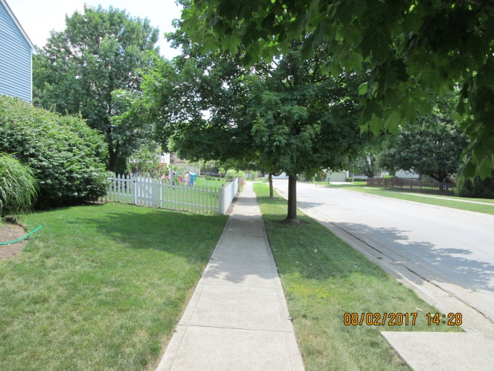
Sidewalk Rescue Program
Program purpose: To make funds available to low income residential property owners and Neighborhood Commercial Revitalization (NCR) district business owners to help them pay for sidewalk/drive approach repairs within the right-of-way.
Amount of the grant:
A maximum of $2,500, or the amount of the approved repairs, whichever is less.
Grants are dependent on the availability of funds.
Property owners will be responsible for payment of any repair charges in excess of the grant award. Unpaid balances can be assessed against the property as a property tax lien.
The City is required to report any funds distributed under the Sidewalk Rescue Program to the IRS as taxable income for the property owner. Anyone eligible for Sidewalk Rescue funds will be required to complete a Form W9 before receiving any grant funds.
Items eligible for repair:
Only existing noncompliant or damaged sidewalk, drive approach, or drive approach curb within the right of way will be approved for repair by the Sidewalk Rescue Grant, the criteria for noncompliant walk can be found in City code section 905.11.
City street-tree root damaged concrete is not eligible for repair under this program. Please report City street-tree related sidewalk damage to the 311 call center for future repair.
How to apply for a grant:
Download the application from the Department of Public Service website (www.columbus.gov/publicservice/Sidewalk-Repair-Grant-Program/) or contact 311 to request an application be sent to you by calling (614)645-3111 or by email at 311@Columbus.gov.
Mail completed applications to:
Department of Public Service Division of Infrastructure Management
Sidewalk Rescue Program
111 N. Front Street, 5th Floor Columbus, OH 43215-9005
Please DO NOT submit an application or any personal documentation by email or other electronic means.
Repair schedule:
Approved grant locations will be added to the next available sidewalk repair contract.
Upon request, a property owner can be approved to schedule repairs using their own labor and material or by hiring a private contractor. An inspection performed by Infrastructure Management and a 905 permit are required prior to beginning any repair.
Property owners that opt to make their own repairs will need to submit receipts for all expenses for which they are claiming grant reimbursement or an itemized invoice from their contractor for work completed.
Questions or concerns?
Please submit further questions or concerns to the 311 call center by calling (614)645-3111 or by email at 311@Columbus.gov.
Eligibility Requirements
The property owner must meet both income and property requirements, which are explained below and in the next section.
Properties eligible for the sidewalk rescue grant:
Eligible properties are residential single-family owner-occupied properties located within the City of Columbus corporation limits or businesses located within one of the City’s Neighborhood Commercial Revitalization (NCR) districts. The business must be the owner of the property.
The applicant must have owned and occupied the property for at least 12 months prior to the time of the grant application.
Property taxes must be current at the time of the grant application or the owner must be on a verifiable payment plan with the Franklin County Auditor's Office.
Property owners must not be delinquent on taxes or other money owed to the City of Columbus.
Residential applicants must be able to provide income verification.

