Slide 1
Instructions
Open the file in Powerpoint
Go to Slide 2
Click on slide show mode
Click through the steps using the space bar or mouse as you would a presentation

Slide 2
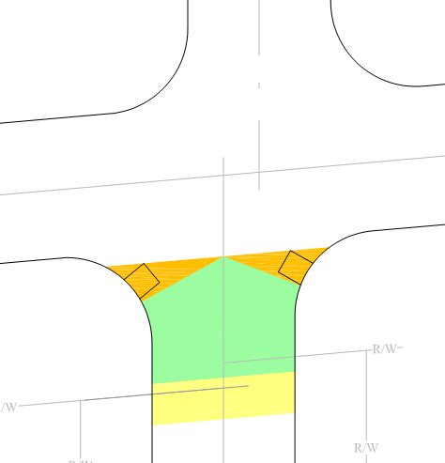
Intersection Design
2. Either the Maximum Safe Crossing Limit (Line A) or the back of the legal crosswalk (Line B)-whichever is the closest to the intersection.
Step 6-Intersect crown of roadway at 2 ft setback (Lines C1 & C2)
Step 1-Define Roadway Projection: Use PC & PT to connect curb lines or extend edge of pavement
Step 7
Establish Design Boundary defined by:
The maximum rotation around the curb radius into the intersection that will allow a level turning area at the flat roadway crown inside the crosswalk and at a safe distance from parallel vehicular traffic. Lines C1 and C2 represent the centerline of the curb ramp, perpendicular to the curb (radius), and
Step 5-Locate Maximum Safe Crossing Limit (Line A)
X=25’ for radius < 20’
Otherwise, X=radius +5’
Step 4-Define legal crosswalk
(Line B) using roadway projection farthest from roadway PLUS 15 ft
Step 2-Establish 2 ft setback parallel to roadway projection
Step 3-Extend each R/W parallel to roadway projection
3. Where obstructions or vehicle sight distance prevent the curb ramps from being located as described in 1 and 2, the ramp may be located closer to the intersection providing a 4’x4’ clear space parallel to the ramp centerline is provided with a 2’ setback from the parallel roadway projection as shown (D)
Step 2
Step 6
2’
Step 1
First area to place ramps
Second area to place ramps
D
Third area to place ramps
D
Line C1
x
Line C2
Step 5
R/W
Line A
R/W
Line B
Step 3
Step 4
Notes:
Show the 2’ and 15’ dimension for offset and ROW

