Slide 1


Operating Budget
Process

Slide 2
City of Columbus Budgeting
City has two annual budget cycles
Operating and Capital
Operating
Funds the daily operations of the City
Staff (personnel), Supplies, and Services
Funded largely through Income Tax, Enterprise Fund revenues, and Property Tax

Slide 3
City of Columbus Budgeting
Capital
Funds infrastructure improvements
Roads, sidewalks, recreation facilities, park improvements, water/sewer infrastructure, etc.
Capital Improvement Program (CIP) 2025-2030
Capital Improvement Budget (CIB) 2025
Funded by Municipal Bonds
Paid by a 25% set-aside from Income Tax (SIT)
Paid by water & sewer utility bills (Enterprise)

Slide 4
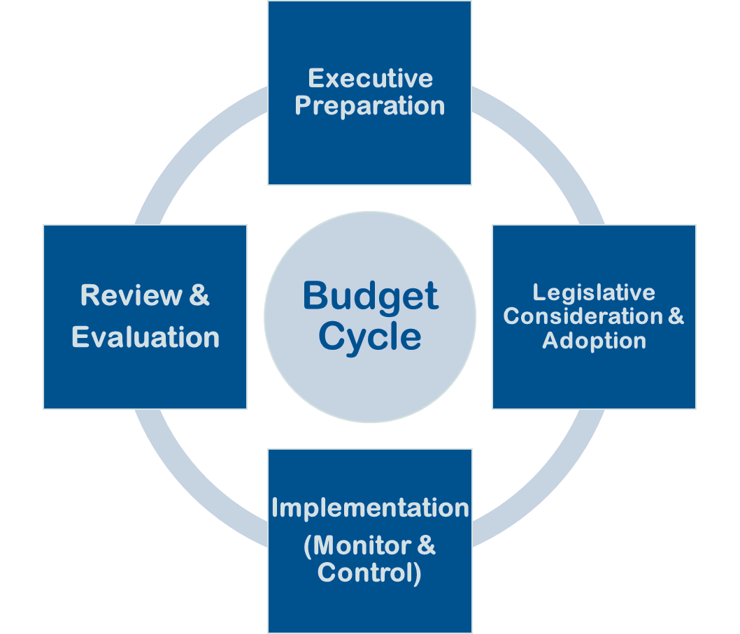
Budget Cycle

Slide 5
Budget Process
Budget Preparation
Revenue Estimate
General Fund Target Allocation
Department Budget Submission & Review
Department Budget Preparation
Technical Review of Submissions
Budget Meetings w/ Department Leadership, Mayor’s Office, Finance
Executive Budget Proposal
Final Decisions by Administration of Reductions and Expansions to Submissions
Budget Proposal Presented on or before November 15th
Legislative Consideration & Adoption
Council Budget Hearings
Council Budget Adoption
Budget Implementation & Control
Quarterly Financial Reviews
Budget Review & Evaluation
Year-End Financial Review
Notes:
TBD

Slide 6
Budget Calendar of Major Activities
May: General Fund (GF) target adjustments and formation processes.
June: GF targets and budget instructions are distributed to city departments.
June-August: Mayor establishes his goals for the upcoming year, and departments under his purview submit departmental strategic priorities and performance measures in alignment with those goals. Separately elected officials submit strategic priorities as well.
August: End of the month, budget submissions are due to the budget office.
September: Budget hearings between departments and Finance and Management (F&M) occur.
October: F&M completes the 3rd quarter financial review, budget meetings with the Office of the Mayor occur, and the City Auditor establishes the official estimate of available resources for the GF.
November: The administration’s formal budget proposal is submitted to Council on or by the 15th.
December: Council holds budget hearings by committee and allows time for public comment.
Jan/Feb: F&M completes year-end financial report, Auditor releases amended estimate based on year-end actuals, and Council amends the proposed budget and adopts it for implementation.

Slide 7
2026 Operating Budget Overview
Notes:
Notes: GF ~ 2.5% growth vs 2025 adopted [was amended up $15.5M June/July ~ 1.2%]
All Funds ~ 5.5% growth vs 2025 adopted
Special Revenue – BZS, Rec/Parks, CPH, SCMRF
Internal Service – DoT, Fleet, Mail/Print

Slide 8
General Fund History

Slide 9
2026 Operating Budget Breakdown

