Slide 1

The Consumer Price Index Commission on Elected Officials’ Compensation March 26, 2026
Bill LaFayette, Ph.D., owner, Regionomics® LLC

Slide 2
Price indices and inflation adjustments
The consumer price index (CPI) is one of several measures of inflation.
Inflation: a process of continuously rising prices and continuously declining value of money.

Slide 3
Price indices and inflation adjustments
The consumer price index (CPI) is one of several measures of inflation.
Inflation: a process of continuously rising prices and continuously declining value of money.
The CPI is based on a pre-defined basket of goods and services.

Slide 4
Deriving a price index
Set price level of a specific basket at base date to a specific value (usually 100)

Slide 5
Deriving a price index
Set price level of a specific basket at base date to a specific value (usually 100)
Price of basket in following months drives index value.
Initial basket value: $1,000
Following month: $1,002
New index value: $1,002 / $1,000 ✕ 100 = 100.2
One year later: $1,050
Index value: $1,050 / $1,000 ✕ 100 = 105.0

Slide 6
Calculating inflation
Percentage change in index between dates:
(CPI₂ – CPI₁) / CPI₁
= CPI₂ / CPI₁ – 1

Slide 7
Calculating inflation
Percentage change in index between dates:
(CPI₂ – CPI₁) / CPI₁
= CPI₂ / CPI₁ – 1
Earlier example:
105.0 / 100.0 – 1 = 0.05 = 5%

Slide 8
Calculating inflation
CPI example:
February 2024: 310.326
February 2025: 319.082
February 2026: 326.785

Slide 9
Calculating inflation
CPI example:
February 2024: 310.326
February 2025: 319.082
February 2026: 326.785
Calculating inflation rate:
February 2024-February 2025:
319.082 / 310.326 – 1 = 2.8%
February 2025-February 2026:
326.785 / 319.082 – 1 = 2.4%

Slide 10
Types of consumer price indices
Type of consumer:
Consumer Price Index for All Urban Consumers (CPI-U).
Consumer Price Index for Urban Wage and Clerical Workers (CPI-W).
The basket weighting reflects purchases of a lower-income household.

Slide 11
Types of consumer price indices
Type of consumer:
Consumer Price Index for All Urban Consumers (CPI-U).
Consumer Price Index for Urban Wage and Clerical Workers (CPI-W).
The basket weighting reflects purchases of a lower-income household.
Breadth of the basket:
All items.
Categories of goods and services (included and excluded).

Slide 12
Types of consumer price indices
Type of consumer:
Consumer Price Index for All Urban Consumers (CPI-U).
Consumer Price Index for Urban Wage and Clerical Workers (CPI-W).
The basket weighting reflects purchases of a lower-income household.
Breadth of the basket:
All items.
Categories of goods and services (included and excluded).
Geographical coverage.

Slide 13
Types of consumer price indices
Type of consumer:
Consumer Price Index for All Urban Consumers (CPI-U).
Consumer Price Index for Urban Wage and Clerical Workers (CPI-W).
The basket weighting reflects purchases of a lower-income household.
Breadth of the basket:
All items.
Categories of goods and services (included and excluded).
Geographical coverage.
Seasonally adjusted and not seasonally adjusted.

Slide 14
Types of consumer price indices
Type of consumer:
Consumer Price Index for All Urban Consumers (CPI-U).
Consumer Price Index for Urban Wage and Clerical Workers (CPI-W).
The basket weighting reflects purchases of a lower-income household.
Breadth of the basket:
All items.
Categories of goods and services (included and excluded).
Geographical coverage.
Seasonally adjusted and not seasonally adjusted.
Chained CPIs.

Slide 15
Problems with the CPI
Market basket based on purchases of ”typical” consumer.
Lots of households aren’t typical.

Slide 16
Problems with the CPI
Market basket based on purchases of ”typical” consumer.
Lots of households aren’t typical.
Changes in item characteristics over time.

Slide 17
Problems with the CPI
Market basket based on purchases of ”typical” consumer.
Lots of households aren’t typical.
Changes in item characteristics over time.
Changes in purchasing patterns.

Slide 18
The chained CPI
The chained CPI responds to changes in relative prices and the introduction of new goods.

Slide 19
The chained CPI
The chained CPI responds to changes in relative prices and the introduction of new goods.
But there are problems.
Chained CPI index values are revised a couple times before they are final – unlike the standard CPI. Do you retroactively revise your cost-of-living adjustment?
Chained CPI inflation rates are generally less than those from the standard CPI.

Slide 20
Which CPI??
Use a seasonally unadjusted index rather than a seasonally adjusted one.
Use seasonally adjusted indices only to compare different calendar months (e.g., inflation from December 2025 to February 2026).
Use an all-items CPI rather than one omitting food and energy.

Slide 21
Which CPI??
Use a seasonally unadjusted index rather than a seasonally adjusted one.
Use seasonally adjusted indices only to compare different calendar months (e.g., inflation from December 2025 to February 2026).
Use an all-items CPI rather than one omitting food and energy.
Chained CPI theoretically better, but you have to deal with its practical problems.

Slide 22
Which CPI??
Use a not seasonally adjusted index rather than a seasonally adjusted one.
Use seasonally adjusted indices only to compare different calendar months (e.g., inflation from December 2025 to February 2026).
Use an all-items CPI rather than one omitting food and energy.
Chained CPI theoretically better, but you have to deal with its practical problems.
Better to use a national index rather than a more volatile regional one.

Slide 23
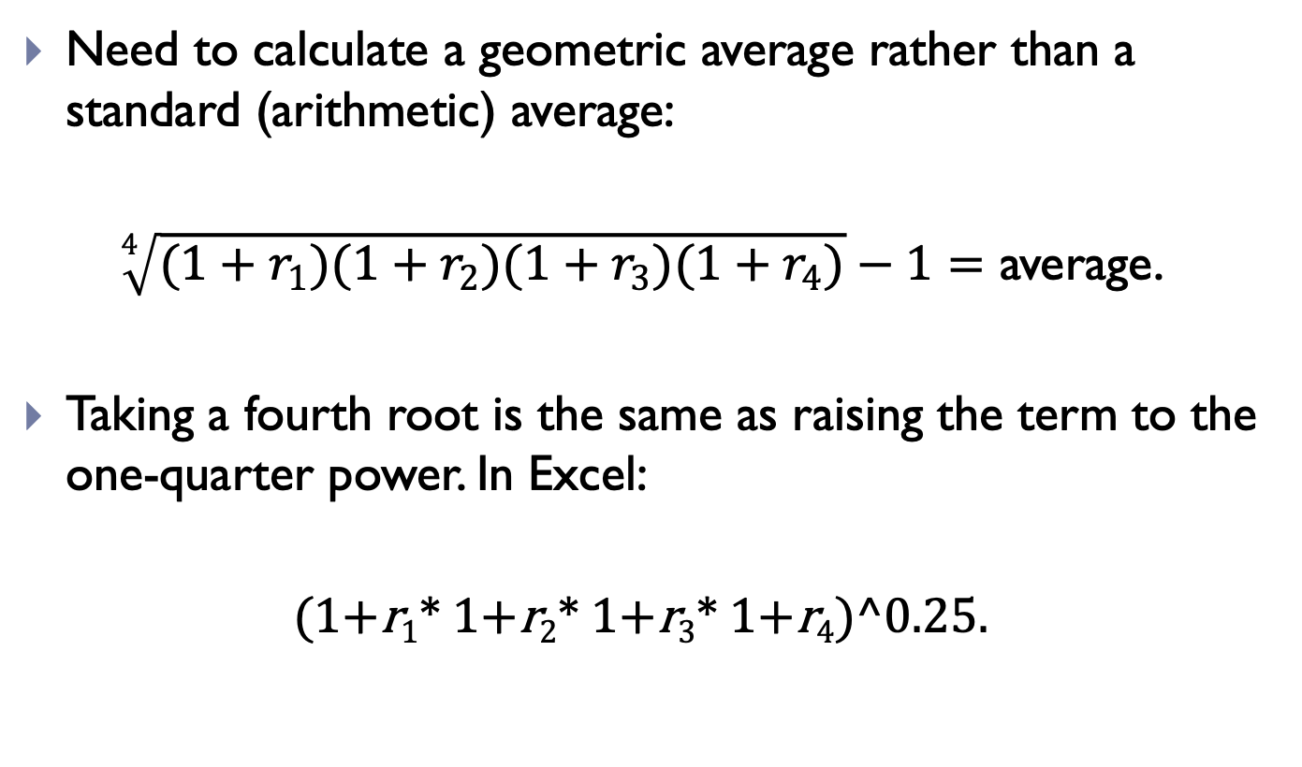
Four-year average inflation
Need to calculate a geometric average rather than a standard (arithmetic) average:
$\sqrt[4]{(1+r_{1})(1+r_{2})(1+r_{3})(1+r_{4})}−1=$ average.
Taking a fourth root is the same as raising the term to the one-quarter power. In Excel:
(1+r₁* 1+r₂* 1+r₃* 1+r₄)^0.25.

Slide 24
Four-year average inflation
Using the U.S. all-items CPI:
Average: (1.0604*1.0315*1.0282*1.0241)^0.25 = 3.426%.
The average using the chained CPI-U is 3.222%.
Year | CPI-U | Inflation
Feb. 2022 | 283.716
Feb. 2023 | 300.840 | 6.04%
Feb. 2024 | 310.326 | 3.15%
Feb. 2025 | 319.082 | 2.82%
Feb. 2026 | 326.785 | 2.41%

Slide 25
So what?
Remember that the four-year average is the maximum annual cost-of-living adjustment.
The average is pulled upward by the 6.0% rate in 2022-23.

Slide 26
So what?
Remember that the four-year average is the maximum annual cost-of-living adjustment.
The average is pulled upward by the 6.0% rate in 2022-23.
Need to think about predicted future inflation over the next four years. From the Congressional Budget Office:
2026: 2.8%.
2027: 2.4%.
2028: 2.3%.
2029: 2.3%.
The geometric average is 2.36%.

Slide 27
So what?
These rates are uncertain, but setting the adjustment at the 3.43% ceiling is probably too high.

Slide 28
So what?
These rates are uncertain, but setting the adjustment at the 3.43% ceiling is probably too high.
A good argument to use 2.36% or the most recent 2.41%.

Slide 29
So what?
These rates are uncertain, but setting the adjustment at the 3.43% ceiling is probably too high.
A good argument to use 2.36% or the most recent 2.41%.
But consider two points:
The prediction is uncertain.
Inflation is initially high, so officials will be losing ground during the first year or two.

Slide 30
So what?
These rates are uncertain, but setting the adjustment at the 3.43% ceiling is probably too high.
A good argument to use 2.36% or the most recent 2.41%.
But consider two points:
The prediction is uncertain.
Inflation is initially higher, so officials will be losing ground during the first year or two.
You also have to compare their salaries and inflation adjustments to those elsewhere.

Slide 31

Thank you!
Bill LaFayette, Ph.D.
(614) 654.2151
www.regionomicsllc.com
www.facebook.com/Regionomics
www.linkedin.com/company/regionomics-llc

