Slide 1



Taking charge of your Anthem benefits
The City of Columbus, L14986
Effective Date: 2/1/2026
Open Enrollment

Slide 2

Agenda
Find Care
Sydney Health Mobile App
Family Advocates
Virtual Care Options
24/7 Nurseline
Building Health Families & WIN Fertility
Hinge Health
Mental Health Resources
Wellbeing Coach Total
Special Offers
Reminders and TOC

Slide 3


Plans at a glance
All plans include:
Access to the nation’s
largest networks of doctors
and hospitals.
Benefits for urgent and
emergency care, wherever
you are.
Convenient access to virtual
care and health plan details
online and from your
mobile device.
Health and wellness tools
that support your well-being
and help you reach your
health goals.
Coverage for preventive
care, including regular
checkups, screenings,
and shots.
3

Slide 4
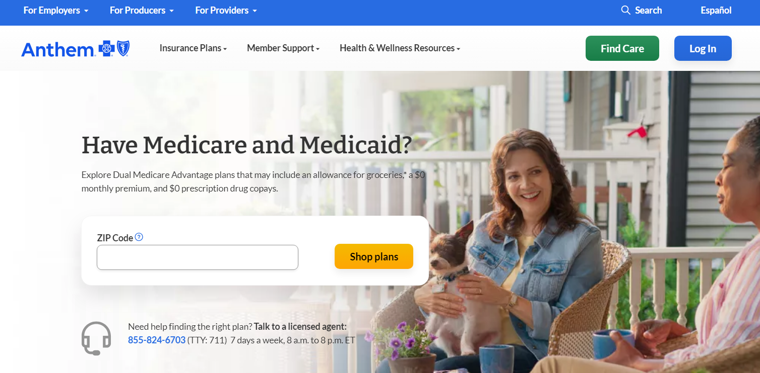

Use the Find Care tool at anthem.com to find the care you need
Quick link: National PPO (BlueCard PPO)
General search
Go to anthem.com and select Find Care on the top-right corner.

Slide 5
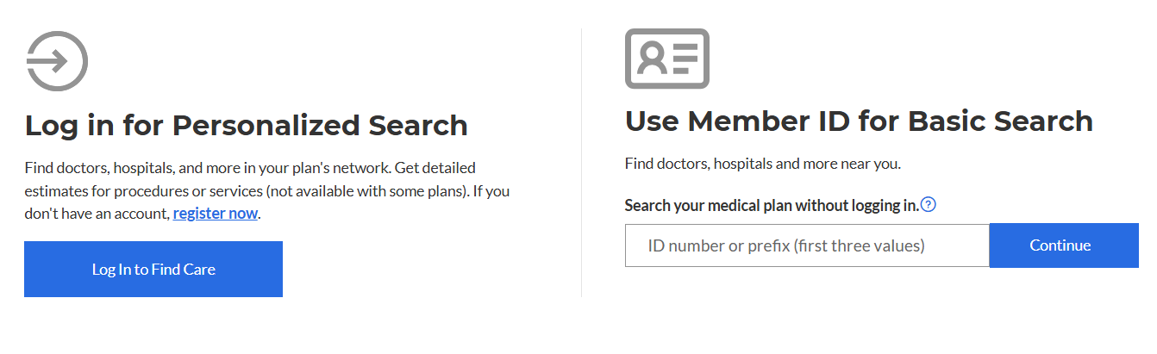
Use the Find Care tool at anthem.com to find the care you need
There are two ways to search for a doctor.
1. Select Log in for Personalized Search and log in with your email address or username and password. You will be directed to your network of providers.
2. Under Use Member ID for Basic Search, enter your member ID or 3-letter prefix and you will be directed to your network of providers without logging in.
Group Prefix: C6C

Slide 6
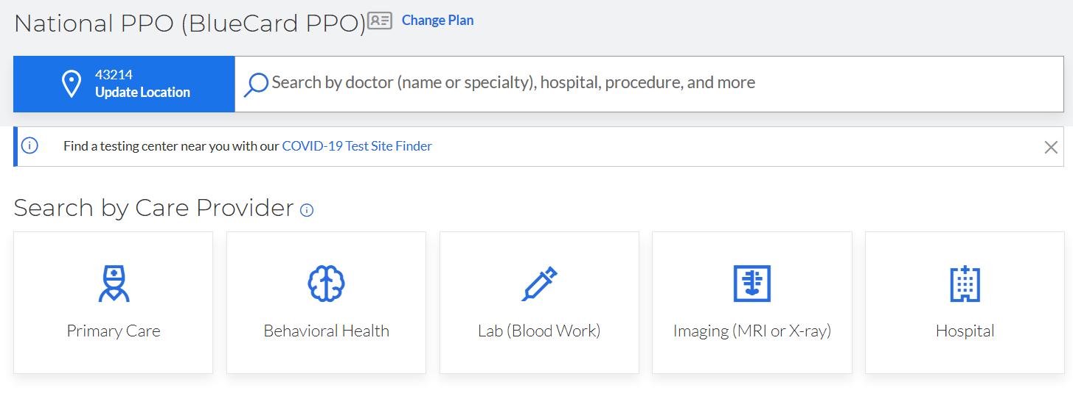
Use the Find Care tool at anthem.com to find the care you need
Next, enter your city, county, or ZIP code.
Enter the name or specialty, national provider identifier (NPI), or license number of a care provider.
You also can select the Search by Care Provider boxes listed in blue for frequently searched care options

Slide 7


Register with us!
Register on the Sydney Health app or through our website at anthem.com/register.
Have your plan ID card ready to get started.
Download the app and select Register new account or go to anthem.com/register.
Select your identification type (this is your member ID).
Enter your plan ID number, full name, and date of birth.
Follow the one-time security prompt and create a username and password.
You’ll use the same login information when you log in to either the app or website.
Review your information to complete your registration.

Slide 8
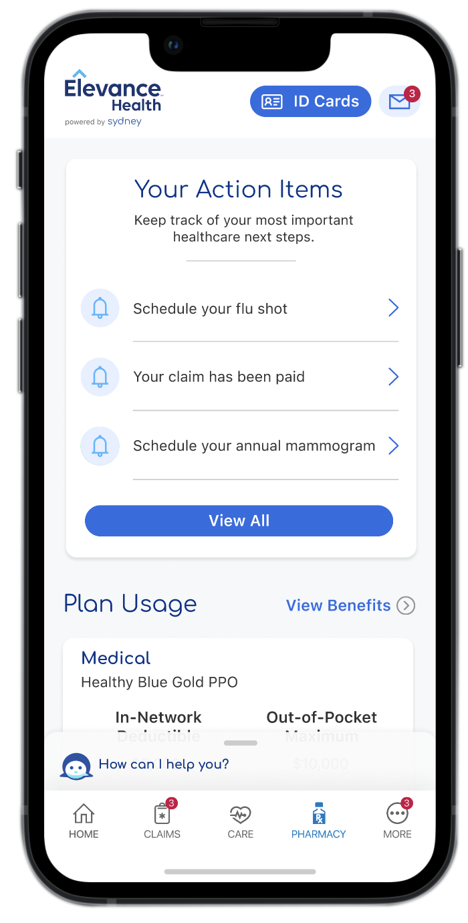
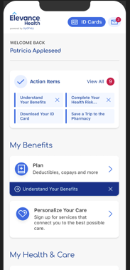
Sydney Health mobile app
Makes healthcare easier
Sydney Health helps you keep track of your health and benefits all in one place. You can use the app to:
Find care and compare costs.
Learn what’s covered and check claims.
View and use your digital ID cards.
Check your plan usage.
Single sign on to CVS.
Chat with Family Advocate if you
have questions or need information.
Access Virtual Care to talk with a doctor via a video session.
Use My Health Dashboard to find wellness tips and programs.
Connect with Community
Resources to find no-cost and
reduced-cost programs.
Simplify your family’s health data
with My Health Record to access
and share health information in
one place.
8

Slide 9












Total Health Connections with Dedicated Family Advocates
With Total Health Connections, you have access to a dedicated Family Advocate to help you and your family with everyday health needs and unexpected emergencies. As your personal health champion, they stay one step ahead, helping you get the care and support you need now and down the road.
To connect to your Family Advocate, download the Sydney Health app or call the Member Service phone number on the back of your health plan ID card.
Clinical Advocates, such as registered nurses, work with your doctor to create personalized care plans for you, as needed.
Total Health Connections Member Video
Community
resources
Wellness and
prevention
Benefit
ecosystem
Behavioral
health
Family support
Provider
coordination
Social
needs
Member
Guidance
and navigation
Clinical
Advocate
Digital
front door
Clinical care
Financial health

Slide 10

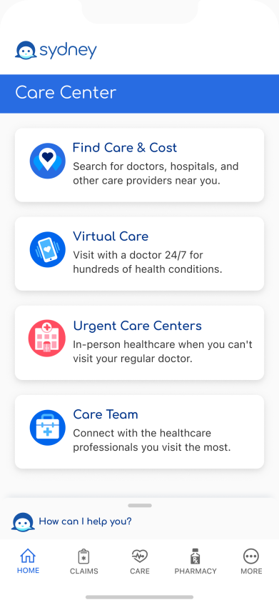
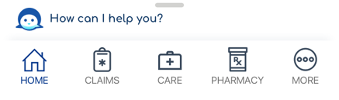

Sydney Health app: one spot for comprehensive virtual care
Accessible through the Sydney Health app, the Care Center connects employees to:
Primary care
Expanded video access to primary care 7 days a week with an appointment²
The ability to schedule care with the same provider on
an ongoing basis
Behavioral health
Integrated behavioral health and data sharing between virtual primary care (VPC) and mental health providers to support whole-person health
Referrals
Labs and imaging
Urgent care
Available 24/7/365 with
no appointment needed
Reminders for checkups, tests, and exams
Wellness visits
Condition management
Annual preventive care (wellness) visits by video for employees ages 18 to 64^{2,3}
Ongoing care for chronic conditions like diabetes and hypertension, coordinated by
a care team

Slide 11

24/7 NurseLine
Support anytime, day or night
Connect with a registered nurse who can:
Answer health questions.
Help you decide where to go for care.
Find doctors or other care healthcare professionals
near you.
11

Slide 12


Building Healthy Families
Extensive content library covering topics
to support diverse families — including
single parents and same-sex or multicultural
couples — on the path to parenthood.
Screenings, tools, and trackers — for preconception, fertility, pregnancy, and
early childhood.
Available 24/7 through our Sydney Health app.
12

Slide 13




WIN Fertility
Fertility benefits
On-boarding with customer service
Diagnosis-specific case management
24/7 access to Nurse Care Managers
Referrals to experienced, in-network reproductive endocrinologists
Treatment plan coordination
Support for all members based on their unique needs
13

Slide 14


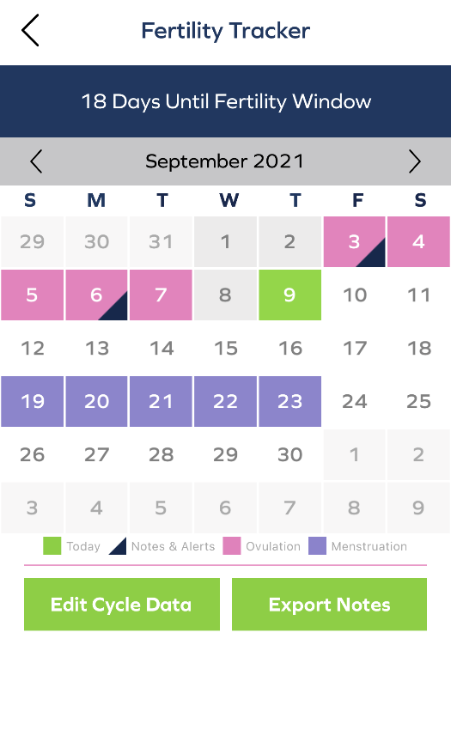
Support when and where you need it, 24/7
The WIN mobile app lets members:
Communicate with a WIN Nurse
Care Manager by phone, video,
email, or mobile messaging.
Privately track multiple
fertility-related activities.
Set calendar reminders for
appointments, medications,
and other medical events.
Receive discreet alerts,
like when ovulation starts.

Slide 15

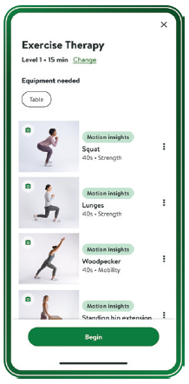

Hinge Health is the leading digital musculoskeletal clinic.
Reduce pain!
Includes:
A dedicated care team
Customized and guided exercises with motion tracking for real-time feedback
Enso is a non-addictive, and non-invasive small, lightweight device that helps members with pain get needed relief.
Women’s pelvic floor therapy
Hinge Health Overview

Slide 16


Mental Health Resources
Low acuity
24/7 Dedicated Substance Use Disorder Inbound Support team
Online Knowledge Hub
Suicide prevention and intervention
Emerging risk care coordination
Emotional Wellbeing Resource
Case Management programs
        Child and adolescent
        Eating disorder
        Autism spectrum disorder
        Complex care
        Post-discharge planning
Self-paced support
Emotional
Well-being Resources
Digital resources
Moderate acuity
Chat support
Behavioral Health
In-person
and virtual care
Inpatient, substance
use disorder, or hospitalization
High acuity

Slide 17


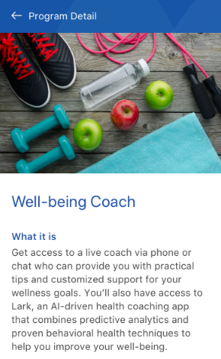
Well-being Coach Total
Live coaching by experienced professionals, featuring:
Weight management and tobacco
cessation support
Telephonic outreach to those identified from claims and health risk assessment (HRA) data
Click-to-chat capabilities during office hours from a computer, Sydney app, or phone
Mobile, AI-driven, virtual coaching for employees of
all risk levels, featuring:
Support for diet and nutrition, exercise, weight loss, tobacco cessation, stress, and sleep
Unlimited 24/7 coaching
Best-in-class technology
Access support through the Sydney app.

Slide 18


SpecialOffers
Get discounts on a variety of programs that help promote health and well-being.
Visit anthem.com and choose Care;
then select Discounts.
Save money on products and services for dental,
vision, hearing, weight loss, fitness, family planning, pet insurance, health supplements, and skincare.
18

Slide 19
Reminders and Transition of Care
Notify your doctors about the change to Anthem and give them your updated ID card.
When you have claims or benefits questions, your Family Advocate should be your first point of contact, and the phone number is on your Anthem ID card.
Anthem will load a prior carrier deductible credit report from UHC so you will get credit for medical expenses you had in January 2026. UHC will send us the report in early or mid- March. Once we receive the report, we will submit it for processing which can take another 30-45 days. We will apply the accums and if anyone is overapplied, we will adjust claims. If members are owed a refund, that will come from their providers.
Certain services require Precertification. Typically, in-network providers know which services need Precertification and will get it when needed. Please contact us at the member service telephone number on the back of your ID card to determine if a Prior Authorization or a Precertification is required.
  Note: There could be some underlying medical policy differences between any two carriers on what is considered medically necessary or not.
  When transition of care files are received, Anthem will load and honor open authorizations from UHC which eliminates member abrasion.
  Transition of Care Self-Referral Form: In cases where a member is being treated for a complex medical condition by an out-of-network provider, this form can be submitted to request that Anthem consider the provider’s claims as in-network.

Slide 20
Questions?
Phone lines are open now for general questions about your medical benefits.
Call: 855-350-1290

Slide 21
Thank you

