Slide 1
Private Hydrant Maintenance

Slide 2
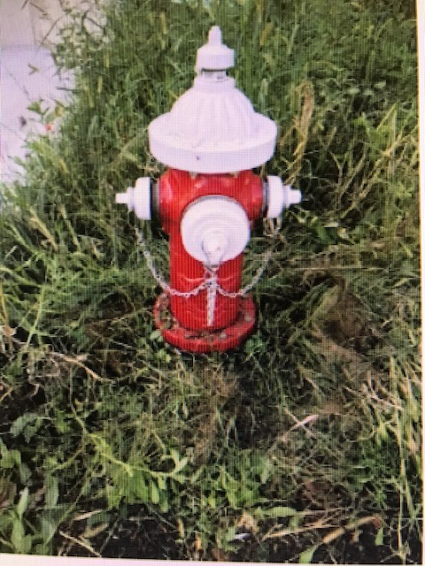
Private Hydrants

Slide 3
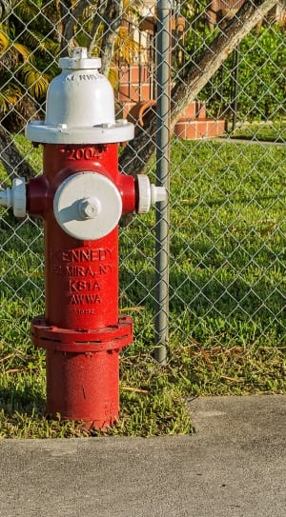
    Government institutions, private plants, apartment complexes and all other occupancies having their own private fire hydrant system, are responsible for maintaining, servicing, pumping, and inspecting such hydrants on a regular basis.
Private Hydrants

Slide 4
Private Hydrants
Regular flushing serves the following purposes:
Enhances long term water quality by removing sediments from inside the mainline and flushing them out through the hydrant.
Identifies malfunctions of the hydrant and related valve issues.
Helps determine weaknesses in the water distribution system.
Identifies inadequate water volumes and pressures in the mainlines.
Helps determine fire flows at the hydrant.
Verifies sufficient flow and pressure is maintained in surrounding areas to support basic service and fire flows.

Slide 5
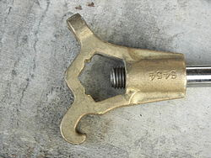
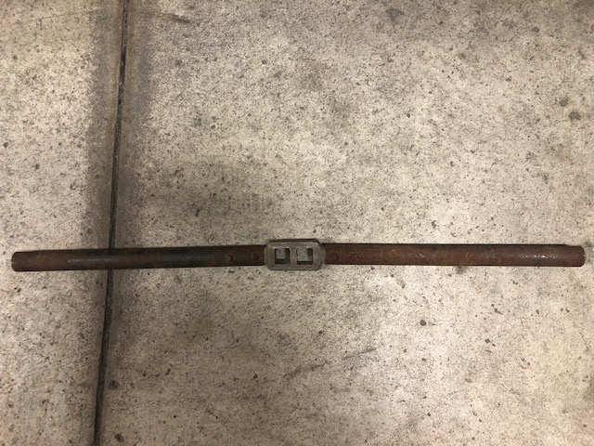
Private Hydrant Flushing
Hydrants should be flushed between April 15 and October 15 of each year.
Do a visual check around the hydrant for: Physical damage or defect, Obstructions on or around the hydrant, Hydrant outlets facing the proper direction, Minimum 12” clearance between outlet and ground, check condition of the paint, ensure outlets are cleaned and lubricated.
Caution always open and close hydrants slowly to avoid water hammer. Water hammer could cause damage to the water piping system.
Use the proper tool to remove the hydrant outlet cap (DO NOT USE A PIPE WRENCH TO OPERATE THE HYDRANT).

Slide 6
Private Hydrant Flushing
Place the proper tool on the operating nut on top of the hydrant and slowly open the valve until water flows approximately 2 to 3 feet out from the hydrant. Allow the water to flow until it runs clear or a minimum of 3 to 5 minutes.
Close the valve stem slowly until the water ceases to flow from the outlet.
If water continues to flow open and close hydrant slowly again. If you still have water flow the hydrant is in need of immediate repair.
Hydrants may be pumped dry at this time but no later than October 15 of each year.
If you feel that you cannot perform the required maintenance, qualified companies can be found in the yellow pages and on the internet.

Slide 7
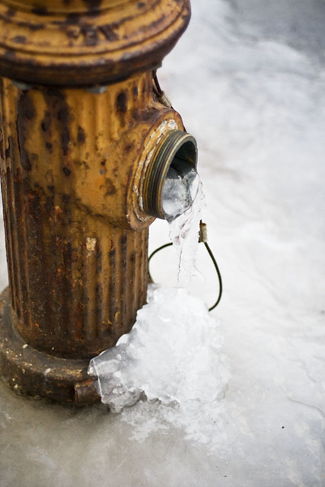
Winter Inspection
Columbus City Code requires private hydrants to be kept free of water above the foot valve between October 15 and April 15 of each year.
Winter inspections should be done every 6 weeks between October 15 and April 15 to insure that all the water has been removed from the barrel of the hydrant and that the valve is not leaking. Water in the barrel of the hydrant could freeze and cause the hydrant not to work.

Slide 8
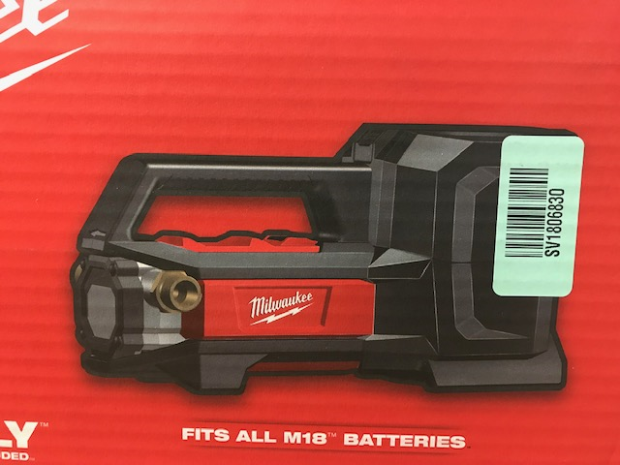
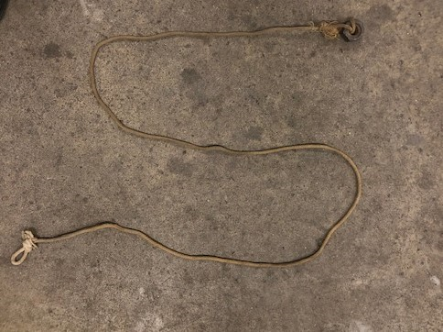
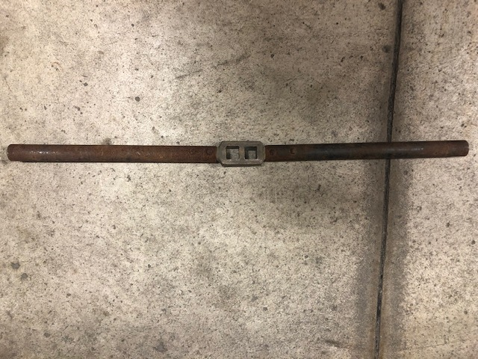
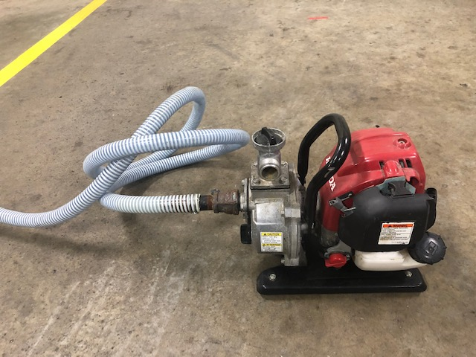
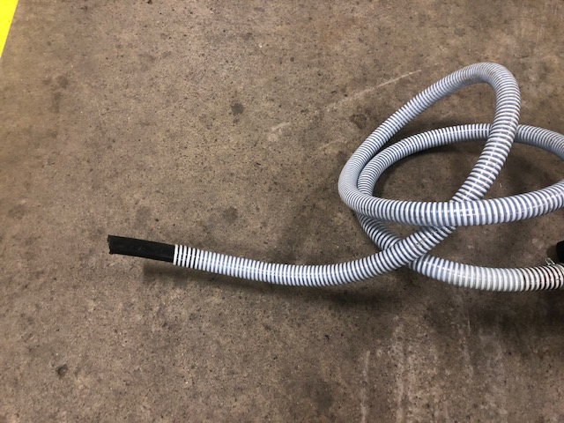
Private Hydrant Pumping Equipment
Hydrant Pump
Sinker Cord
Hydrant Wrench
Hydrant Pump
Suction Hose
Hydrant Wrench

Slide 9
Private Hydrant Pumping
Use a small self-priming pump with approximately 8 feet of garden hose attached for suction.
Remove the hydrant cap and push the suction hose on the pump downward into the hydrant barrel approximately 5 feet.
Turn on pump until all the water is removed from the hydrant barrel.
Pull suction hose out of hydrant barrel.
Hydrant should be checked for residual water in the barrel immediately after pumping and once every 6 weeks between October 15 and April 15.

Slide 10

Private Hydrant Winter Inspection
Winter inspection should be done between October 15 to April 15.
Remove the outlet cap and slowly lower a lightweight rope with a weight on the end into the hydrant barrel approximately 5 feet. Be careful not to let the rope wrap around the hydrant stem or fall into the hydrant.
Slowly remove the rope out of the hydrant, if more than 6 inches of water is showing on the rope, re-pump the hydrant. You may attempt to reopen and close hydrant to reseat the valve. If this does not work the Hydrant is in need of immediate repair.
If pumping of the hydrant was needed it will need to be inspected for water for 3 consecutive days.
Water showing continuously on the rope will indicate the valve is not properly seated and the hydrant is in need of immediate repair.

Slide 11
Private Hydrants Codes
Ohio Fire Code Inspection, testing and maintenance. Fire hydrant systems shall be subject to periodic tests as required by the fire code official. Fire hydrant systems shall be maintained in an operative condition at all times and shall be repaired where defective. Additions, repairs, alterations and servicing shall comply with approved standards. Records of tests and required maintenance shall be maintained.
OFC Obstruction. Unobstructed access to fire hydrants shall be maintained at all times. The fire department shall not be deterred or hindered from gaining immediate access to fire protection equipment or fire hydrants.

Slide 12
Private Hydrants Codes
OFC (e) 507.5.5 Clear space around hydrants. A 3-foot (914 mm) clear space shall be maintained around the circumference of fire hydrants except as other wise required or approved.
OFC (f) 507.5.6 Physical protection. Where fire hydrants are subject to impact by a motor vehicle, guard posts or other approved means shall comply with paragraph (L)(312) of rule 1301:7-7-03of the Administrative Code.

Slide 13
Private Hydrants Codes
Columbus City Code 1115.12 If any activity or Regulated Substance poses a risk to or may have a deleterious effect directly or indirectly upon the public water supply, wellfields or when deemed by the Director to be in the best interest of managing the water utility. Any actions that are legally available such as, administrative remedies or enforcement actions including, but not limited to injunctive relief and penalties.
After October 15 of this year. Firefighters will be checking private hydrants through out the city to ascertain compliance with this code. Failure to comply with the code may subject owner to civil penalties as set forth in Sections 2501.94 and 2501.98, and to criminal penalties in section 2501.99 of the Columbus City Code.

Slide 14
Contact Information
Columbus Fire Prevention Bureau Emergency Services Bureau
3639 Parsons Ave. Hydrant Liaison Office
Columbus, Ohio 43207 3639 Parsons Ave.
Office : 614.645.7641 Columbus, Ohio 43207
Office: 614.645.6422 - opt. 4 firehydrantliaisonoffice@columbus.gov

