Slide 1
School Inspections
Ohio Fire Code (OFC)

Slide 2
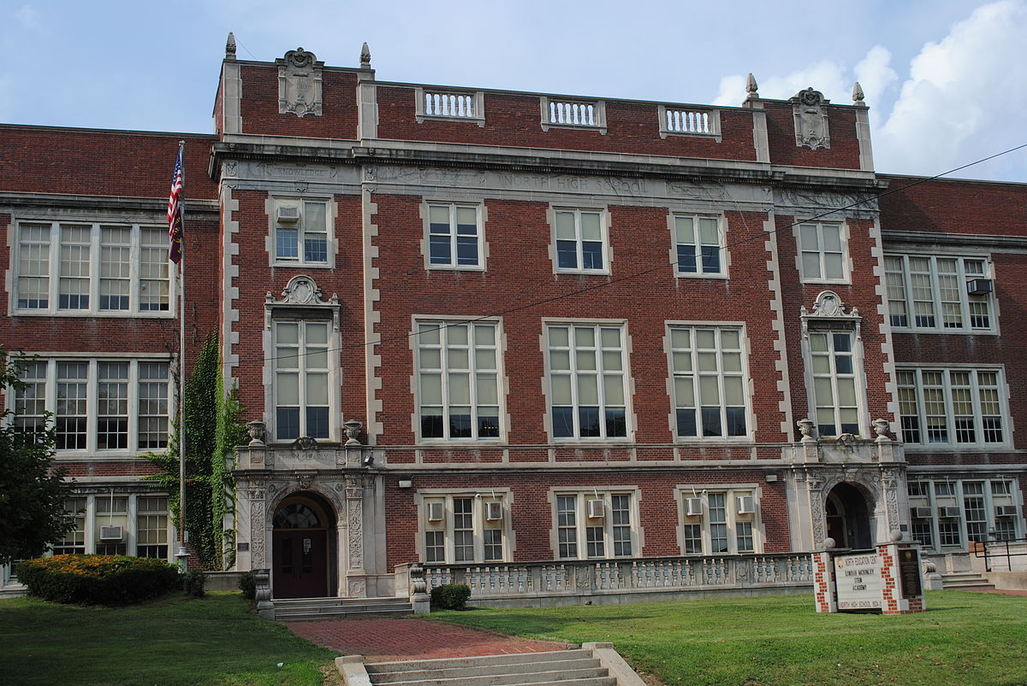
Schools

Slide 3
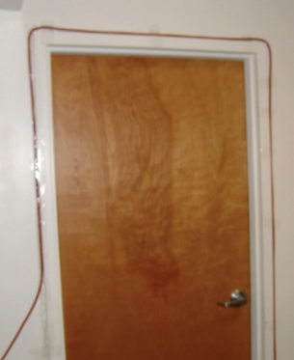
Extension Cords
    Are to be used portable appliances only 605.5.1 OFC
    Are to be plugged directly into an approved receptacle (outlet) 605.5.1 OFC
Shall not be a substitute for permanent wiring 605.5 OFC
Shall not be extended through walls, ceilings, floors, under doors, or floor coverings 605.5 OFC
Shall not be subject to environmental damage or physical impact 605.5 OFC

Slide 4
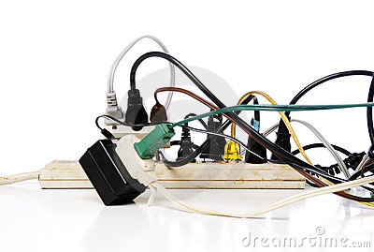
Power Taps ( Strips)
Shall be listed in accordance with UL 1363 605.4.1 OFC
Power strips are to be equipped with overcurrent protection 605.4.1 OFC
Shall be directly connected to a permanently installed receptacle (outlet) 605.4.2 OFC

Slide 5
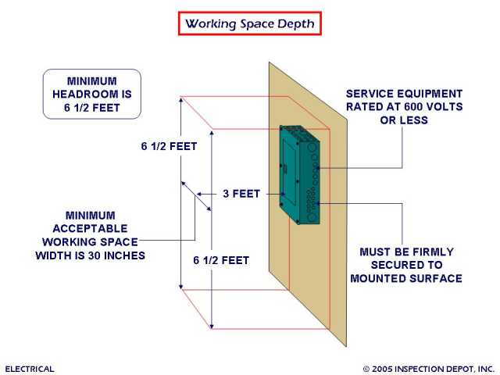
Working Space & Clearance
Working space of no less than 30 inches in with, 36 inches in front, and 78 inches in height shall be provided in front of electrical service equipment 605.3 OFC

Slide 6
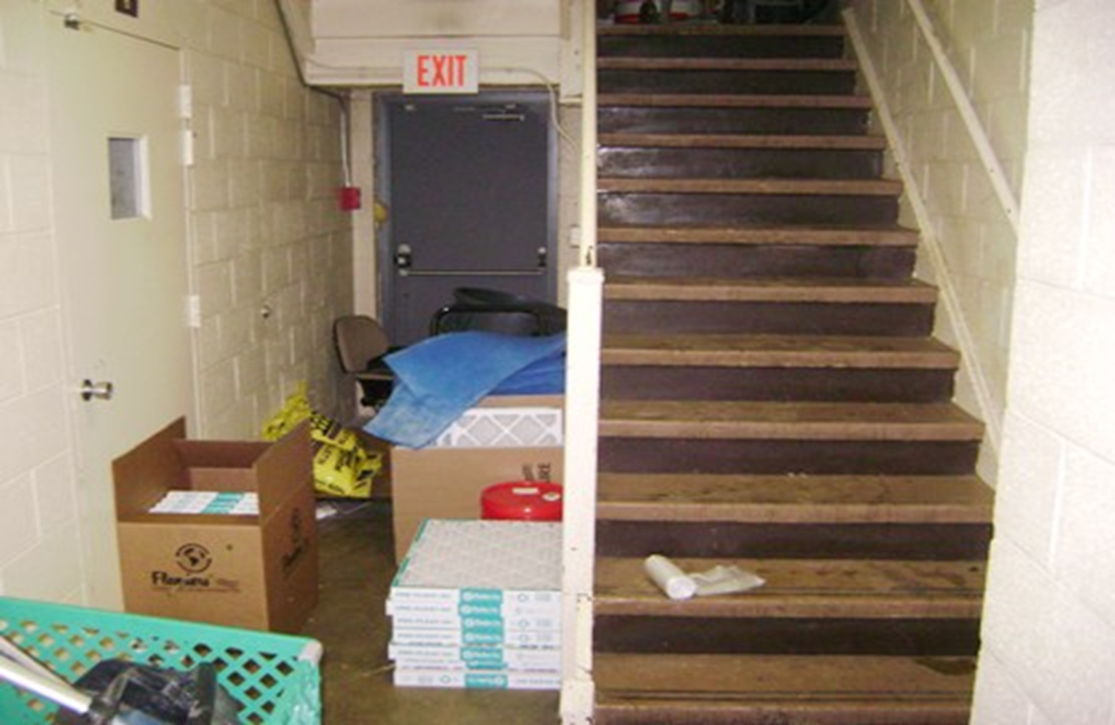
General Storage
315.3.2 OFC Means of egress. Combustible materials shall not be stored in exits or exit
enclosures.

Slide 7
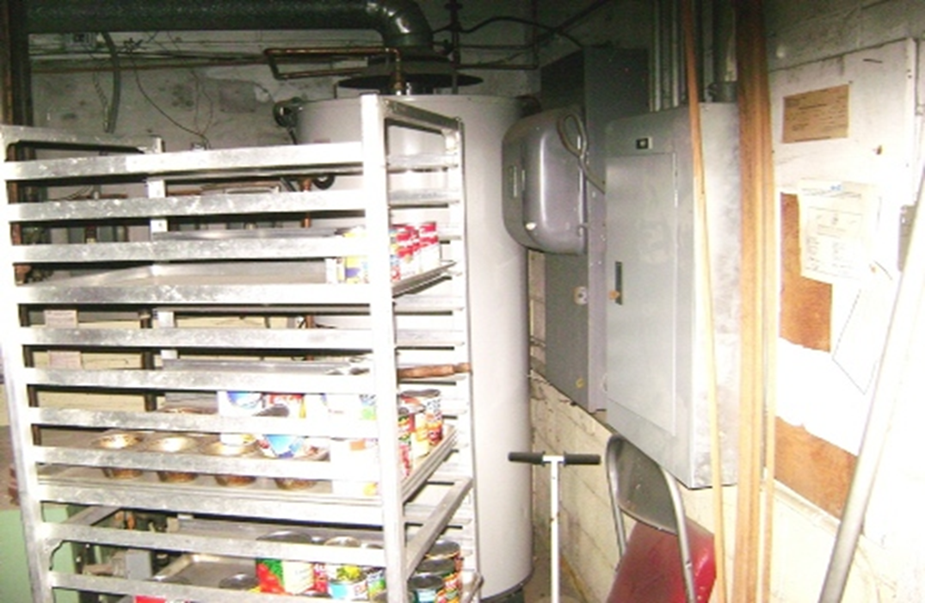
General Storage
315.3.3 OFC Equipment rooms. Combustible material shall not be stored in boiler rooms, mechanical rooms or electrical equipment rooms.

Slide 8
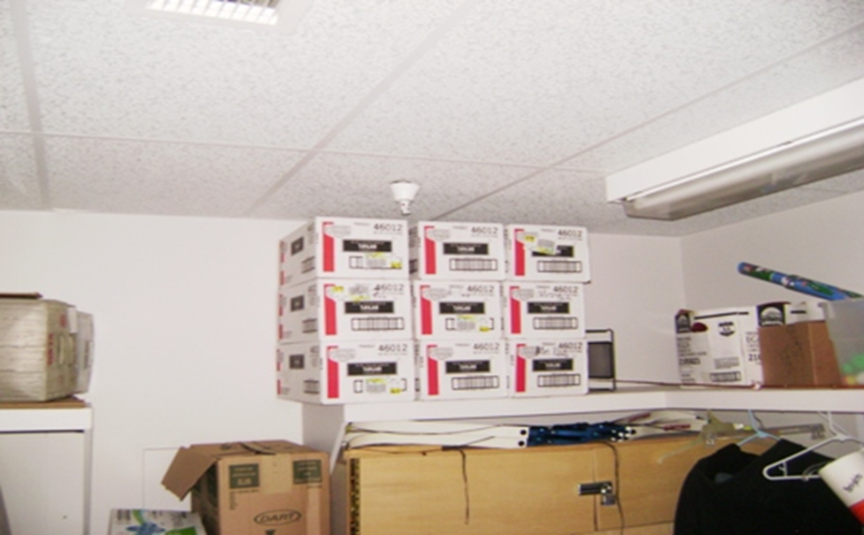
General Storage
315.3.1 OFC Ceiling clearance. Storage shall be maintained 2 feet (610 mm) or more below the ceiling in non-sprinklered areas of buildings or a minimum of 18 inches (457 mm) below sprinkler head deflectors in sprinklered areas of buildings.

Slide 9
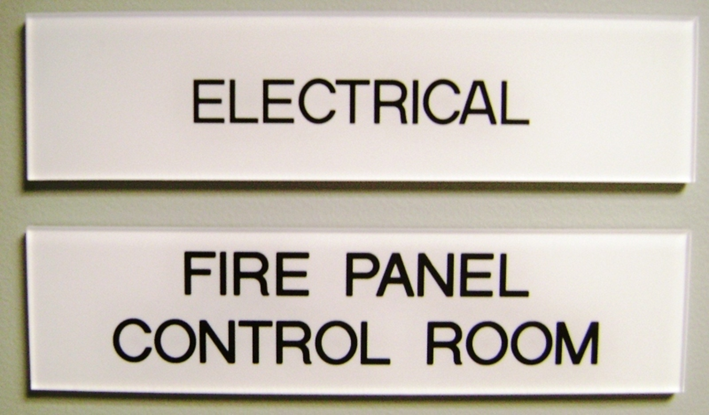
Labeling
605.3.1 OFC Labeling. Doors into electrical control panel rooms shall be marked with a plainly visible and legible sign stating “ELECTRICAL ROOM” or similar approved wording. The disconnecting means for each service, feeder or branch circuit originating on a switch board or panel board shall be legibly and durably marked to indicate its purpose unless such purpose is clearly evident.

Slide 10
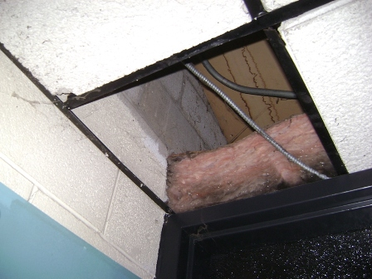
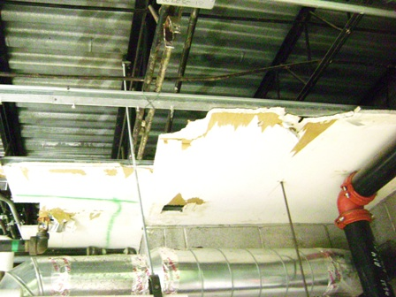
Ceiling Tile
703.1 OFC Maintenance. The required fire-resistance rating of fire-resistance rating of fire-resistance-rated construction including but not limited to, walls, firestops, shaft enclosures, partition, smoke barriers, floors, fire-resistant materials applied to structural members and fire-resistant joint systems shall be maintained.

Slide 11
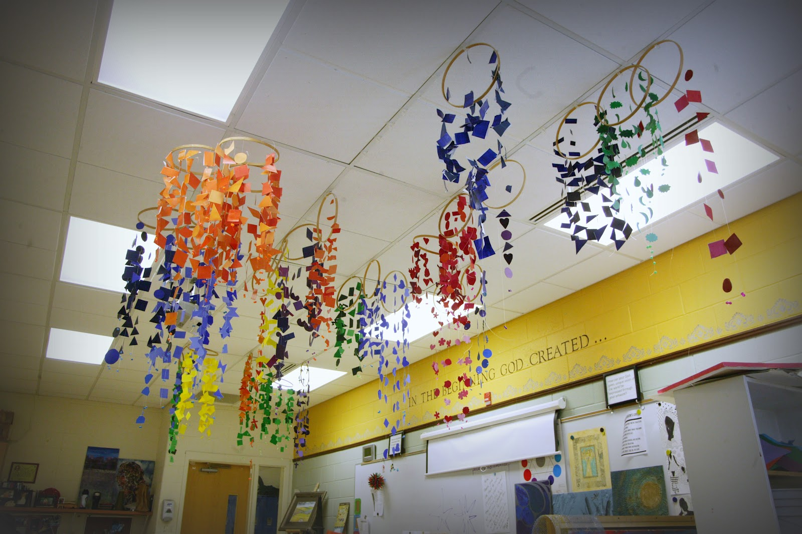
Ceiling Artwork
703.3 OFC Ceilings. The hanging and displaying of salable goods and other decorative materials from acoustical ceiling systems that are part of a fire-resistance-rated horizontal assembly, shall be prohibited

Slide 12

Artwork
(ii) 807.5.2.2 OFC Artwork in corridors. Artwork and teaching materials shall be limited on the walls of corridors to not more than 20 per cent of the wall area.
iii) 807.5.2.3 OFC Artwork in classrooms. Artwork and teaching materials shall be limited on walls of classrooms to not more than 50 per cent of the specific wall area to which they are attached.

Slide 13
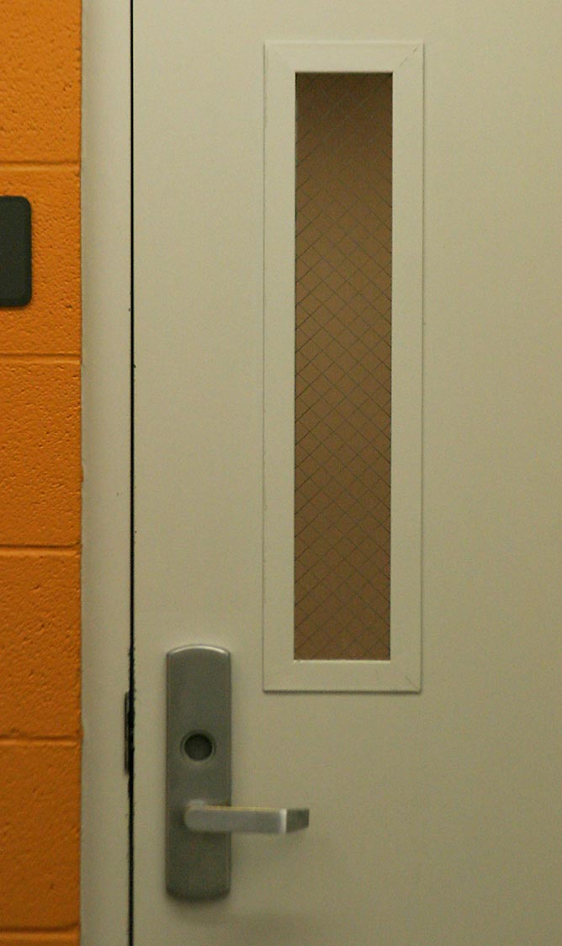
Door Artwork
NFPA 4.1.4.1- The total area of all attached signs shall not exceed 5 percent of the area of the face of the fire door to which they are attached.
NFPA 4.1.4.3- Signs shall not be installed on fire protection rated glazing in fire doors.

Slide 14
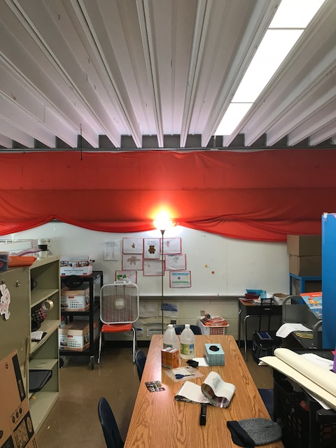
Curtains, Draperies and Fabrics

Slide 15
Curtains, Draperies and Fabrics
807.4 OFC Acceptance criteria and reports. Where required to exhibit improved fire performance, curtains, draperies, fabric hangings and other similar combustible decorative materials suspended from walls or ceilings shall be tested by an approved agency and meet the flame propagation performance criteria of Test Method 1 or Test Method 2, as appropriate, of NFPA 701 as listed in rule 1301:7-7-80 of the Administrative Code, or exhibit a maximum rate of heat release of 100 kW when tested in accordance with NFPA 289 as listed in rule 1301:7-7-80 of the Administrative Code, using the 20 kW ignition source. Reports of test results shall be prepared in accordance with the test method used and furnished to the fire code official upon request.

Slide 16
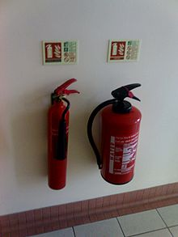
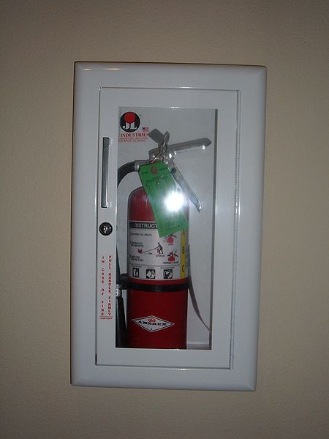
Fire Extinguisher

Slide 17
Fire Extinguishers
906.5 OFC Conspicuous location. Portable fire extinguishers shall be located in conspicuous locations where they will be readily accessible and immediately available for use. These locations shall be along normal paths of travel, unless the fire code official determines and in accordance with the building code as listed in rule 1301:7-7-80 of the Administrative Code that the hazard posed indicates the need for placement away from normal paths of travel.
(6) 906.6 OFC Unobstructed and unobscured. Portable fire extinguishers shall not be obstructed or obscured from view. In rooms or areas in which visual obstruction cannot be completely avoided, means shall be provided to indicate the locations of extinguishers.
(7) 906.7 OFC Hangars and brackets. Hand-held portable fire extinguishers, not housed in cabinets, shall be installed on the hangers or brackets supplied.
(a) 906.9.1 OFC Extinguishers weighing 40 pounds or less. Portable fire extinguishers having a gross weight not exceeding 40 pounds (18 kg) shall be installed so that their tops are not more than 5 feet (1524 mm) above the floor.
(b) 906.9.2 OFC Extinguishers weighing more than 40 pounds.Hand-held portable fire extinguishers having a gross weight exceeding 40 pounds (18 kg) shall be installed so that their tops are not more than 3.5 feet (1067 mm) above the floor.
(c) 906.9.3 OFC Floor clearance.The clearance between the floor and the bottom of installed hand-held portable fire extinguishers shall be not less than 4 inches.

Slide 18
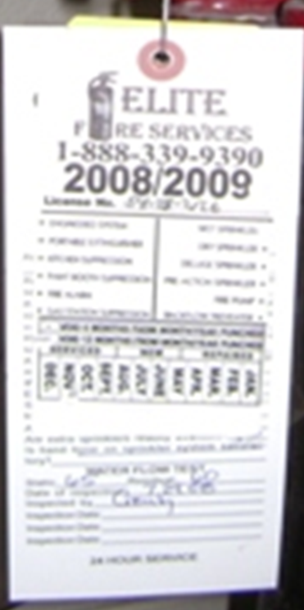
Inspection tags and Records
901.6.2 OFC Records. Records of all system inspections, tests and maintenance required by the referenced standards shall be maintained.

Slide 19
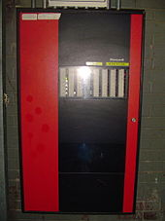
Monitoring
904.4.3 OFC Monitor testing. Connections to protected premises and supervising station fire alarm systems shall be tested to verify proper identification and retransmission of alarms from automatic fire-extinguishing systems.

Slide 20
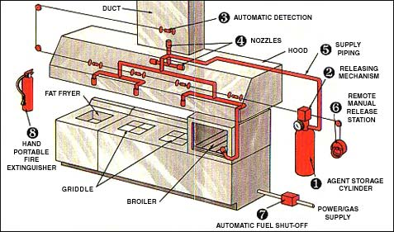
Cooking Systems
904.12 OFC Commercial cooking systems. The automatic fire-extinguishing system for commercial cooking systems shall be of a type recognized for protection of commercial cooking equipment and exhaust systems of the type and arrangement protected. Pre-engineered automatic dry- and wet-chemical extinguishing systems shall be tested in accordance with UL 300 as listed in rule 1301:7-7-80 of the Administrative Code and listed and labeled for the intended application. Other types of automatic fire-extinguishing systems shall be listed and labeled for specific use as protection for commercial cooking operations. The system shall be installed in accordance with this code, its listing and the manufacturer's installation instructions.

Slide 21
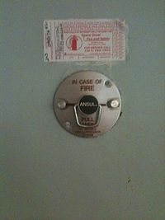
Cooking Systems
(a) 904.12.1 OFC Manual system operation. A manual actuation device shall be located at or near a means of egress from the cooking area not less than 10 feet (3048 mm) and not more than 20 feet (6096 mm) from the kitchen exhaust system. The manual actuation device shall be installed not more than 48 inches (1200 mm) nor less than 42 inches (1067 mm) above the floor and shall clearly identify the hazard protected. The manual actuation shall require a maximum force of 40 pounds (178 N) and a maximum movement of 14 inches (356 mm) to actuate the fire suppression system.

Slide 22
FDC and Standpipe Signs
912.5 OFC Signs. A metal sign with raised letters at least 1 inch (25 mm) in size shall be mounted on all fire department connections serving automatic sprinklers, standpipes or fire pump connections. Such signs shall read: "AUTOMATIC SPRINKLERS" or "STANDPIPES" or "TEST CONNECTION" or a combination thereof as applicable. Where the fire department connection does not serve the entire building, a sign shall be provided indicating the portions of the building served.

Slide 23
FDC and Standpipe Signs
912.2.2 OFC Existing buildings. On existing buildings, wherever the fire department connection is not visible to approaching fire apparatus, the fire department connection shall be indicated by an approved sign mounted on the street front or on the side of the building. Such sign shall have the letters "FDC" not less than 6 inches (152 mm) high and words in letters not less than 2 inches (51 mm) high or an arrow to indicate the location. Such signs shall be subject to the approval of the fire code official.

Slide 24
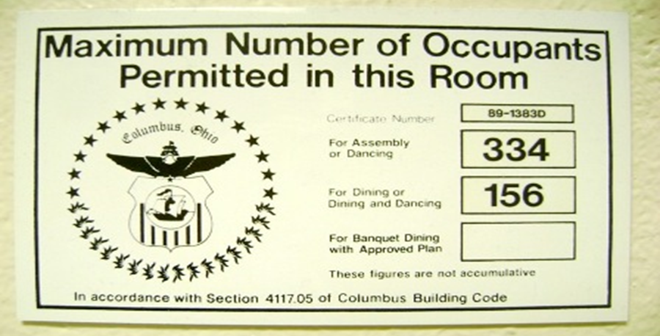
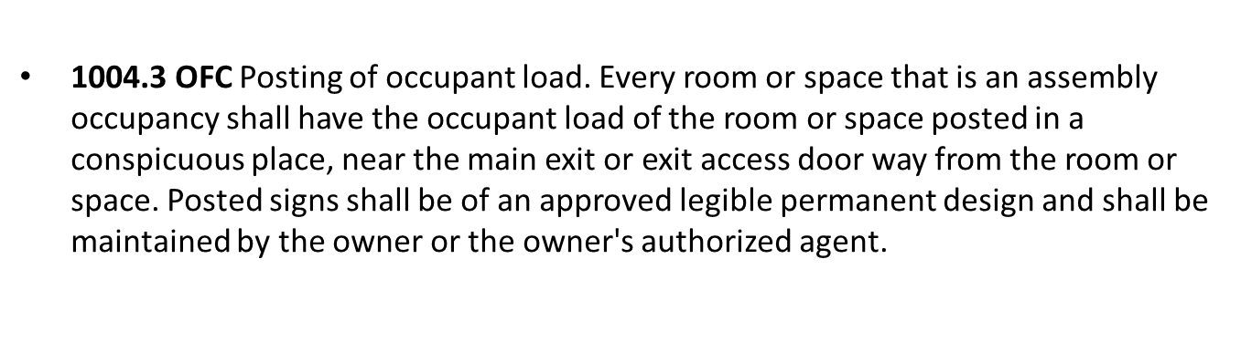
Occupancy Signs

Slide 25
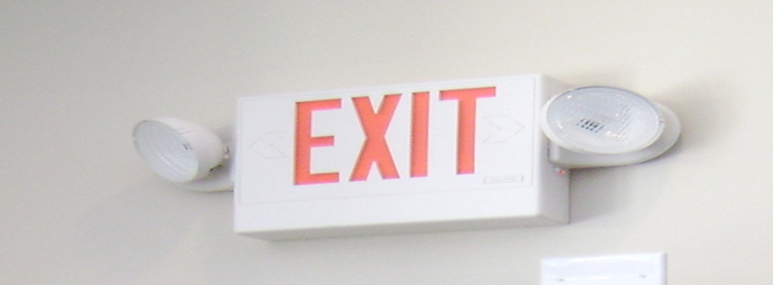
Means of egress illumination
1008.1 OFC Means of egress illumination. Illumination shall be provided in the means of egress in accordance with paragraph (BB)(2)( 1008.2 ) of this rule. Under emergency power, means of egress illumination shall comply with paragraph (H)(3)( 1008.3 ) of this rule.
(2) [BE] 1008.2 OFC Illumination required. The means of egress serving a room or space shall be illuminated at all times that the room or space is occupied.
(3) [BE] 1008.3 OFC Emergency power for illumination. The power supply for means of egress illumination shall normally be provided by the premises' electrical supply.

Slide 26
Means of egress illumination
(a) [BE] 1008.3.1 OFC General. In the event of power supply failure in rooms and spaces that require two or more means of egress an emergency electrical system shall automatically illuminate all of the following areas:
(i) Aisles.
(ii) Corridors.
(iii) Exit access stairways and ramps.
(b) [BE] 1008.3.2 OFC Buildings. In the event of power supply failure, in buildings that require two or more means of egress, an emergency electrical system shall automatically illuminate all of the following areas:
(i) Interior exit access stairways and ramps.
(ii) Interior and exterior exit stairways and ramps.
(iii) Exit passageways.
(iv) Vestibules and areas on the level of discharge used for exit discharge in accordance with paragraph (BB)(1)( 1028.1 ) of this rule.
(v) Exterior landings as required by paragraph (J)(1)(f)(1010.1.6) of this rule for exit doorways that lead directly to the exit discharge.

Slide 27
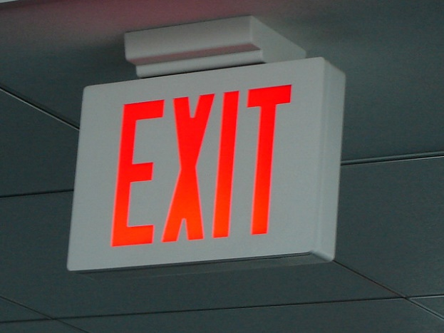
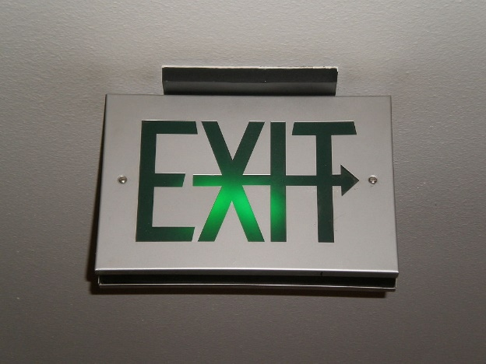
Exit Signs
1013.1 OFC Where required. Exits and exit access doors shall be marked by an approved exit sign readily visible from any direction of egress travel. The path of egress travel to exits and within exits shall be marked by readily visible exit signs to clearly indicate the direction of egress travel in cases where the exit or the path of egress travel is not immediately visible to the occupants. Intervening means of egress doors within exits shall be marked by exit signs. Exit sign placement shall be such that no point in an exit access corridor or exit passageway is more than 100 feet (30 480 mm) .

Slide 28
Emergency lighting equipment
(a) 604.6.1 Activation test. An activation test of the emergency lighting equipment shall be completed monthly. The activation test shall ensure the emergency lighting activates automatically upon normal electrical disconnect and stays sufficiently illuminated for not less than 30seconds.
(i) 604.6.1.1 Activation test record. Records of tests shall be maintained. Person completing the test.
(b) 604.6.2 Power test. For battery-powered emergency lighting, a power test of the emergency lighting equipment shall be completed annually. The power test shall operate the emergency lighting for not less than 90 minutes and shall remain sufficiently illuminated for the duration of the test.

Slide 29
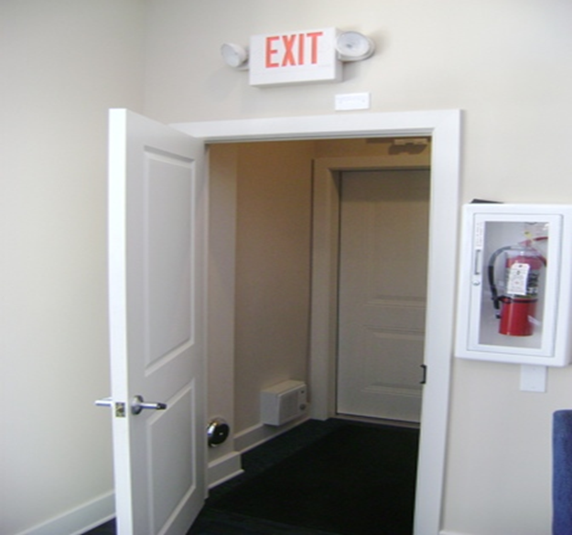
Direction of swing
1010.1.2.1 OFC Direction of swing. Pivot or side-hinged swinging doors shall swing in the direction of egress travel where serving a room or area containing an occupant load of 50 or more persons or a Group H occupancy.

Slide 30
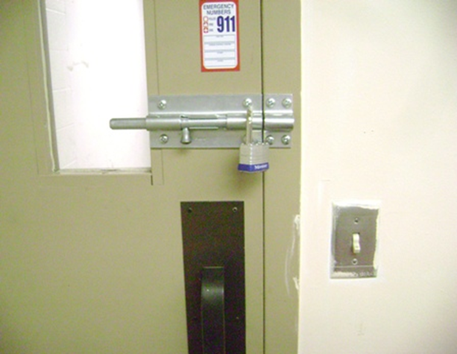
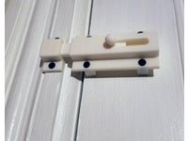
Bolt Locks
1010.1.9.4 OFC Bolt locks. Manually operated flush bolts or surface bolts are not permitted.
1010.1.9.5 OFC Unlatching. The unlatching of any door or leaf shall not require more than one operation.

Slide 31
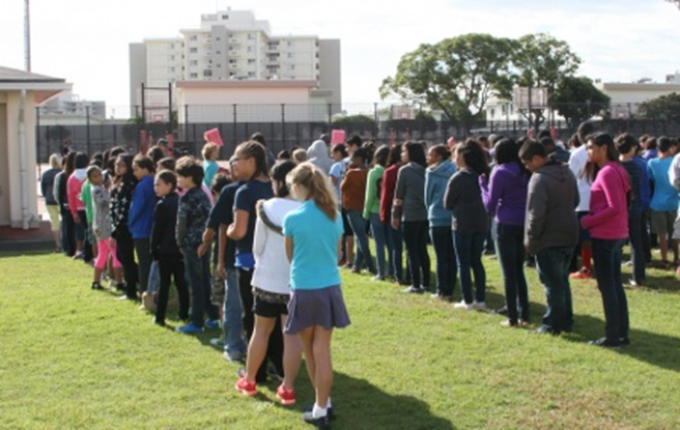
Emergency evacuation drills
405.1 OFC General. Emergency evacuation drills complying with paragraphs (E)(2) (405.2) to (E)(9)(405.9) of this rule shall be conducted not less than annually where fire safety and evacuation plans are required by paragraph (C)(403) of this rule or where required by the fire code official. Drills shall be designed in cooperation with the local authorities.

Slide 32
Emergency evacuation plan

Slide 33
Emergency evacuation drills
(a) 405.1.1 OFC Schools and children's homes. A principal or person in charge of a public or private school or educational institution having an average daily attendance of twenty or more pupils or a person in charge of any children's home or orphanage housing twenty or more minor persons shall instruct and train such children by means of drills or rapid dismissals so that such children in a sudden emergency may leave the building in the shortest possible time without confusion. Such drills or rapid dismissals shall be conducted in accordance with the:
Table 405.2 Fire and evacuation drill frequency and participation
Group or occupancy Frequency Participation
Group E Monthly All Occupants

Slide 34
Fire Drill Checklist
Egress routes free of obstruction
Exit doors are operating properly
Drill preannounced
Doors and windows closed
Evacuation was orderly
Meeting place at safe distance from building
Monitored system
FAO notified by alarm Co.
911 called by school (OFC 401.3.2 Alarm activations. Upon activation of a fire alarm signal, employees or staff shall immediately notify the fire department.)
All personal accounted for

Slide 35
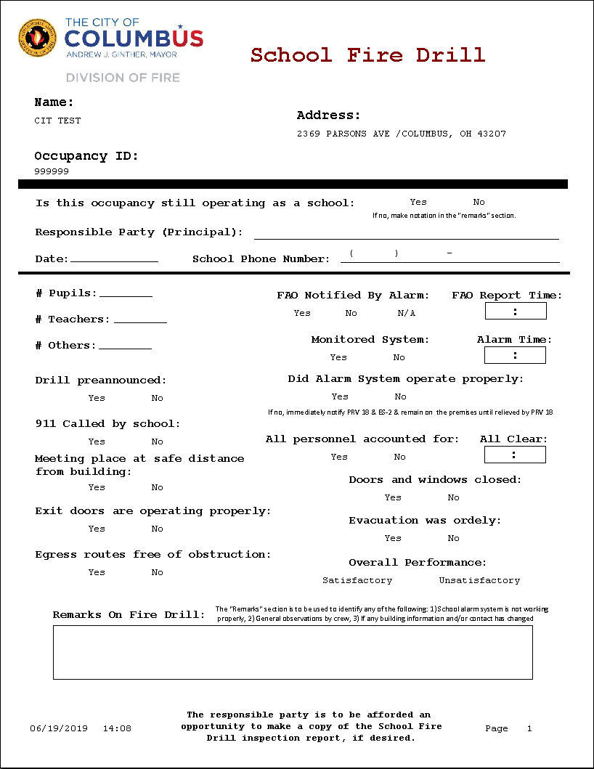
Fire Drill Checklist

Slide 36
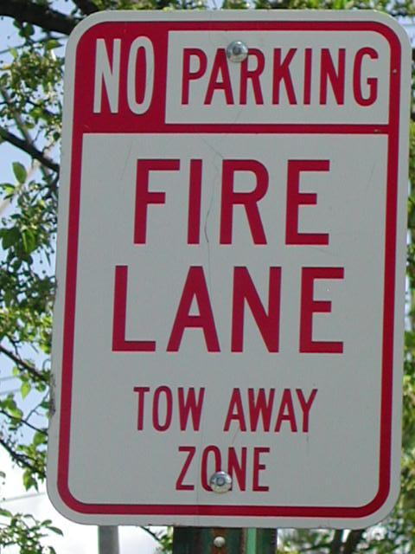
Fire Lanes
503. 1.1 Buildings and facilities. Approved fire apparatus access roads shall be provided for every facility, building or portion of a building hereafter constructed or moved into or within the jurisdiction which are not readily accessible from a public and/or private street. The fire apparatus access road shall comply with the requirements of this paragraph and shall extend to within 150 feet (45 720 mm) of all portions of the facility and all portions of the exterior walls of the first story of the building as measured by an approved route around the exterior of the building or facility.

Slide 37
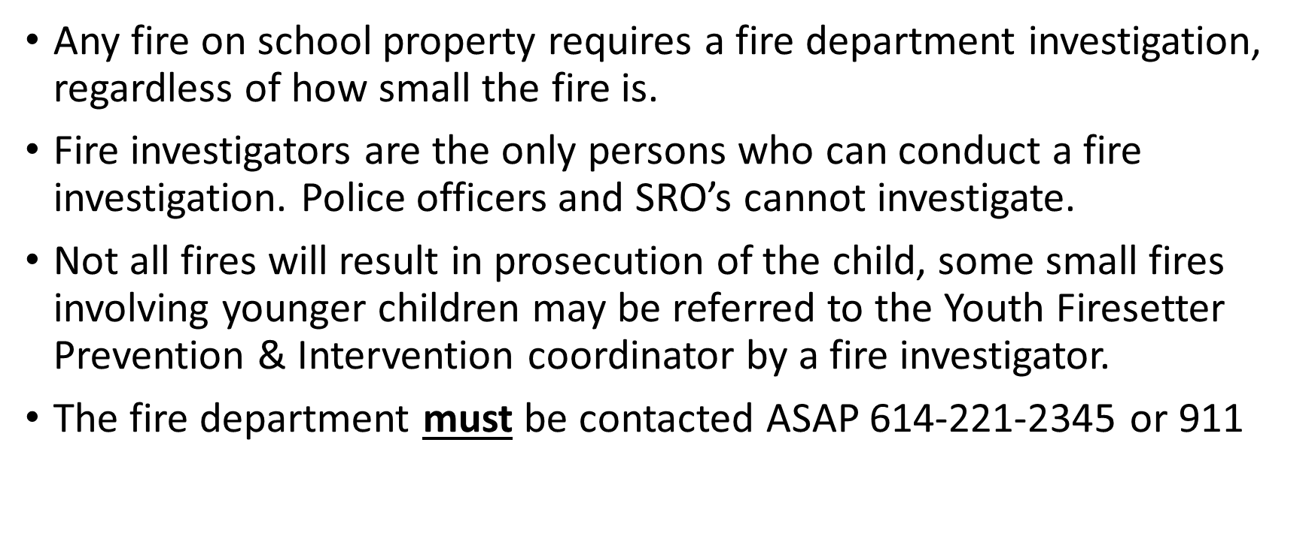
Fire Investigations/Set Fires On School Grounds

Slide 38
Procedure in the event of fire
(1) 117.1 OFC Notification of fires in buildings. In the event of an unfriendly fire in any building regulated by the building code, the responsible person shall, immediately and with all reasonable dispatch and diligence, call or otherwise notify the fire department concerning the fire and shall spread an alarm immediately to all occupants of the building.
(2) 117.2 OFC Notification of fires at a premises. In the event of an unfriendly fire at any premises, the responsible person shall immediately and with all reasonable dispatch and diligence, call or otherwise notify the fire department concerning the fire and shall spread an alarm immediately to all occupants of the premises.
(3) 117.3 OFC Reporting of fires. Unfriendly fires shall be reported to the fire department having jurisdiction.

Slide 39
Youth Firesetter Prevention & Intervention Program
Educating youth about fire safety & consequences of fire-play
Attempting to intervene and modify behaviors of fire-curious youth before a serious injury or fatality occurs by fire.
Can be referred by family, hospital, child & family services, or the juvenile court system; however:
A fire Investigator must be called to interview the child & family and gather significant information in order to enter the youth into the program.
A referral cannot be made to the program without a preliminary investigation by the Columbus Fire & Explosives Investigation Unit.
May be utilized in lieu of filing criminal charges.

Slide 40
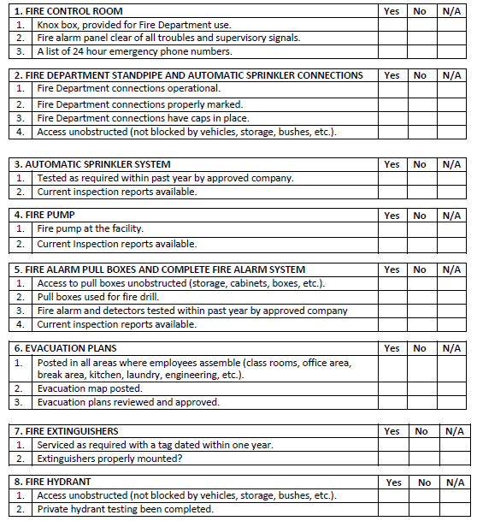
School Self Inspection Checklist

Slide 41
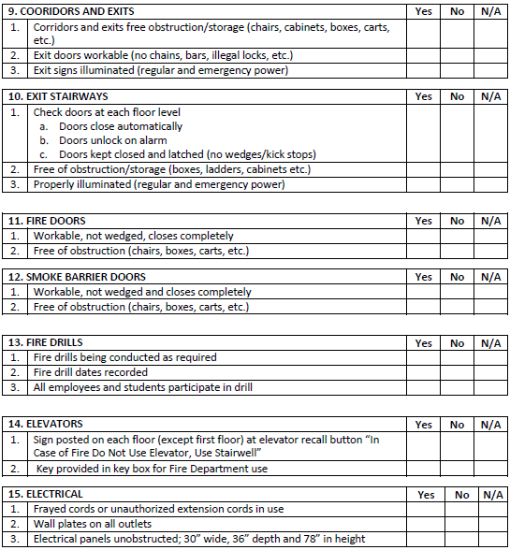
School Self Inspection Checklist

Slide 42
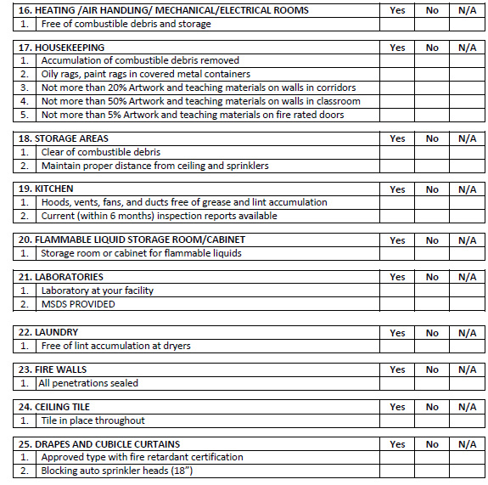
School Self Inspection Checklist

Slide 43
Contacts
FF Terry Mason FF Jeff Harris
Prevention 71 Prevention 72
T (614) 645-6741 Ext: 75671 T (614) 645-6741 Ext: 75672
C (614) 330-3246 C (614) 778-4235
TLMason@Columbus.gov JNHarris@Columbus.gov
CONTACT INFO Columbus Division of Fire
3639 Parsons Ave
Columbus, Ohio 43207
Office : 614.221.3132
https://www.columbus.gov/public-safety/fire/inspections/Institution,-Education-and-Requested-Inspections-Office/

Slide 44

Presenters
Lieutenant Armstrong
Fire Prevention 7
T (614) 645-7641 Ext:75607
bmarmstrong@columbus.gov
Fire Prevention Bureau
3639 Parsons Ave., Columbus, Ohio 43207

