Slide 1
Construction Industry Communication # 45

Slide 2
City of Columbus Department of Building and Zoning Service in an effort to offer more flexibility to contractors has decided to use section 108.8 which allows jurisdictions to implement a contractor self-certification process for required tests.

Slide 3
Using section 108.8 is up to each individual jurisdiction, and the jurisdiction must decide the “what” and “how” to implement the process.

Slide 4
OPC section 312.1.4 specifies the testing media for “all plumbing system piping, fittings and shower liners shall be water”, jurisdictions have to follow what is required.

Slide 5
There is an “exception” listed in 312.1.4, “IF the manufacturer of the pipe, fittings, and solvent cement (if applicable) allows for an alternative testing method”, then the contractor is permitted to do so.

Slide 6
Alternative testing methods listed are:
Compressed Air
Another Compressed Gas
Vacuum
Any other alternative testing method specified by the manufacturer.

Slide 7
If a contractor wants to use an alternative testing method acceptable to the manufacturer, the contractor would need to provide documentation that the manufacturer accepts the testing method and what the acceptable testing parameters are, such as;

Slide 8
Duration of the test
Minimum test pressure or vacuum pressure

Slide 9
The inspector would have to verify all the requirements were met, and verify every pipe, fitting and solvent cement manufacturer of the products used accepts the alternative testing procedure.

Slide 10
That would result in extremely long inspection times and would result in many inspections lasting more than one hour.

Slide 11
We felt this would not be in the best interest of the contractors, design professionals and building owners.

Slide 12
CIC # 45 allows for contractors to self-certify certain required tests. In order to take advantage of this option, the contractor will first need to complete the “Notification of Independent Test Certification” form.

Slide 13
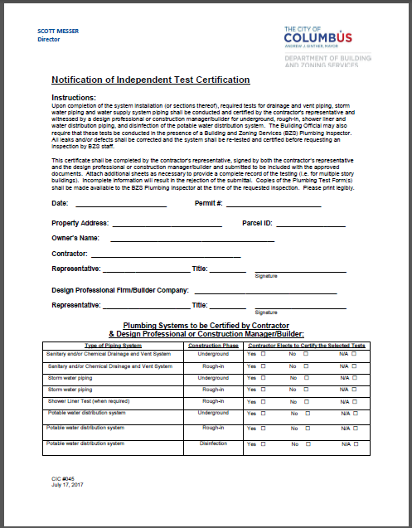

Slide 14
Please note, on the first page of CIC # 45, we specifically state that the self-certification in no way replaces a required inspection. The process only applies to the testing of the installation.

Slide 15
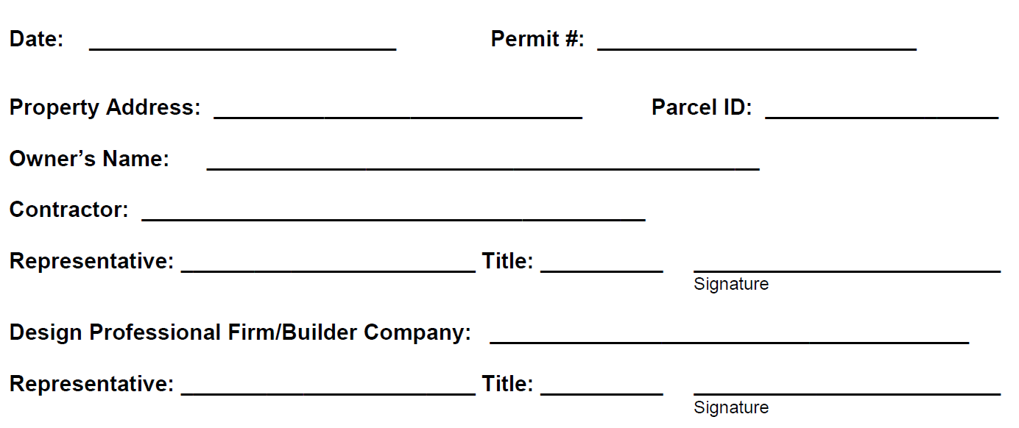
All information will need to be completed on the form for the form to be valid.
09/18/2017
PMEPCXXXXXXX
757 Carolyn Ave
01013774
City of Columbus
ABC Plumbing Contracting
Guy Miller Jr.
Foreman
Guy Miller Jr.
JR Designs
James A. Richardson Jr.
Owner
James A. Richardson Jr.

Slide 16
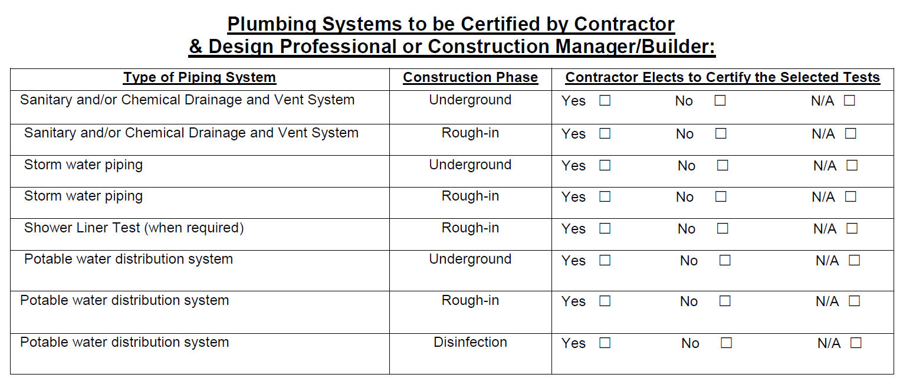
You will need to indicate which test or tests you wish to self-certify. Again, there must be an answer for each question.
In order for the form to be accepted, each section will need to be marked appropriately.
x
x
x
x
x
x
x
x

Slide 17
This form lets us know of your intention to self-certify the specific tests you have indicated. A copy will be scanned into the digital record and a copy shall be kept with the approved documents.

Slide 18
If you have chosen to self-certify tests, you will need to have the completed test form onsite for the inspector to review and document as part of the scheduled inspection.

Slide 19
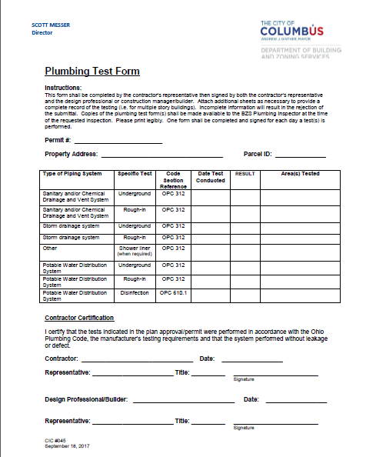

Slide 20
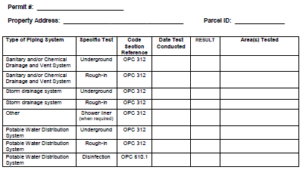
The specific information regarding testing for the scheduled inspection will need to be completed appropriately.
PMEPC1711111
757 Carolyn Ave.
01000000
07/20/2017
PASS
Area A – column A1- D1
07/20/2017
PASS
Area A – column A1- D1

Slide 21
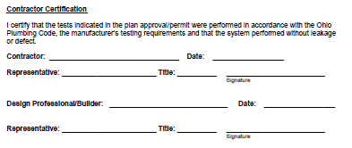
The contractor’s representative and the Design Professional or Builder’s representative (or construction management firm representative) are required to provide their information and sign the form.
ABC Plumbing Contracting
07/20/2017
Guy Miller Jr.
Foreman
Guy Miller Jr.
JR Designs
07/20/2017
James A. Richardson Jr.
Owner
James A. Richardson Jr.

Slide 22
If you have any additional questions please send them to:
plumbinginfo@columbus.gov
We will attempt to answer any questions within 24 hours either by email reply or direct phone contact.
Click to end slideshow

